Slide 1
THE CRITICALITY
OF
RESURECTING TDI & TNDM
Why I believe TDI must become
a permanent D.O.D. ally and global military watchdog,
and how I think it could happen.
A non-Trevor Dupuy Institute Perspective
With Trevor Dupuy Institute and Other Professional Inputs
Joe R. Follansbee
9/29/2022

Slide 2
This briefing is developed to be a stand-alone briefing to be individually read, or to be presented.
It is intended to be a catalyst for action, not a model of optimal power-point presentation methods.

Slide 3
A friend brings solutions.

Slide 4
Distinguished Contributors to this Vision
Christopher A. Lawrence President , Trevor Dupuy Institute (TDI)
Professor Arnold Dupuy, (MSG, ARNG Retired) Principal Owner, TNDM. Former TDI Researcher
Ernie Blair (USAF Retired) Operational Research/Deterministic Modeling SME
Leading the Expansion of TNDM into Naval/Air
4. Professor Don Thieme (USNWC)(LTC, USMC Retired) USNWC Strategy and Wargaming Professor
William “Chip” Sayers (USMC/DIA, Retired) Author, The Combat Assessment Technique, 1999, USMC C&GSC. USAF/DIA Analyst.
Bryan Clements (COL, ARNG Retired) USAF Pentagon Senior Civilian, Army War College Alumni
Professional Disclaimer: Contribution does not equal 100% concurrence or endorsement. All contributors served as priceless mentors to “me”, all mistakes and errors in this briefing are mine and mine alone. This briefing does not represent any of these professionals directly in any manner, and captures my interpretations of their mentorship and inputs only.

Slide 5
MAJOR Input Credits to this Vision
Christopher A. Lawrence Major/Overall/Foundational (Everything)
Professor Arnold Dupuy Major/Overall/Foundational (History, CIA, More)
Ernie Blair Major/Overall World Almanac Revitalization with QJM, You Tube/PATREON
The Value of “Truth and Beauty” over Politics
Professor Don Thieme Department of State 1038 Funding, The “Faults” of AI Software
William “Chip” Sayers TNDM/QJM & TLI – Vetted and Priceless
5. Bryan Clements Concurrence: TDI is a National Asset

Slide 6
DISCLAIMER
This briefing is a voluntary effort with the goal of increasing friends and fans of the Trevor Dupuy Institute (TDI) quickly leading to a major resurrection of this national asset.
This is not intended to be an advanced briefing for instructors of deterministic modeling as a component of operational research. It is intended to rapidly elevate professionals new or non-fluent to deterministic modeling on the value of what TDI has done, and can do in the future.
It does not represent any adopted position or intent of the TDI nor is intended to present itself as doing so.
This briefing is intended to provide an “out of box” perspective on TDI to it’s current principal safekeeper, Christopher Lawrence. Also safekeeping TDI are Arnold Dupuy and Ernie Blair, both SME’s in QJM/TNDM and both very experienced with the founder Colonel Trevor Dupuy.
TDI is a NATIONAL ASSET, and it needs to be PERMANENTLY IN EXISTENCE, in my strongest opinion. I’m just not Bill Gates or it would already have happened.
This document is not formally sanctioned nor approved by the Trevor Dupuy Institute in any way. It has been fully shared with them, in both draft and final version, but it is completely independent of them in all ways DELIBERATELY. It is however developed to assist Christopher A. Lawrence in visioning a possible resurrection of the Trevor Dupuy Institute.
Any errors or omissions in this briefing are completely mine.

Slide 7
My reason for becoming an advocate for TDI include:
I co-own a weapons company called Combat Weapons Development, have co-patented as the primary inventor the
most brutal conventional weapon ever to be issued to an American warrior in the history of human warfare.
2. In doing National Science Foundation I-CORPS methodology research to justify this weapon, I found the Theoretical Weapons Lethality Indices (TLI) subcomponent of TNDM (formerly QJM) to be a PRICELESS TOOL with which to calculate the lethality of my system in comparison to other contemporary weapons, without which my understanding of my own invention would be incomplete.
3. The fact that this tool is UNCLASSIFIED, BATTLE TESTED, and EXTERNALLY VETTED by the Naval Postgraduate School and USMC Command and General Staff College (among others), make it a PRICELESS ASSET to my company and company mission.
4. The QJM/TNDM SYSTEM under which TLI exists, is also a PRICELESS ASSET but is currently outside the scope of my company mission. We are not doing deterministic battle evaluations. However, in my extensive efforts to fully understand the TLI system, I became fully exposed to the AMAZING and PRICELESS QJM/TNDM system.
5. I strongly believe that the QJM/TNDM system is a PRICELESS UNCLASSIFIED NATIONAL ASSET that must be resurrected/modernized fully for the next 100 years or more.
6. The current masters and keepers of TDI, Christopher Lawrence and Professor Arnold Dupuy, are truly superb professionals who have retained the methodology and are able to pass it on to their successors. Their key supporters include Ernie Blair, a retired USAF civilian with an amazing research and operational research inclusive career within the Air Force, who had direct relations and experiences with Trevor Dupuy professionally. If there is any good in this briefing, these 3 are primary key to that good.

Slide 8
NOW LET ME SHOW YOU WHY I FEEL THIS WAY,
AND WHAT I BELIEVE SOLUTIONS MIGHT BE

Slide 9
BLUF

Slide 10
BOTTOM LINE UP FRONT (BLUF)
Relevance in the complex field of military history and military analysis must be earned, it cannot be bequeathed.
There are many thousands of institutions and individuals doing historical research.
There are very few institutions or individual’s doings historical research blended with deterministic modeling.
AI is nowhere near proximate enough to human analysis to replace TNDM at this point. There needs to be a “HIL”
(Human in the Loop) for deterministic modeling to work.
There is relevance in each approach. The latter is more complex AND OF GREATER NATIONAL VALUE. Anyone can
postulate opinions, millions of individuals and thousands of organizations can and will DAILY. But – only a very
very few, can deliver opinions BACKED by a second to none deterministic modeling method. THIS – is a future CRITICAL
REALITY that will make the resurrected TDI – VITAL in the future.
6. There is also greater relevance in historical research blended with deterministic modeling as it forces military science to be
an applied science component of the research, increasing the value and resultant lessons learned impact. It transcends the
information conveyed from fact/opinion to fact/military science. This is value and relevance of national security impact.
7. Deterministic modeling as an applied science has been mastered by few organizations and individuals. The Dupuy
Institution history is SECOND TO NONE.
8. Critically, deterministic modeling can also be used to PREDICT future combat results, a critical function in a free democracy
9. This independent predictive capability blended with a proven methodology and open-source (and therefore accountable)
nature is essential in a democracy to provide an independent source for evaluating a national declaration of war.
10. It is these realities that makes the preservation of and continuation of The Dupuy Institute a national priority.

Slide 11
THE WHY

Slide 12
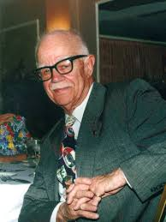
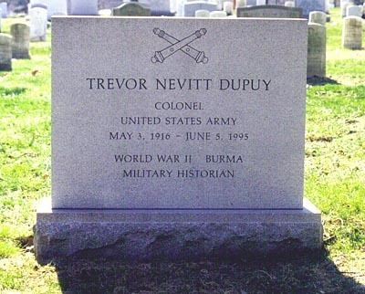
COLONEL TREVOR DUPUY
Colonel Trevor Dupuy, a graduate of West Point, served a remarkable military career as a Field Artillery Officer, including
serving as a staff officer on General Eisenhower's staff following World War Two. He was a second-generation
Army Officer. He was a highly productive author and founded the Trevor Dupuy Institute after his retirement. He was
a “second generation” West Pointer, Army Officer, Historian and Author.

Slide 13
Colonel Dupuy served on Eisenhower’s staff in WW2. Being at the highest levels of the Army, is a testimony to the intellectual and professional skills that he had, as only very the best and brightest made it to that level. Further, it positioned him for the rest of his career to be able to view the Army from a “zenith” perspective, and to both see and understand the politics that exists in the Army as within any large human organization.
As a personality, he was determined, fierce in the pursuit of what he believed to be right, and fearless when facing institutional politics in opposition of what he believed was right. In the words of Ernie Blair, a former colleague and associate of Colonel Dupuy, he fought for “Truth and Beauty” over what was politically correct. To his opponents, he likely was a force to be reckoned with.
A key example of this was his military science findings that the German Infantry were more effective than the British and American Infantry during major portions of WW2. Many key Generals in power in the US Army took offense to these data backed findings that were published by Colonel Dupuy after his retirement. This was a conflict between truth and sentiment.
In addition, Colonel Dupuy wrote a book titled “The Genius of the German General Staff”. This book also contributed to some political backlash, as it captures the “genius” that was truly there, and that was beautiful and literally transformed warfare.
I am convinced the passion with which Colonel Dupuy fought to expose “Truth and Beauty” despite institutional politics resulted in national treasures. Those treasures being – the truth. Examples - The German combat units were superior during the periods when Colonel Dupuy’s data analyzed the conflict. They outperformed the hastily trained British and
United States ground combat forces on the ground at the outset at the combat unit level.
History has shown that a major factor in the US and British victory was our MASSIVE logistical superiority over the Germans. Logistics – wins wars. But – the TRUTH is BEAUTIFUL. And Colonel Dupuy, despite the political cost, fought for the truth to be studied, understood, and chronicled accurately, despite the politics of DOD that at times opposed him. And this opposition was more by key individuals in key positions, than the institutional whole. It was the politics of rank arrogance and national arrogance in contestation with a junior and science. There are Generals in this world who equate rank with intelligence and superiority. I’ve seen them. And this kind of thinking can lead a smart General – to marginalize a smarter retired Colonel and be threatened by same.. Fact not opinion.
Those who fail to study and understand history accurately, are doomed to repeat bad history. Colonel Dupuy’s legacy must continue.

Slide 14
COLONEL TREVOR DEPUY ORGANIZATIONS AND CAPABILITY SUMMARY
- Founded Historical Evaluation and Research Organization (HERO) (1960 Era)
- HERO transitioned into The Dupuy Institute (TDI) (1970 Era)
TDI has:
Compiled an extremely large database from modern military campaigns and battles. One of the largest such databases in the world.
Developed a superior deterministic battle modeling system, called the Quantified Judgement Model (QJM). This then evolved into the Tactical Numerical Deterministic Model (TNDM). It is a ground combat modeling system currently.
TNDM enables a comparison of the equipment and personnel fighting capabilities of opposing forces based on an extensive
and proprietary set of layered data in numerous carefully selected relevant combat power affective areas, and includes a subset
weapons Theoretical Lethality Index (TLI).
TNDM allows rapid comprehensive battle assessments, and battle predictions, using an open source/unclassified method.
Independent external sources including multiple thesis from the Naval Postgraduate School superbly validate the value of TNDM
Prior to the Gulf War, TDI using TNDM presented to Congress the most accurate battle forecast of many organizations
This system has been battle-tested and refined against battles in WW2, Korea War, Vietnam, Israeli, and the Falklands War.
TDI has further published many books that are priceless assets in any military library.

Slide 15
Potential Mission Statement of Resurrected TDI
The Dupuy Institute is dedicated to scholarly research and objective analysis of historical data related to armed conflict and the predictive analysis of potential combat using the science based the proven open-source methodology “Trevor N. Dupuy Method” (TNDM).

Slide 16
FROM THE TDI WEBSITE TODAY
The Dupuy Institute is an organization dedicated to scholarly research and objective analysis of historical data related to armed conflict and the resolution of armed conflict. The Dupuy Institute provides independent, historically-based analyses of lessons learned from modern military campaigns. In tribute to what Colonel Trevor N. Dupuy pioneered, and to pursue his goals, The Dupuy Institute continues to amass historical data and strives to refine their understanding of the complexities of modern warfare. The Dupuy Institute is committed to the original goals of the founders of operational research - the accumulation of recorded, detailed data from actual battlefield experience - and the utilization of actual battlefield experience to understand all dimensions of combat, including technological and human factors. The Dupuy Institute conducts its military history research, analysis and reporting under contract with government and private agencies, through book contracts with publishers, under the terms of grants from foundations and corporations, and through projects developed under its own initiative.

Slide 17
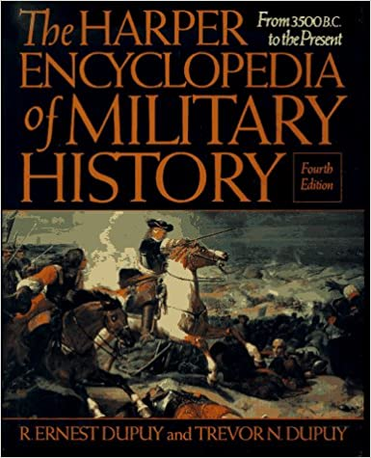
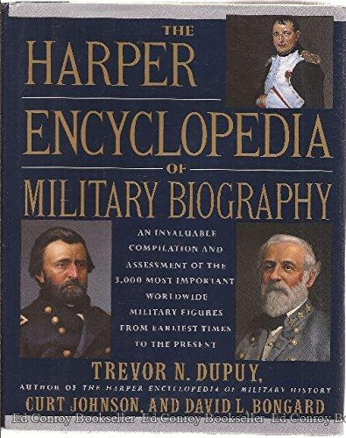
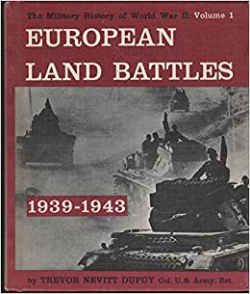
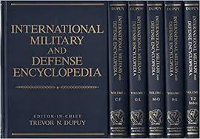
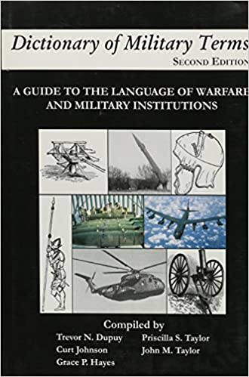
COLONEL DUPUY’S ENCYCLOPEDIA’S AND DICTIONARY’S INCLUDED:
The Encyclopedia of WW2
(18 Volumes)
CLEARLY having authored these speaks to a definably unique
historical level of understanding of military operations.
All of these (and more) should be FULLY RESURRECTED as
a part of the future of TDI.

Slide 18
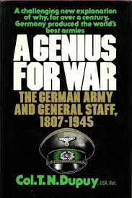
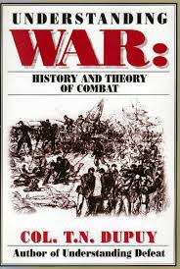
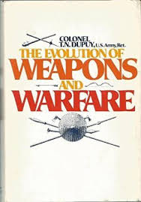
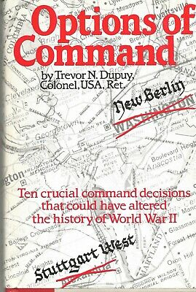
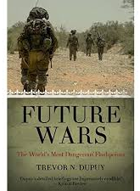
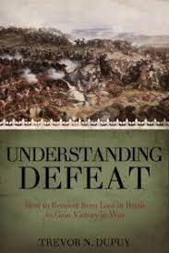
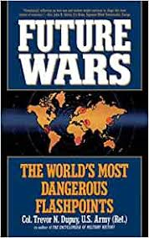
COLONEL DUPUY’S
PUBLISHED WORKS
INCLUDED THE FOLLOWING ELITE
AND TIMELESS BOOKS:

Slide 19
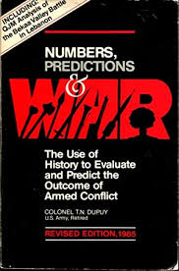
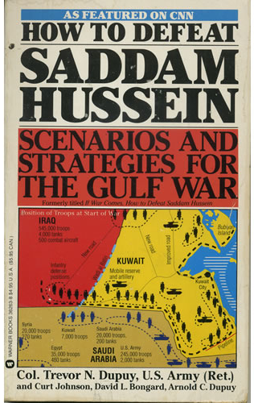
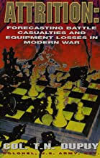
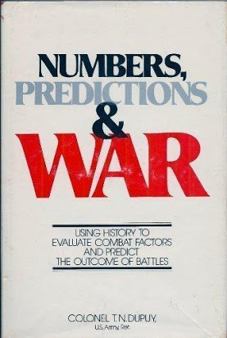
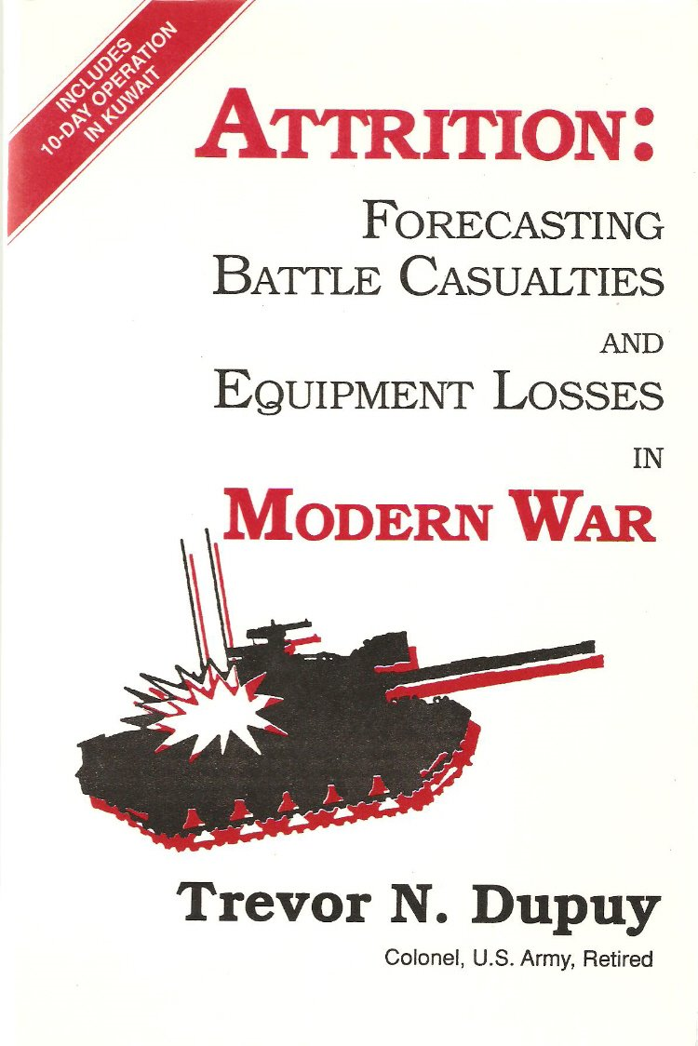
COLONEL DUPUY’S PUBLICATIONS ON THE QUANTIFIED JUDGEMENT MODEL AND
TNDM INCLUDED:
1985
1979
1985
1990
1991
1996

Slide 20
COLONEL DUPUY’S PUBLISHED BOOK LISTING
• TO THE COLORS; THE WAY OF LIFE OF AN ARMY OFFICER (with R.E. Dupuy), Chicago, 1942
• FAITHFUL AND TRUE; HISTORY OF THE 5TH FIELD ARTILLERY, Schwabisch-Hall, Germany, 1949
• CAMPAIGNS OF THE FRENCH REVOLUTION AND OF NAPOLEON, Cambridge, MA, 1956
• BRAVE MEN AND GREAT CAPTAINS (with R. E. Dupuy), New York, 1960, 1984, 1993
• COMPACT HISTORY OF THE CIVIL WAR (with R.E. Dupuy), New York, 1960, 1991
• CIVIL WAR LAND BATTLES, New York, 1960
• CIVIL WAR NAVAL ACTIONS, New York, 1961
• MILITARY HISTORY OF WORLD WAR II, 18 Vols., New York, 1962-65
Vol 1—European Land Battles: 1939–1943
Vol 2—European Land Battles: 1944–1945
Vol 3—Land Battles: North Africa, Sicily, and Italy
Vol 4—The Naval War in the West: The Raiders
Vol 5—The Naval War in the West: The Wolf Packs
Vol 6—The Air War in the West: Sep 1939–May 1941
Vol 7—The Air War in the West: Jun 1941–April 1945
Vol 8—Asiatic Land Battles: Expansion of Japan in Asia
Vol 9—Asiatic Land Battles: Japanese Ambitions in the Pacific
Vol 10—Asiatic Land Battles: Allied Victories in China and Burma
Vol 11—The Naval War in the Pacific: Rising Sun of Nippon
Vol 12—The Naval War in the Pacific: On to Tokyo
Vol 13—The Air War in the Pacific: Air Power Leads the Way
Vol 14—The Air War in the Pacific: Victory in the Air
Vol 15—European Resistance Movements
Vol 16—Asian and Axis Resistance Movements
Vol 17—Leaders of World War II
Vol 18—Chronological Survey of World War II
• COMPACT HISTORY OF THE REVOLUTIONARY WAR (with R. E. Dupuy), New York, 1963
• MILITARY HISTORY OF WORLD WAR I, 12 Vols., New York, 1967
Vol 1—1914: The Battles in the West
Vol 2—1914: The Battles in the East
Vol 3—Stalemate in the Trenches, Nov 1914– Mar 1918
Vol 4—Triumphs and Tragedies in the East,
1915–1917
Vol 5—The Campaigns on the Turkish Front
Vol 6—Campaigns in Southern Europe
Vol 7—1918: The German Offensives
Vol 8—1918: Decision in the West
Vol 9—Naval and Overseas War, 1914–1915
Vol 10—Naval and Overseas War, 1916–1918
Vol 11—The War in the Air
Vol 12—Summary of World War I • HOLIDAYS, editor, contbr., New York, 1965
• MILITARY HERITAGE OF AMERICA (with R. E. Dupuy, Paul Braim), 2 Vols., New York, 1966, 1986, 1992
• THE BATTLE OF AUSTERLITZ, New York, 1968
• MODERN LIBRARIES FOR MODERN COLLEGES: RESEARCH STRATEGIES FOR DESIGN AND DEVELOPMENT, Washington, D.C., 1968
• FERMENT IN COLLEGE LIBRARIES: THE IMPACT OF INFORMATION TECHNOLOGY, Washington, D.C., 1968
• MEDIAPOWER: A COLLEGE PLANS FOR AN INTEGRATED MEDIA SERVICE SYSTEM, Washington, D.C., 1968 • MILITARY HISTORY OF THE CHINESE CIVIL WAR, New York, 1969
• THE MILITARY LIFE OF ALEXANDER THE GREAT, New York, 1969 • THE MILITARY LIFE OF HANNIBAL, New York, 1969
• THE MILITARY LIFE OF JULIUS CAESAR, New York, 1969
• THE MILITARY LIFE OF GENGHIS KHAN, New York, 1969
• THE MILITARY LIFE OF GUSTAVUS ADOLPHUS, New York, 1969
• THE MILITARY LIFE OF FREDERICK THE GREAT, New York, 1969
• THE MILITARY LIFE OF GEORGE WASHINGTON, New York, 1969
SOURCE: TDI WEBSITE (51 Books)

Slide 21
COLONEL DUPUY’S PUBLISHED BOOK LISTING
• THE MILITARY LIFE OF NAPOLEON, New York, 1969
• THE MILITARY LIFE OF ABRAHAM LINCOLN, New York, 1969
• THE MILITARY LIFE OF HINDENBURG AND LUDENDORFF, New York, 1970
• THE MILITARY LIFE OF ADOLPH HITLER, New York, 1969
• THE MILITARY LIFE OF WINSTON CHURCHILL, New York, 1970
• REVOLUTIONARY WAR NAVAL BATTLES (with Grace P. Hayes), New York, 1970
• REVOLUTIONARY WAR LAND BATTLES (with Gay M. Hammerman), New York, 1970
• MONGOLIA, FOREIGN AREA STUDIES HANDBOOK, Washington, D.C., 1970
• ALMANAC OF WORLD MILITARY POWER 1970 (with John A. Andrews, Grace P. Hayes), New York, 1970
• ALMANAC OF WORLD MILITARY POWER 1972 (with John A. Andrews, Grace P. Hayes), New York, 1972
• DOCUMENTARY HISTORY OF ARMS CONTROL AND DISARMAMENT (with Gay M. Hammerman), New York, 1974
• WORLD MILITARY LEADERS (with Grace P. Hayes, Paul Martell), 1974
• ALMANAC OF WORLD MILITARY POWER 1974 (with John A. Andrews, Grace P. Hayes), New York, 1974
• PEOPLE AND EVENTS OF THE AMERICAN REVOLUTION (with Gay M. Hammerman), New York, 1974
• AN OUTLINE HISTORY OF THE AMERICAN REVOLUTION (with R.E. Dupuy), New York, 1975
• ENCYCLOPEDIA OF MILITARY HISTORY (with R.E. Dupuy), New York, 1975, 1986, 1993
• A GENIUS FOR WAR: THE GERMAN ARMY AND GENERAL STAFF, 1807-1945, New Jersey, 1977, 1984, 1989, 1993
• NUMBERS, PREDICTION AND WAR, New York, 1978,
• ELUSIVE VICTORY: THE ARAB-ISRAELI WARS, 1947-1974, New York, 1978, 1984, 1989, 1992
• ALMANAC OF WORLD MILITARY POWER 1980 (with John A. Andrews, Grace P. Hayes), New York, 1980
• THE EVOLUTION OF WEAPONS AND WARFARE, New York, 1980, 1984, 1986
• GREAT BATTLES OF THE EASTERN FRONT (with Paul Martell), New York, 1982 • OPTIONS OF COMMAND, New York, 1984
• FLAWED VICTORY: THE ARAB-ISRAELI CONFLICT AND THE 1982 WAR IN LEBANON (with Paul Martell), Virginia, 1986
• UNDERSTANDING WAR: MILITARY HISTORY AND THE THEORY OF COMBAT, New York, 1986
• DICTIONARY OF MILITARY TERMS (with Curt Johnson, Grace P. Hayes), New York, 1987
• UNDERSTANDING DEFEAT, New York, 1990
• ATTRITION: FORECASTING BATTLE CASUALTIES AND EQUIPMENT LOSSES IN MODERN WAR, Virginia, 1990
• IF WAR COMES: HOW TO DEFEAT SADDAM HUSSEIN, Virginia, 1991
• FUTURE WARS: THE WORLD’S MOST DANGEROUS FLASHPOINTS, New York, 1992
• ENCYCLOPEDIA OF MILITARY BIOGRAPHY (with Curt Johnson, David L. Bongard), New York, 1992
• INTERNATIONAL MILITARY AND DEFENSE ENCYCLOPEDIA, (Brassey’s) 6 Vols., Editor in Chief, New York, 1992
• HITLER’S LAST GAMBLE (with David L. Bongard, Richard C. Anderson), New York, 1994
SOURCE: TDI WEBSITE (32 Books)

Slide 22
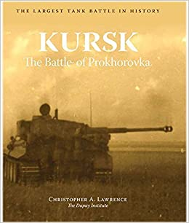
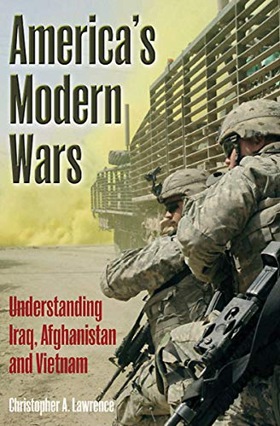
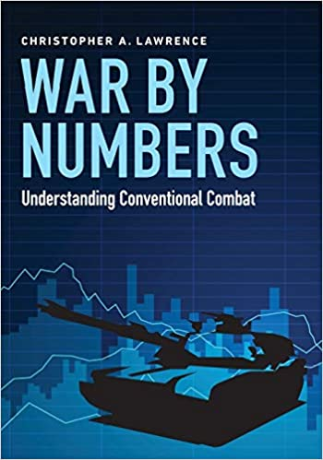
STELLAR BOOKS USING QJM/TNDM ANALYSIS BY CHRISTOPHER A. LAWRENCE INCLUDE:
2015: 1,700 Pages/10 Pounds
the -
single most comprehensive
battle analysis
ever published ANYWHERE.
A NATIONAL TREASURE.
2015: A powerful
deterministic modeling
assessment helping
understand recent conflicts
from the President of
TDI.
2017: The latest book on
deterministic modeling
from the President of
TDI.

Slide 23
STELLAR BOOKS USING QJM/TNDM ANALYSIS BY CHRISTOPHER A. LAWRENCE INCLUDE:
RELEASE DATE: OCTOBER 30, 2022
The essential companion book to
KURSK, The Battle of Prokhorovka.

Slide 24
“War by Numbers takes the study of military history out of the realm of storytelling and simplistic interpretation
into a realm of systematic and impartial analysis of available recorded data. This is an essential book for the
theorist, the analyst, the war planner, and the war fighter”.
--Maj. General NICHOLAS KRAWCIW, U.S. Army (Ret.)
(THIS ENDORSEMENT IS WORTH READING SEVERAL TIMES.
iT SELLS QJM/TNDM IN TWO SENTENCES BETTER THAN
ANYTHING I’VE EVER SEEN. JRF)

Slide 25
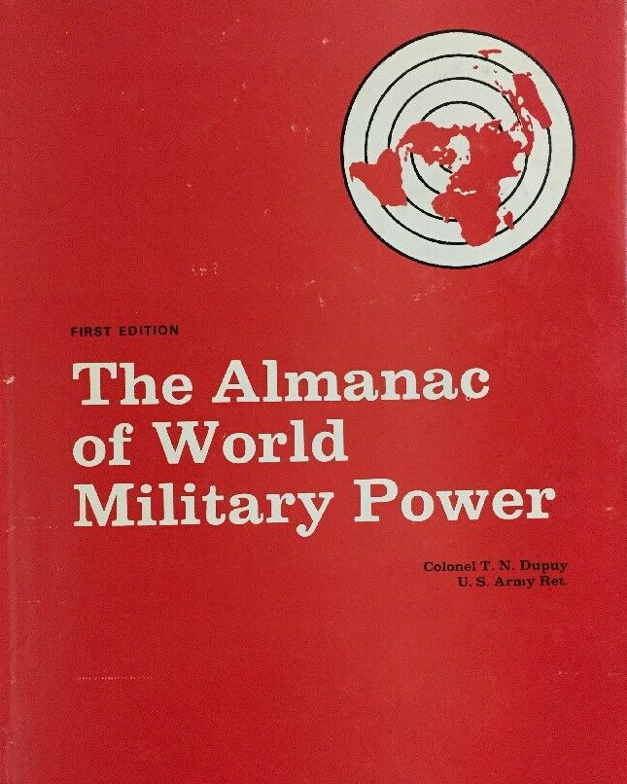
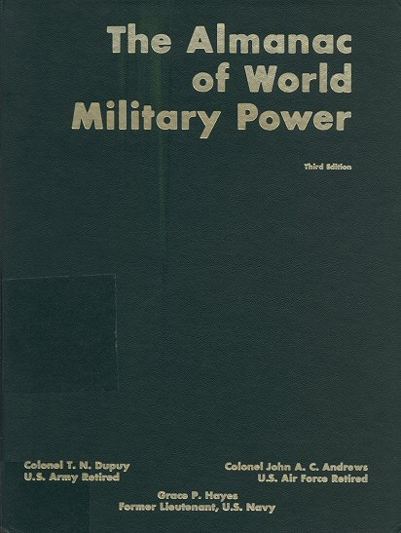
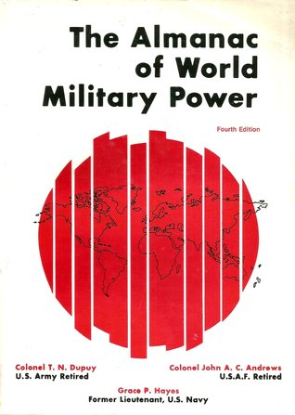
THE WORLD MILITARY ALMANAC
1970
1972
1974
1980
At the time these books were published, pound for pound they OUTPERFORMED – “The Military Balance” from the
International Institute for Strategic Studies (IISS) in England.
These books provided detailed orders of battle for world militaries as well as national and regional analysis. They included a
glossary providing definitions and weapons summaries. These were an EXCEPTIONAL WORLD CLASS PRODUCT in their day,
and the IISS must have paid attention as from 1981 onward the evolution of the IISS Military Balance increasingly looked like
The Trevor Dupuy principally authored Almanac’s of World Military Power.

Slide 26
THE WORLD MILITARY ALMANAC - CONTENTS
Regional Surveys Of:
Military Geography
Strategic Significance
Regional Alliances
Recent intra and extra-regional conflicts
National Statistics on:
Area
Population
Total Active Regular Armed Forces
Gross military expenditures
Fuel Production
Power Output
Merchant Fleet
Civil Air Fleet
Defense Structure
Politico-Military Policy
Strategic Problems
Military Assistance
Alliances
Army, Navy and Air Force: personnel,
organization, major equipment inventory,
reserves, and major bases.
Paramilitary
EACH – A National Resource
DENSE with Value
RELEVANT ON ARRIVAL
BETTER THAN IISS

Slide 27
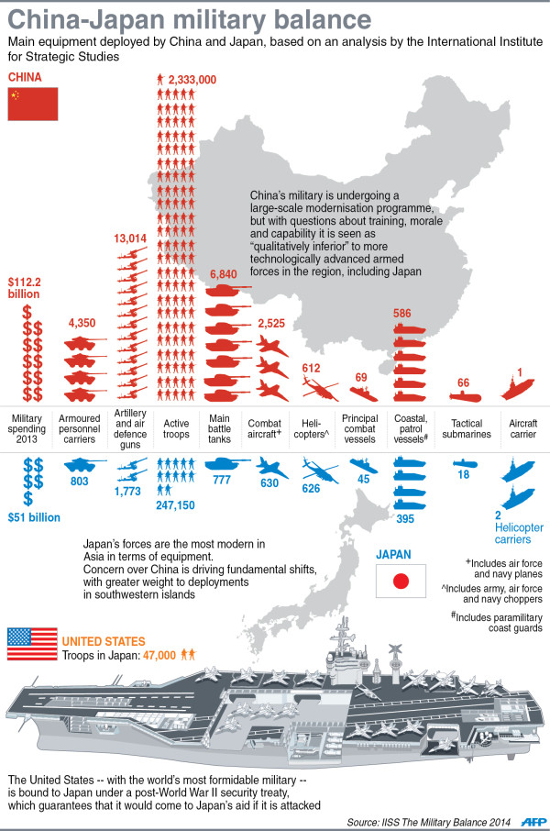
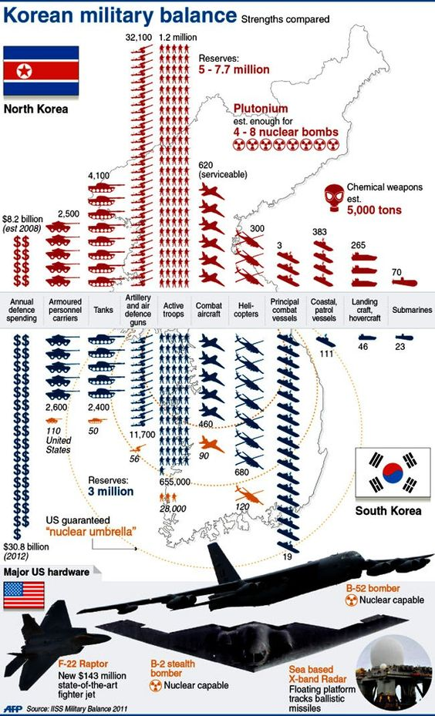
EXAMPLE OF IISS FLAWS
The IISS Military Balance allows enumerative comparisons like this.
BUT – they are completely devoid of weapon system Theoretical Lethality Index elements (first flaw) and secondarily omits 70+ deterministic factors of TNDM (second flaw).
AKA: Weapons counts are EASY and obviate over 9 TLI and 70+ TNDM factors.

Slide 28
About Christopher A. Lawrence
Christopher A. Lawrence is a professional historian and military analyst. He is the Executive Director and President of The Dupuy Institute, an organization dedicated to scholarly research and objective analysis of historical data related to armed conflict and the resolution of armed conflict. The Dupuy Institute provides independent, historically-based analyses of lessons learned from modern military experience. Mr. Lawrence was the program manager for the Ardennes Campaign Simulation Data Base, the Kursk Data Base, the Modern Insurgency Spread Sheets and for a number of other smaller combat data bases. He has participated in casualty estimation studies (including estimates for Bosnia and Iraq) and studies of air campaign modeling, enemy prisoner of war capture rates, medium weight armor, urban warfare, situational awareness, counterinsurgency and other subjects for the U.S. Army, the Defense Department, the Joint Staff and the U.S. Air Force. He has also directed a number of studies related to the military impact of banning antipersonnel mines for the Joint Staff, Los Alamos National Laboratories and the Vietnam Veterans of American Foundation. His published works include papers and monographs for the Congressional Office of Technology Assessment and the Vietnam Veterans of American Foundation, in addition to over 40 articles written for limited-distribution newsletters and over 60 analytical reports prepared for the Defense Department. He is the author of Kursk: The Battle of Prokhorovka (Aberdeen Books, Sheridan, CO., 2015), America’s Modern Wars: Understanding Iraq, Afghanistan and Vietnam (Casemate Publishers, Philadelphia & Oxford, 2015), War by Numbers: Understanding Conventional Combat (Potomac Books, Lincoln, NE., 2017): The Battle of Prokhorovka (Stackpole Books, Guilford, CT., 2019), Aces at KURSK (The Dupuy Institute, Arlington, VA., 2022) Mr. Lawrence lives in northern Virginia, near Washington, D.C., with his wife and son.

Slide 29
ABOUT PROFESSOR ARNOLD DUPUY
Arnold Dupuy is a defense contractor. In this capacity, Dr. Dupuy provides qualitative and quantitative analyses of operational energy risks to mission assurance. A particular area of interest is the cyber-energy nexus and geo-political and military operational challenges of energy security within the Trans-Atlantic Alliance, particularly on NATO’s ‘Eastern Flank’.
Retired from the United States Army after 25 years of both active and reserve component service, Dr. Dupuy’s last major assignment was in Afghanistan, where he earned the Bronze Star and the Global War on Terrorism Expeditionary Medals.
In 2016, Dr. Dupuy completed a Ph.D. in Planning, Governance and Globalization at the Virginia Polytechnic Institute and State University (Virginia Tech). His dissertation title is: “Changing Patterns of Regionalism and Security in the Wider Black Sea Area: The Transformative Impact of Energy.” He is an adjunct professor of political science at Virginia Tech and George Mason University, teaching graduate-level international politics and energy geo-politics.
Dr. Dupuy serves as Adjunct Faculty for two national Universities.

Slide 30
What this TDI legacy means to me (and I believe to all Americans)?:
Colonel Trevor Dupuy authored the Dictionary of Military Terms, multiple military historical encyclopedias, and over
80 books total of substance. His “World Military Almanac’s” were priceless assessments of global military power.
In the pantheon of the warriors who have earned the moniker “Certified Military Genius”, he is second to none. And in a
hard assessment is likely #1. He understood warfare better than most who published at elite levels during his era.
And his QJM/TNDM system, was based on his understanding of warfare at genius levels. And it is – and remains today –
PURE GENIUS. And it was 100% client supported historically by both DOD and the CIA, among other government agencies
And over 12 nation-states other than the United States. An amazing legacy.
Christopher A. Lawrence, the current President of TDI, has published world class works that have helped elevate QJM/TNDM
in 2015 and 2017. He remains a world class Subject Matter Expert on the implementation of QJM/TNDM. He has
multiple acolytes and colleagues.
Dr. Arnold Dupuy has experienced TDI as a researcher and remains a principal curator of his father’s systems. He has extensive
professional, academic, and military accomplishments that are global in impact. He cares deeply for his father’s legacy, and
wishes to see the continuation of his father's work into future generations.
The Dupuy Institute through historic and recent book publications, and its many accumulated analysis works, and its
two distinguished and accomplished curators, is a MAJOR NATIONAL RESOURCE that must be preserved and extended.

Slide 31
REASONS I BELIEVE TNDM IS ESSENTIAL FOR RESURRECTION AND PERMANENCE
It is Battle Proven (90-95% Efficacy Per External Reviews)
a. The Best Gulf War estimate of MANY presented to US Congress, and the LEAST expensive of them all to the taxpayer*
It’s UNCLASSIFIED
a. Open to input and oversight
b. More accessible to users globally by factors of MILLIONS over CLASSIFIED systems
c. Lack of classified status is NOT resulting in reduced value or efficacy,
d. Classified systems are actually defendably LESS effective, BUT are “private” AND “CLASSIFIED”, and aren’t subject to public critique or inputs
It comprehensively quantifies WEAPONS (9+ Scoring Factors) and BATTLE FACTORS (74+ Scoring Factors)
It is INSTRUCTIVE, it can help senior military leaders in both training and operations to “see more/understand more”
It is AFFORDABLE (The original cost was $18,000, and this was sold to over 12 US Allies, in the 70’s and 80’s)
It has a SOLID HISTORIC INTERNATIONAL CLIENT RECORD OF OVER 12 NATION-STATES (Proven INTERNATIONAL Value)
It allows CONGRESS/other Governmental Agencies (Department of State primarily)/Allied nations/Business - an INDEPENDENT ASSESSMENT,
A. Either unclassified or classified
9. It is a tool for:
A. Historians/Academia
B. Military War Colleges
C. Congress
D. Department of State (Either internally or contracted)
E. DOD and Military Leaders within
F. Allies
G. Defense Contractors
H. Intelligence Agencies
I. Independent “Think-Tanks”
J. Military Analytic Organizations, such as the International Institute for Strategic Studies
K. Business (Both Military-Industrial and Commercial)
It is FAST, especially when contrasted with Classified Systems, because it can RAPIDLY be shared EXTENSIVELY, be externally VETTED, AND IS ACCURATE.
It meets YGBSM Status (See next slide)

Slide 32
REASONS I BELIEVE “THE WORLD MILITARY ALMANAC” MUST BE FOR RESURRECTED AND PERPETUATED
IISS has priced it’s annual “The Military Balance” at $475 (!). There is an opportunity here to produce greater quality at substantially lower cost.
The HIGH PRICE of the IISS document REDUCES the number of American military leaders and intelligentsia who actually read it – which is to national detriment of our military leaders overall. TDI should create a book that becomes both POPULAR and CRANIAL ELEVATING – thus reestablishing a past national treasure.
The Military Balance by IISS has ZERO deterministic modeling. It is basically a “count” of military weapons and units WITHOUT relevant analysis. It has VALUE in the itemization of “units and weapons”, but FAILS in the aggregate assessment of ACTUAL POWER. This failure is TO THE NATIONAL DETRIMENT of all Democracies.
A resurrected “World Military Almanac” becomes an annual MAJOR publication with MAJOR immediate relevance.
This can be sold in 4 Variants by TDI:
A. Hardback ($150?)
B. Soft Cover ($100?)
C. CD ($55?)
D. Online (Through TDI Membership) ($55?)
Can critically provide an annual NUMERIC estimate of Russian, Chinese, United States conventional and nuclear power using TNDM as an annual element
Can additionally provide select regional estimates of power for select “competitors” (North Korea/South Korea, Taiwan-China, NATO vs. Russia, etc.)
Can additionally provide “Historical Assessments” and “Historical Information” in appendices to illustrate HISTORIC combat exchanges that help “predict the future” based on TNDM data.
Can perpetuate the “Glossary” of Editions 1-4 by providing summaries of weapon systems that are listed in the document
Can provide “force v. force” illustrations with BOTH numeric and combat power representations
Can educate the military elite on TNDM annually and TDI annually (Guerilla Marketing)
Elevates TDI by blending BOTH priceless historical research AND contemporary CURRENT RELEVANCE, and able to “intertwine” into the Almanac
Allows “Other Authors” to be featured with relevant contributions
Allows potential partnership with other agencies to produce, elevating the “network” of TDI (TDI retains primary author status).
A. Naval War College (A Top 10 College in US)
B. Army/Air War College
C. Naval Postgraduate School
D. Special Operations University
E. US Ally War Colleges
F. Global Think-Tanks

Slide 33
The YGBSM status. “QJM/TNDM and TLI”.
I will leave it to the reader to elect to follow up on the meaning of
the 5 letters at the bottom of this patch which remains active in the
USAF today, dating back to Vietnam. This patch is for a “WILD WEASEL”
Squadron, tasked with attacking enemy air defense systems.
One can – if one chooses – decide to calibrate things based on the
YGBSM standard. QJM/TNDM has helped me to prove that my
weapon system meets YGBSM standards. Which is why “I am here”
right this moment “in this briefing” . I’ve seen the massive ACTUAL
value of QJM/TNDM firsthand and taken the time to understand it,
with the help of Colonel Dupuy, Christopher A. Lawrence, Professor
Arnold Dupuy, Ernie Blair, and Chip Sayers.
The relatively small Dupuy Institute - stood in front of Congress and testified as to their casualty prediction of the Gulf War. They also wrote a book how to defeat the Iraqi Army which – was SPOT ON.
Their prediction was BY FAR the most accurate of the many given before Congress. The book must have almost been read by Norman Schwarzkopf himself, as what the book forecasts could be considered prescient by some, but it wasn’t. It was STUNNINGLY accurate prediction based on a battle proven deterministic model.
QJM/TNDM meets fully the YGBSM standard of accomplishment.
The movie “Moneyball” captures the Oakland A’s use of baseball player deterministic modeling to go from one of the worst teams in baseball to winner of the world series, which meets the YGBSM standard. This transformed baseball. TDI with the QJM/TNDM projection beating HEAVILY FUNDED COMPETITORS and other governmental agencies in Congress – was a game-changer too.

Slide 34
The YGBSM status. THE WORLD MILITARY ALMANAC.
The 4 “World Military Almanacs” published by TDI between 1970 and 1980 were far better
resources than their competitors during that era (I own them/I know).
The TDI “World Military Almanacs” meets fully the YGBSM standard of accomplishment in their time. They can and must again – in the future..

Slide 35
The YGBSM status. HOW TO DEFEAT SADDAM HUSSEIN.
CONCEIVED AND PUBLISHED IN 30 DAYS
RESULTED IN THE MOST ACCURATE HISTORIC CASUALTY ESTIMATE OF ALL TO CONGRESS.
DEPICTED IN ADVANCE THE FUTURE CAMPAIGN STRATEGY.
30 DAYS

Slide 36
The YGBSM status. “KURSK, The Battle of Prokhorovka”.
This book sets a global standard that has not been seen before and will not be equaled
easily again. It is a national treasure that has yet to be identified as such. (Future tasking).
The TDI “KURSK, The Battle of Prokhorovka” meets fully the YGBSM standard of accomplishment. The TDI can and must again repeat this standard – in the future.

Slide 37
SIX SOLUTION VISIONS
&
One Consideration

Slide 38
SOLUTION 1: VOLUNTEER TDI RESURECTION EXECUTIVE DIRECTOR & FUNDRAISING DIRECTOR
CHALLENGE: The Trevor Dupuy Institute as a Non-Profit should be stood up to enable and attract maximum volunteers for the resurrection of the institute, to include the initial “resurrection” Executive Director & Fundraising Manager to join Christopher A. Lawrence as the CEO.
SOLUTION(s): Volunteers will be essential initially to the full reemergence of the TDI as a national asset. Despite the incredible capabilities of Christopher A. Lawrence as the person who nearly singularly sustained the institute since 1995, and the outstanding books authored by same as a continuity of the Trevor Dupuy Institute, the efforts required to fully resurrect TDI are beyond any one or two persons. But – engagement at the earliest opportunity of a founding Executive Director and Fundraising Manager, UNPAID, is immediately achievable and should be initiated expeditiously. These professionals can become key to recruiting and establishing a robust board of directors, attracting additional volunteers (and unpaid interns), and increasingly expanding the organization working closely with Christopher A. Lawrence, who should become the dual hatted CEO and Director of Research and oversee 100% of all organizational efforts due to his 26-year record of directing The Dupuy Institute as it’s President.
These positions are not permanent unpaid positions, they are DEVELOPMENTAL unpaid position. It initially will of necessity be “work at home”, with any meetings being virtual or at pro-bono locations donated by sponsors. The objective of these two is to work with the Board of Directors and the CEO/Research Director to refine the vision and establish the means and methods for the institute to be a fully funded entity in a substantial location able to accommodate a 20+ permanent staff/team.
The ideal resurrection Executive Director is a recently distinguished retired senior military officer, optimally a war college graduate, optimally published, and willing to build his or her job and the institute into a funded entity. This professional is
further optimally located within 60 miles of Arlington Virginia, but for the right person – greater distance is fully acceptable.
The Fundraising Manager should be a credentialed professional with proven experience raising funds in non-profits.
The Director should be sought through a combination of paid and unpaid mediums, to include Linked-In, Indeed, and other local sources to allow a large umbrella of the greater DC metropolitan area as well as a secondary nation-wide search.

Slide 39
PRIVATE NON-PROFIT STRUCTURE (Target Endstate)
Dr. Arnold Dupuy
Senior TDI Advisor &
Chairman of the Board
(TBD)
Advisory Board
TBD
Christopher A. Lawrence
CEO
TBD
Executive Director
TBD
Fundraising Director
TBD
CFO
TBD
Manager
TBD
CIO
Christopher A. Lawrence
DIRECTOR OF RESEARCH
Fundraising Manager(s)
(Two)
TBD
Administrative
Assistant (Two)
TBD
IT MGR
Research Analysts
(Nine)
Unpaid
Interns
(Three)
Visiting Resident
Multi-National Military
Officers/NCO’s
(Ten)
Research Associates
Ph.D/M.D. Level
(Ten)
Research Volunteers
(Fifty)
Interns
(Five)
Unpaid Or Grant
Funded BY PROJECT
20 Salaried Professionals
8 Unpaid Interns
50 Research Volunteers
10 Research Associates
Arlington, VA
Believe and you’re half-way there. Theodore Roosevelt.

Slide 40
PRIVATE NON-PROFIT STRUCTURE (Conceptual Staff Expansion Priority)
Concept: Growth Order
Executive Director
Fundraising Manager
Administrative Assistants
Interns (8) Research Volunteers (50)
Fundraising Manager
Research Associates (10)
Research Analysts
Manager
CIO
IT Manager
CFO
Christopher A. Lawrence
CEO (IN PLACE)
TBD #1
Executive Director
TBD #2
Fundraising Director
TBD
CFO #11
TBD #8
Manager
TBD
CIO #9
Christopher A. Lawrence
DIRECTOR OF RESEARCH
Fundraising Manager (s)
(Two) #5
TBD #3
Administrative
Assistant (Two)
TBD
IT MGR #10
Research Analysts
(Nine) #7
Unpaid
Interns
(Three) #4
Research Associates
Ph.D/M.D. Level
(Ten) #6
Research Volunteers
(Fifty) #4
Interns
(Five) #4
Unpaid Or Grant
Funded BY PROJECT
20 Salaried Professionals
8 Unpaid Interns
50 Elite Research Volunteers
10 Elite Research Associates
Arlington, VA
Believe and you’re half-way there. Theodore Roosevelt.

Slide 41
The Elite Research Fellows and Research Volunteers
Research Associates
Ph.D/M.D. Level
(Ten)
Research Volunteers
(Fifty)
The survival of almost every non-profit is directly linked to it’s volunteers and associates. This includes the Board of Directors.
These 60 elite professionals are as critical to the future of the Trevor Dupuy Institute as the 20 full time staff and need to be precisely always viewed in this manner by the Board of Directors, Staff Leadership, and the staff themselves. These Fellows and Research volunteers will report to and operate 100% under the Director of Research, and will not be independent or self directing players – EVER. But the recruitment AND retention of these vital professionals will be foundational to the enduring success of the institute.
The emphasis MUST be on quality not quantity. Exacting requirements must be established for entry, and careful efforts to recruit elite professionals in both of these categories must be expended. UCMJ type conduct expectations must be clear and enforced at all times. The objective is for this 60-person force to be elite, motivated about the TDI mission, and motivated about substantively contributing to same.
The Research Associates will be both compensated and non-compensated in their duties. They may blend with TDI full time research staff to co-author articles and other published works, including those which may be either contracted or grant funded. They may independently or jointly author as specified researchers of the TDI. These professionals may be faculty or adjunct faculty, retired Senior military leaders with TDI relevant qualifications and distinguished military careers, or others outside these boundaries who meet the “TDI Elite” requirements.
The Research Volunteers will generally be non-compensated in their duties. Their efforts will be focused on creating “small products of
substantial impact”. The emphasis here will be less on replicating the VOLUME of major published book nature, but on other priceless
Documents, video’s, posters, and other products of substantial impact to the TDI audience. These volunteers will best be organized into small teams to create higher success likelihood (“Together Each Achieves More”) while allowing single person efforts when opted for by the Director of Research.

Slide 42
Teams (3-7 Personnel)
The Elite Research Volunteers Teams and Product(s)
Research Volunteers
(Fifty)
VIDEO TEAMS: The Video team will produce videos advancing the TDI mission. The average video length will be 5-20 minutes, with allowable exceptions as authorized by the Director of Research. This videos will be targeted for YOU-TUBE, with the objective of attaining 250,000 International You-Tube subscribers yielding an annual income of $50,000. However, the IMPACT of these video’s will be of FAR GREATER annual impact in terms of prestige and “marketing” of the TDI. In addition, the video’s will be available through the TDI website, and additionally, will be sold in “Annual Compilations” each year as an additional fundraising tool, as well as being sold in “Decade Compilations”. Additionally, Video Teams may be tasked with near term educational videos on a wide range of topics in direct support of Active Military leaders who are members of TDI who have requested same from the TDI, subject to approval of the Director of Research.
REPORT TEAMS: Near identical to above but focused on 1–8-page open-source rapid reports of current relevance or alternatively historic relevance. These reports will include graphics and maps as warranted but will be focused on rapid impact(s) more suitable for volunteer production and rapid outputs. These may include taskings of reports on a wide range of topics in direct support of Active TDI Military leader members who are members of TDI who have requested same from the TDI, subject to approval of the Director of Research.
POSTER TEAMS: Informational Posters of frameable military value will be produced by poster teams. These will be distributed by PDF Free to TDI members and will additionally be offered for sale globally. These will include historical research and contemporary issues.
WEBINAR TEAMS: This small team will work with other teams to establish webinars promoting TDI products globally that emerge from the Research Volunteer efforts. This is a critical small team that will be permanently established and become masters of global webinars.
SPECIAL MISSION TEAMS: Out of the box assignments can be tasked when justified.
BLENDED TEAMS: Any combination of the above can be created when justified.
RECRUITMENT TEAMS: These teams will be assembled for brief periods to focus on recruitment of Elite Researchers. The objective of 50 is a must attain standard, but this objective does NOT need to be borne by the Director of Research AT ALL. Instead, occasionally recruitment teams of Research Volunteers should be assembled for short duration periods when needed to maintain the size of the team.
LEADERSHIP TEAM: Seven volunteers (from within the 50) should be selected to serve as the organizational leaders of the collective research volunteer group. They should be specifically organized along the lines of the German General Staff, with a Commander, Chief of Staff, CSM, and S-1/2/3/4. This leadership structure should internally lead the collective research volunteer effort, subject to approval of the Director of Research always.
“WORLD WAR 3”: Should a major durative war happen, 100% of this volunteer force could rapidly be transitioned to full time status to help augment DOD MRO operations. TDI will contribute to preventing this from ever needing to happen, but the capacity needs to be built into this plan deliberately and up front and needs to be a specific element of recruiting. TDI is a national resource, and a DOD resource.

Slide 43
The Elite Research Volunteer Team Concepts
Research Volunteers
(Fifty)
There are great men and women who served the military passionately and then ran into their Mandatory Retirement Date (for the first time). Many have no need of post retirement jobs or income, but still have the desire to SERVE THE NATION. There are many great men and women who have achieved Ph.D. status but are yet to be full time faculty in prestigious institutions as they someday soon will. These academic professionals are striving to build relevant CV’s and published products upon which to demonstrate their abilities fully, as well as to expand their professional networks. These two groups include professionals who want to contribute to the advancement of national security through historical or contemporary defense related research. These are two target groups for recruitment specifically, although any outside these ranges who meet the TDI standards of an “Elite Research Volunteer” are welcome as volunteers subject to final approval of the Director of Research.
This status does not come without recognition. All Elite Researchers will be highlighted on the TDI website, have a TDI e-mail account, and will receive TDI specific business cards and individualized TDI “Note Stationary” and “TDI Envelopes” and “TDI Thank-You Cards” and “TDI Post-Cards”, and will be able to selectively engage in TDI missions to strengthen national defense. Their individualized correspondence options will allow them to render thank-you notes, send snail mail impacts, and other actions in a professionally impressive manner further promoting TDI.
This group MAY be expended beyond 50, but only in small numbers and only to ensure that 50 is maintained in expectation of annual turnover.
This group will receive fiscal support for TDI related expenses and will not be expected to self fund major expenses, but all expenses will be approved by the Director of research. The intent is NOT for this to be an EXPENSIVE element of TDI, but to actually be a “fundraising and friend raising and status raising and service enhancing” element of the TDI team, again to be valued AS EQUAL in importance to the 20 full time staff itself. This group is a critical “treasure” of the TDI, and should absolutely be GLOBAL in nature, drawing upon some professionals from nations allied to the United States, with careful targeting of where these professionals are. This group however will NEVER have security clearances or be involved in classified research of any type EVER.
The key factor in maintaining this group is the relationship balance between the Director of Research, the Volunteer “7 Leaders”, and the Volunteers. It is incumbent on the “Volunteer 7 Leaders” to attain 50 elite researchers, and to ensure that those retained are “annual contributors” to the TDI. What will not be acceptable is a volunteer “benefiting” from association without contributing visibly to the objectives of TDI during every year they are participating, with the exception of medical leave’s of absence or other officially approved leaves of absence. Not all volunteers will be required to contribute equally, but all volunteers will be required to contribute ANNUALLY to maintain their volunteer status. These are “elite” volunteers, who have requirements of their status. This is not a place for lightweight volunteering, but one for substantive and national impact volunteering.
Annually a recognition event should be held by Webinar to celebrate volunteer accomplishments and to recognize excellence accordingly.

Slide 44
SOLUTION 2: SOFTWARE CONVERSION EVALUATION
CHALLENGE: The current DOS/PASCAL software upon which QJM/TNDM is built upon, needs to be upgraded.
This upgrade – as determined by 3 SME’s on IT technology “at my end”, can be done with MSQL open-source software.
The “conversion” of the existing system using MSQL to excel is a potentially fairly short process. Hours not days.
An “estimate” of time that this FULL conversion would take is between 2-6 weeks (80-240 hours). This could be far greater.
After the basic conversion, the system would have to be extensively tested by TDI to insure mathematical flow and connectivity.
The “totality” of this system is approximately 9 weapons lethality “tables” and approximately 74 battlefield “Tables”.
(This system at its inception pre-computer was done manually).
END PRODUCT: Transfer of this system into Excel. Then work with Ernie Blair to bring Naval and Air components into TNDM.
SOLUTION(s): Volunteers external to TDI have been identified who will attempt DOS-MSQL conversion to assess estimated actual time requirements with more definition. Acolytes within TDI may already have MSQL fluency additionally. Unpaid interns
might be able to be found for this through TDI vicinity local colleges. Or – this conversion can be funded as a component
of an externally funded resurrection of this system by an external governmental agency (best bet) or prime defense contractor.
The conversion will require manual checking for connectivity and math accuracy, it will not be able to be “simply converted” and immediately be viable.

Slide 45
SOLUTION 3: POTENTIAL FUNDING - SHORT TERM
CHALLENGE: A new NATO potential client is in dialog. Other nation-states are STILL using DOS/PASCAL based
QJM/TNDN and would WELCOME an EXCEL based variant of same. TDI does not want to sell their 1990 era system.
A new variant would BEST be elevated to fully include Naval and Air Warfare components, BOTH of which are achievable and
would be based on the same proven methodology of the current land primary model.
My (stress – NOT TDI’s) estimated cost of this product would be between $750,000 and $1,500,000. They are the only qualified
to accurately price the upgrade.
TDI has been a non-profit in the past, it is currently incorporated. There are pros/cons to each, not the purpose of this
brief. This issue is internal to TDI but is relevant to this solution at their end for dialogue.
QJM/TNDM ownership is shared by majority owner Professor Arnold Dupuy and Christopher A. Lawrence.
When a rejuvenated version of QJM/TNDM is created for the land model using MSQL, the subsequent expansion into Air-Naval
would be executed by TDI faster in Excel than ever could be accomplished in DOS/PASCAL.
SOLUTION(s): The US Department of State has 1038 funding for the training of foreign militaries. A proposal for the
Upgrading of QJM/TNDM to provide to the new NATO potential client, and any others who wish it – free of charge –
will result in DOS funding of this unclassified deterministic modeling system for our global allies. This system will be of
additional long-term benefit to the Department of State allowing independent analysis to be conducted by the TDI for
All Government agencies as well as our nations allies using this unclassified, accurate, and rapid system.
An illustration of this potential solution follows.

Slide 46
SOLUTION 3: CONCEPTUAL FUNDING - NEW EUROPEAN/NATO CLIENT
Potential Allies in Securing DOS Funding For UPGRADE to QJM/TNDM
That Nations Embassy (Military Attaché) (DC)
US Military Attaché – in our Embassy in that Nation
Historic Users of QJM, Letters of Support
The National Guard OIC in Charge of Support to that Nation
NPS Professor Nussbaum and NWC Professor Thieme
Institutes and Individuals within that Nation (Support Letters
SBA/VBOC NORFOLK (Don Miller, Senior Business Advisor)
Virginia Congressional Delegation
Virginia State Corporation Commission
DOD Prime Contractor (Raytheon, General Dynamics, Boeing?)
International Institute of Strategic Studies
Combat Weapons Development, NH
Objectives:
This grant could serve as a catalyst for full resurrection of TDI.
A long-term support network is established concurrent with DOS funding.
Do NOT seek minimalist funds. Seek resurrection funding levels.
Contributing:
Documentation of demand for QJM/TNDM Upgrade
Letters of support for DOS 1038 Grant
Some “staffing” assistance
Problem Solving assistance
Potential Funding (Prime Contractors – need to seek support)
TDI
Submits
1038 Grant
$
Funding
Granted
$750,000
-$1,500,000

Slide 47
SOLUTION 3: POTENTIAL FUNDING - SHORT TERM
CHALLENGE: The CIA was a major funder of TDI at one point. Loss of this relationship has been (in the authors estimate) to the detriment of the CIA as there WILL be times in the future when having a contracted unclassified organization to conduct deterministic analysis and estimates WILL be of value. If only to serve as a second assessment for leaders within the CIA itself, as a cross check on internal systems of the same nature. The ability of the Intelligence Community to draw upon TDI to provide OPEN ANALYSIS from an organization considered independent of Executive Authority will be a resource selectively, and additionally the ability to use the TDI to provide additional analysis and findings to the current classified/non-public systems at the Agency will prove valuable as they make recommendations in their future to national leaders in both the White House and Congress.
It is the INDEPENDENCE of the TDI and the PROVEN METHOD that are the principle selling points. TDI is NOT nor should EVER BE in conflict with national intelligence agencies but should be considered an open-source alternative with CLASSIFIED OPTION as well.
A third selling point should be that in a period of major national stress, such as a near peer conflict, the TDI can be a surgeable contractor force for conduct of Military Research Operations on behalf of the national intelligence community.
SOLUTION(s): Immediately upon reconstitution of the Trevor Dupuy Institute, the Board of Directors and initial Executive Director
Working closely with the CEO Christopher A. Lawrence should itemize the major historic projects conducted for the agency by TDI and reconnect with leadership at the agency. After 25 years, the institute has likely been forgotten within the CIA.
Seeking annual start-up funds of $500,000 annually should be the objective of this combined Board/Staff effort. This is not about chasing contracts. This is about retaining a national asset. However, due to government contracting requirements, a open-consulting/retainer contract mechanism will likely be the best way to secure funding. Major efforts to align this effort with end of year spending should be made.

Slide 48
SOLUTION 4: FUNDING – MULTIPLE STREAMS - LONG TERM
CHALLENGE: Perpetuate TDI and its delivery of Historical and Forecasted Research with/without QJM/TNDM for 100 +years
SOLUTION(s): Once a resurrected QJM/TNDM system is created on contemporary software with Air and Naval Warfare included,
this system will have to be routinely updated to stay relevant. Future addition of Cyber and Space Warfare should be planned. Being in private control (A private non-profit) will be essential to maintaining an independent and unclassified status which is centric to the value of the deterministic model.
Establishing a sustainable institute with a target of 10 full time deterministic management analysts and combined support &
leadership structure of 10 personnel will require approximately $2,000,000 in annual income in 2020 dollars. This size will
allow a dynamic blend of continuous maintenance of the QJM/TNDM system, historic analysis, and critical current analysis of
“hot spots”. Further, the aggressive and intentional involvement of volunteers, associate researchers, and unpaid interns will add to the staff substantively, as well as a carefully cultivated Board of Directors.
The income sources to sustain this size structure will be a combination of governmental and private sector clients and additional
income generation will come from books, reports, articles, and other sources to possibly include TDI members/subscribers. Should the private non-profit option be selected, grants will be a component added to the funding sources as well as the full
range of non-profit fundraising, to include benefactors and endowments.
In this authors opinion, the single most strategically valuable partnership for TDI to establish with with the International
Institute for Strategic Studies. Through this partnership, the synergy of each organizations PROVEN expertise in conducive to
Better service of each organization to their individual and future JOINT clients. Joint publications by IISS/TDI will rapidly elevate
TDI Globally while additionally heavily fortifying the value to IISS strategic surveys and other publications. Further, jointly
Published “Hot Spot” deterministic modeling can be produced for sale, generating both income for TDI and increase global clients. Visuals expanding upon this solution follow.

Slide 49
SOLUTION 4: CONCEPTUAL SUSTAINING NON-PROFIT FUNDING
NON-PROFIT MISSION
PREDICTING WAR OUTCOMES
TO
CREATE PEACE
TARGET QJM/TNDM CLIENTS:
1. EVERY Former QJM Client (Target Set 1)
2. NATO
3. All Other Allies
Sustainment Income Streams:
TNDM UPGRADED Program (Ground/Air/Naval/Cyber/Space)
Annual “The World Military Almanac” with integrated deterministic modeling
Annual “China and Russia” TNDM Assessment(s)
Updated Biography, Dictionary, Encyclopedias
TDI Deterministic Assessments – Forecasted (Published & Private & Grant)
TDI Deterministic Assessments – Historical (Published & Private & Grant)
TDI Contracted Assessments (Global, Classified (USA DOD/CIA/DOS and Allies))
Congressional Testimony & Reports (Independent Analysis, Classified and Unclassified)
Partner Publications (with War Colleges, NPS, SOU, DAU, and other partners)
All Trevor Dupuy Books and Institute Books (Single Point Sales/Globally)(New AND Used)
Endowments (To Include PATREON)
Corporate Sponsors (Prime DOD Contractors) & International Sponsors (Mossad)
Private Benefactors (Individuals)
Individual Members by Subscription
TNDM Wargame (Professional Platform, for Organizations AND Individual acquisition(s))
CNN/MEDIA SME appearances
You-Tube Video’s (See 250,000 Subscribers/$50,000 Annual Income. Guerilla Marketing)
Online “Webinars” and Lectures
New – World’s Weapons Encyclopedia – Full Capture 1700 On – with TLI
TARGET ANNUAL PREDICTIVE ANALYSES
World Military Almanac
US vs. China & Russia TNDM Assessment (s)
WOrl
TARGET BIENNIAL PREDICTIVE ANALYSES
Israel vs. Arab World
Greece-Turkey
N. Korea – S. Korea
MAJOR US GOVERNMENT CLIENTS & PARTNERS
(For Analysis)
Department of State
Congress
CIA
Department of Defense
Partner Publications for Joint Products
International Institute of Strategic Studies
Harvard University JFK School of Government
Military War Colleges & Universities
Heritage Foundation

Slide 50
1. TNDM UPGRADED Program
(Ground/Air/Naval/Cyber/Space)
Institution Package & Training: $36,000*
Individual TNDM War Game Variant: $ 250
Objective Income
$200,000
SOLUTION 4: CONTINUED
2. Annual World Military Almanac
(With Elemental Deterministic Modeling)
Hardback: $150
Softcover: $100
CD: $50
Online: $50 (w/TDI Membership)
Advertising: $150,000
Objective Income
$500,000
Objective 1: Annual Income
$2,000,000
$200,000
$500,000
$100,000
$100,000
$100,000
$ 50,000
$ 50,000
$ 30,000
$820,000
$ 0**
$ 50,000**
$ 0**
$ 50,000
3. Annual “USA vs. China and Russia”
TNDM Assessment(s)
Hardback: $100
Softcover: $50
CD: $50
Online: $50 (TDI Membership)
Advertising: $20,000
Objective Income
$100,000
10. CNN/MEDIA SME appearances
(Status)
Objective Income
No Cash Income
IN-KIND Promotion of TDI
Value: Priceless
4. Updated Biography, Dictionary,
Encyclopedias & Other
Hardback: $100
Advertising: $10,000
Objective Income
$100,000
5. TDI Deterministic Assessments
Forecasted and Historic
Published: $30,000
Private: $30,000
Grant: $30,000
Objective Income
$100,000
11. You-Tube (Documentaries)
250,000 Subscribers
Objective Income
$50,000 Annual Income
& Guerilla Marketing
6. Congressional Testimony & Reports
(Independent Analysis, Classified and Unclassified)
Objective Income
$50,000*
12. Online “Webinars” and Lectures
Objective Income
No Cash Income
IN-KIND Promotion of TDI
Value: Priceless
7. Partner Publications
War Colleges, NPS, SOU, DAU
Objective Income
$50,000*
8. All Trevor Dupuy Books and Institute Books
(Single Point Sales/Globally)(New AND Used)
Objective Income
$30,000
13. Weapons Encyclopedia w/TLI
Objective Income
$50,000 Annual Income
Promotion of TDI
Value: Priceless
9. Non-Profit Fundraising
Objective Income
Endowments (To Include PATREON) $100,000
Corporate Sponsors (Prime DOD Contractors) $100,000
National Sponsor (CIA) $500,000***
Private Benefactors (Individuals) $ 20,000
Individual Members by Subscription (2000 at $50 Ea.) $100,000
Sustaining Endowment (To Build ASAP) $ 0
* This price can increase, but keeping it affordable is likely best
**Priceless – in terms of STATUS impact
***Target Resurrection Income – only. (Years 1-5)
***A major historic funder of TLI

Slide 51
1. TNDM UPGRADED Program
(Ground/Air/Naval/Cyber/Space)
Institution Package & Training: $36,000
Individual TNDM War Game Variant: $ 250
Objective Income
$200,000
SOLUTION 4: Prioritized
2. Annual World Military Almanac
(With Elemental Deterministic Modeling)
Hardback: $150
Softcover: $100
CD: $50
Online: $50 (TDI Membership)
Advertising: $150,000
Objective Income
$500,000
First
Second
Third
Fourth
Objective 1: Annual Income
$2,000,000
3. Annual “USA vs. China and Russia”
TNDM Assessment(s)
Hardback: $100
Softcover: $50
CD: $50
Online: $50 (TDI Membership)
Advertising: $20,000
Objective Income
$100,000
$200,000
$500,000
$100,000
$100,000
$100,000
$ 50,000
$ 50,000
$ 30,000
$820,000
$ 0*
$ 50,000+*
$ 0*
$ 50,000
4. Updated Biography, Dictionary,
Encyclopedias & Other
Hardback: $100
Advertising: $10,000
Objective Income
$100,000
10. CNN/MEDIA SME appearances
(Status)
Objective Income
No Cash Income
IN-KIND Promotion of TDI
Value: Priceless
5. TDI Deterministic Assessments
Forecasted and Historic
Published: $30,000
Private: $30,000
Grant: $30,000
Objective Income
$100,000
11. You-Tube (Documentaries)
250,000 Subscribers
Objective Income
$50,000 Annual Income
& Guerilla Marketing
6. Congressional Testimony & Reports
(Independent Analysis, Classified and Unclassified)
Objective Income
$50,000*
12. Online “Webinars” and Lectures
Objective Income
No Cash Income
IN-KIND Promotion of TDI
Value: Priceless
7. Partner Publications
War Colleges, NPS, SOU, DAU
Objective Income
$50,000*
8. All Trevor Dupuy Books and Institute Books
(Single Point Sales/Globally)(New AND Used)
Objective Income
$30,000
13. Weapons Encyclopedia w/TLI
Objective Income
$50,000 Annual Income
Promotion of TDI
Value: Priceless
9. Non-Profit Fundraising
Objective Income
Endowments (To Include PATREON) $100,000
Corporate Sponsors (Prime DOD Contractors) $100,000
Governmental Sponsors (CIA) $500,000**
Private Benefactors (Individuals) $ 20,000
Individual Members by Subscription (2000 at $50 Ea.) $100,000
Sustaining Endowment (To Build ASAP) $ 0
*Priceless – in terms of STATUS impact
**Target Resurrection Income – only. (Years 1-5)
**Author volunteers to visit the Israeli Embassy

Slide 52
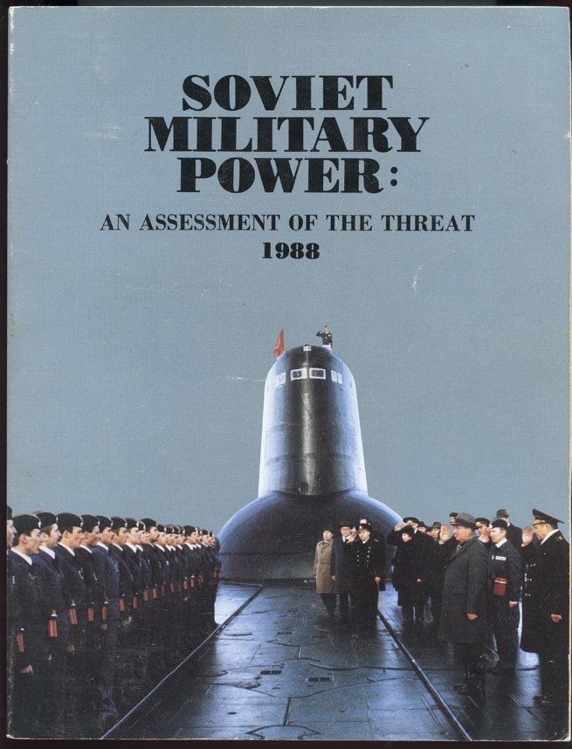
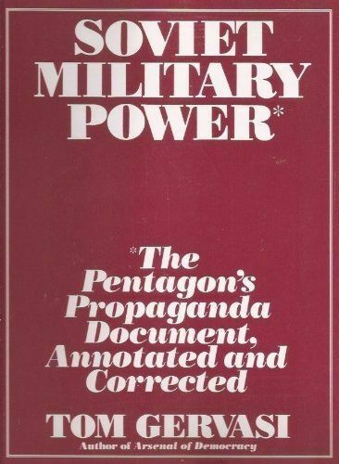
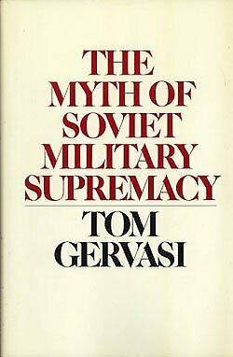
SOLUTION 5: Replace “TOM GERVASI”; BE THE RELEVANT QUALIFIED WATCHDOGS OF THE USA VS. RUSSIA & CHINA
Dwight D. Eisenhower: In the councils of government, we must guard against the acquisition of unwarranted influence whether sought or unsought, by the MILITARY INDUSTRIAL COMPLEX. The potential for the disastrous rise of misplaced power exists and will persist.
“Truth and Beauty”
DOD PUBLISHED
GERVASI COUNTERED
The US Military is a world class defender of democracy and Is one of the most trusted of any
Organizations in the USA with a historical public confidence rating at the highest of 85%.
I believe this trusted is merited. I loved and trusted DOD in all my 33 years of uniform service. However, the US Military is subject to political leadership, essential in democracy, and that political leadership has control over the military. And regardless of who controls it per-se,
It remains the single most powerful institution in the US by far, and alsoglobally. It needs to
be kept ethical to the greatest extent possible.
In the late 80’s, the DOD was publishing SOVIET MILITARY POWER. They ELEVATED the power
representation of the Soviet Union. This contributed to the end of the cold war, as we built
overwhelming conventional power while they spent themselves into failure. This was a superb result, from which the territory actual Russian control was substantially reduced, and as a result the actual territorial size of NATO was expanded and continues to grow. So I celebrate the multiple “SOVIET MILITARY POWER” publications themselves and their end results.
Tom Gervasi and a small group of supporters – exposed this over representation of Soviet
Military Power. They reprinted the actual reports in oversize publications, and in the expanded margins – pointed out all of the exaggerations and embellishments. There were THOUSANDS. DOD political leadership likely did not like this, but – in a democracy – in
direct consonance with the Eisenhower quote above – we need to be WARY of the
MILITARY INDUSTRIAL COMPLEX lest it become too aggressive in its portrayal of threats
to the American People.
I believe The Dupuy Institute can optimally replace Tom Gervasi’s role with one that is as relevant, but one actually welcomed by the MILITARY INDUSTRIAL COMPLEX. And this role is to serve as an Independent team overseeing superpower related deterministic combat models, with the intent of not only ensuring the US DOD does not inflate our opponent's abilities, BUT MORE CRITICALLY DOES NOT UNDERESTIMATE THEM.
1 VISIONED TDI
PUBLICATION
USA vs. China and Russia
with
TNDM Assessments

Slide 53
SOLUTION 6: Rename the Institute
CHALLENGE: Despite his martial genius and incredible accomplishments, Colonel Trevor Dupuy was so busy and fully engaged in his efforts at the Trevor Dupuy Institute that he did not establish an optimal succession plan nor build the institution for perpetual operations. This omission is completely understandable given the fact that he was a powerhouse of energy and talent the like of which is rarely seen on this planet, and he did not himself anticipate leaving us as early as he did.
Christopher A. Lawrence has preserved the Trevor Dupuy Institute almost single handedly since 1995. He has published priceless works advancing the findings of the institute, maintained internet website and blog activity, maintained the institute archives, and much more.
This effort has been foundational to his publication of “Kursk, The Battle of ProKhorovka”, which is defendably the single greatest assessment of a battle ever to be published in global history, at 1,700 pages and 10 pounds with numerous fold out maps, establishing a precedent of analysis that will be only equaled with great investment. The entire story of this book alone, to include the involvement of Professors of the Frunze military academy following the fall of the Berlin Wall and collapse of the Soviet Union, is literally worthy of a Hollywood movie. That movie – should someday be scripted – without exaggeration.
SOLUTION(s): Christopher A. Lawrence merits inclusion in the renaming of the Trevor Dupuy Institute to the “Dupuy – Lawrence Institute”. This merited retitling should be paralleled with the immediate assumption of the intention to make the institution a permanent U.S. resource with a targeted staff of approximately 20, supported by a carefully cultivated volunteer researcher group of 50 and 9 unpaid interns, as well as 10 associate researchers.
Dupuy should remain primary in homage to the exceptional work of Colonel Dupuy, but Lawrence should be added due to the success of Christopher A. Lawrence in keeping the Institute alive, leading to the publication of the greatest battle assessment – of the greatest battle – in global history.

Slide 54
REPLACE:
DLI
Dupuy-Lawrence Institute
Predicting War Outcomes
To
Create Peace
The Baton was passed in 1995.
recognizing the founder and
successor – is relevant historically.

Slide 55
ONE OPTIONAL CONSIDERATION
REPLACE:
WITH:
PREDICTING WAR OUTCOMES
TO
CREATE PEACE

Slide 56
FUTURE ANNUAL TDI MILITARY ALMANACS
Duplicates the Military Balance accounting of military power but adds:
Provides additional information than IISS Military Balance (Maps, Influence, More)
Key Calculations of national military power for key nations
Key comparison tables of potential conflict military between adversarial nations
Itemization(s) of key weapons calculated power – and capabilities
Vital historical facts of key national military power beyond weapons count
Recently declassified key information
Key captures of emergent strategy and technology
Select interviews of key global military leaders
Directory to global military referential websites and libraries
More

Slide 57
A “POTENTIAL” INTERNATIONAL PARTNERSHIP
IISS is a superb military analysis organization in the free world. Their annual publications “The Military Balance” and
“The Strategic Survey” are critical unequaled annual documents that look in depth at detailed military orders of battle,
and provide analysis of same. They are established, and TDI should not view them as a threat or an opponent, but instead, an
Ally.
However, the IISS is clearly absent of any deterministic modeling system internally. The Dupuy Institute has the best
unclassified battle proven deterministic modeling system on the planet today. A partnership is potentially warranted.
Adding TDI inputs will elevate IISS products.
IISS needs TDI. They just don’t know it today. TDI needs to change that in my opinion. It will immediately enhance both
organizations in terms of their global impact and outreach. And the independence of TDI will compliment the known
Independence of IISS.

Slide 58
CONCLUSIONS
1. The American People need the independent TDI to be perpetuated – and don’t know this. The capacity in this institution strengthens democracy. Democracy – must always be the smartest at war – or it will perish. TDI helps keep the American Warrior brain as the most dangerous weapon that it truly is of all our weapons in the arsenal. This system – elevates actual warrior leader cognitive understanding of war substantially. We cannot afford to lose it.
2. Margaret Mead said, “Never doubt that a small group of thoughtful, committed citizens can change the world; indeed, it’s the only thing that ever has.” This brief is an attempt to help the current leaders of TDI band together this group to change the world through the perpetuation of TDI.

Slide 59
CONCLUSION ADDENDUM
“TRUTH AND BEAUTY”: There is an ongoing and ever likely future conflict within the DOD between
“Truth and Beauty” and politics. The examples are many, but the TDI examples include QJM/TNDM military
science-based claims of early WW2 German ground combat tactical superiority over allied ground forces by the TDI being
REJECTED by US a very small but positionally influential group of specific Generals (a long time ago) to the
POLITICAL DETRIMENT of TDI.
This was a failing by Generals, resulting in negative impacts on a STELLAR TDI.
Trevor Dupuy stood his ground for “Truth and Beauty” in face of these politics. This was the correct thing to do.
The TDI needs to ALWAYS prioritize “Truth and Beauty” over politics.
“ITS LIKE A NATURAL LAW”: The genius of QJM/TNDM (as a permutation of the Lanchester Method) is that it
consistently works almost “like a natural law”. There is room to improve and expand upon past methodology, but this
expansion will not dissipate the “natural law” reality of the elevated future TNDM.
Expansions should include inclusion of Naval and Air Warfare Components, and likely the expansion of tank TLI’s from the h
Historic “Heavy-Medium-Light” tank general scores to very specific individual weapon systems scoring with greater expanse
for detailed technical variations. For example, a M-60A3 on the battlefield today should not be scored the same as a
Merkava IV tank.

Slide 60
CONCLUSION ADDENDUM
“INCREASE PROFESSIONAL WRITING AND READING” within DOD allowing increased
opportunities for Officers and NCO’s to publish and be introduced to higher level strategy at
early career developmental levels enriching full careers and enhancing PME (Professional
Military Education) systems in place. FILL THE GAPS in PME, by design and deliberately.

Slide 61
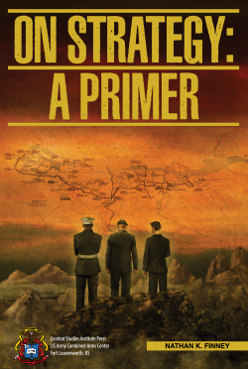
EXAMPLE: TARGET TDI RECRUITS
DR. BOB HUMBEL
DR. DEAN HARTLEY
MORS BOARD MEMBERS
(FUTURE DLI BOARD MEMBERS?)

Slide 62
FINAL CONCLUSION
THE USE OF OPERATIONAL RESEARCH BY SCIENTISTS IN WW2 HELPED
DEFEAT U-BOATS, WITHOUT WHICH WE WOULD HAVE LOST WW2.
LOGISTICS WINS WARS. SHIPS MOVED LOGISTICS.
THIS WAS BOOK CAPTURES ONE OF THE VERY FIRST DOCUMENTED
USES OF OPERATIONAL RESEARCH BEING INTEGRATED INTO MILITARY
DECISION MAKING – WITH SPECTACULAR RESULTS.
THE DUPUY INSTITUTE IS AN INDEPENDENT OPERATIONAL RESEARCH
ORGANIZATION WITH A LEGACY THAT UNQUESTIONABLY QUALIFIES IT AS A
NATIONAL RESOURCE ABLE TO REPLICATE THIS WAR WINNING RESEARCH
IN THE FUTURE.
THE FUTURE OF THE DUPUY INSTITUTE MUST BE PRESERVED.
IT IS NOT ONLY A NATIONAL TREASURE DURING PEACETIME, BUT
CAN BE DURING FUTURE PERIODS OF WARFARE.

