Slide 1
Quantitative Analysis of History of Direct Fire Weapons
(or: Anticipating the Next Technology)
Alexander Kott, PhD
Approved for public release, distribution unlimited
ST and Chief Scientist, ARL
September 2022

Slide 2
outline
Quantitative characterization of our ability to envision the future of military technology – based on history
Quantitative analysis of the history (with implications for the future) – infantry small arms, 1200-2020
Quantitative analysis of the history (with implications for the future) – mobile direct fire systems, 1300-2020
Suggestions and Discussion

Slide 3
Quantitative characterization of our ability to envision the future of military technology – recent history

Slide 4
Examples of technology forecasts
Kott, A., & Perconti, P. (2018). Long-term forecasts of military technologies for a 20–30 year horizon: An empirical assessment of accuracy. Technological Forecasting and Social Change, 137, 272-279.

Slide 5
Accuracy of “functional” forecasts is quite high!
Average of SME assessments – 76%
Forecasts assessed above “half-true” – 81%
Forecasts assessed as “viable” – 89%
Kott, A., & Perconti, P. (2018). Long-term forecasts of military technologies for a 20–30 year horizon: An empirical assessment of accuracy. Technological Forecasting and Social Change, 137, 272-279.

Slide 6
History and future may surprise us
Kott, A., & Perconti, P. (2018). Long-term forecasts of military technologies for a 20–30 year horizon: An empirical assessment of accuracy. Technological Forecasting and Social Change, 137, 272-279.

Slide 7
Quantitative analysis of technology history (with implications for the future) – infantry small arms, 1200-2020

Slide 8
Exponential model:
log(MOP) = p1 + p2*Year
Kott, A., Perconti, P., and Leslie, N. (2021). Anticipating the Next Technology, The Study of the 800-year Evolution in Small Arms. Research-Technology Management, v.64, n.4, pp.48-56

Slide 9
Exponential model:
log(MOP) = p1 + p2*Year
Quadratic Exponential:
log(MOP) = p1*(Year – p2)²
Piecewise Exponential:
log(MOP) = p1 + p2*Year for Year < Breakpoint; log(MOP) = p3 + p4*Year otherwise
Kott, A., Perconti, P., and Leslie, N. (2021). Anticipating the Next Technology, The Study of the 800-year Evolution in Small Arms. Research-Technology Management, v.64, n.4, pp.48-56

Slide 10
Figure 1.––Muzzle kinetic energy of infantry small arms, 1000–2018
Kott, A., Perconti, P., and Leslie, N. (2021). Anticipating the Next Technology, The Study of the 800-year Evolution in Small Arms. Research-Technology Management, v.64, n.4, pp.48-56

Slide 11
MOP = A1^{k1}A2^{k2}A3^{k3}
Kott, A., Perconti, P., and Leslie, N. (2021). Anticipating the Next Technology, The Study of the 800-year Evolution in Small Arms. Research-Technology Management, v.64, n.4, pp.48-56

Slide 12
MOP = A1^{k1}A2^{k2}A3^{k3}
log(MOP) = p1*(Year – p2)²
Kott, A., Perconti, P., and Leslie, N. (2021). Anticipating the Next Technology, The Study of the 800-year Evolution in Small Arms. Research-Technology Management, v.64, n.4, pp.48-56

Slide 13
Kott, A., Perconti, P., and Leslie, N. (2021). Anticipating the Next Technology, The Study of the 800-year Evolution in Small Arms. Research-Technology Management, v.64, n.4, pp.48-56

Slide 14
log(MOP) =
-5.96 + 2.0log(V) + 2.35log(Range) + 0.39log(Rate) + 0.61log(M)
log(MOP) =
1.0 + 8.27(10)⁻⁶ (Year-1200)²
Kott, A., Perconti, P., and Leslie, N. (2021). Anticipating the Next Technology, The Study of the 800-year Evolution in Small Arms. Research-Technology Management, v.64, n.4, pp.48-56

Slide 15
Rifles: rifled muskets,
repeaters, assault rifles
Log of the Figure of Regularity
Muzzle-loading smoothbores:
handgonnes, harquebuses, muskets
R²=0.955
Bows and longbows
Crossbows
The year of the system’s initial appearance
Figure 2.––Figure of Regularity fits well the empirical data. The logarithm of the composite measure, log(FoR), is closely approximated by a quadratic function of time 1.0+8.27(10)⁻⁶ (Year-1200)². Here log(FoR) = -5.96 + 2.0logV + 2.35logD + 0.39logR + 0.61logM.

Slide 17
hypothetical illustration
log(MOP) should increase by 0.8 by 2050
Can my research portfolio support this?
log(MOP) = -5.96 + 2.0log(V) + 2.35log(Range) + 0.39log(Rate) + 0.61log(M)
I anticipate to increase V by 10%; this will add 0.08 to log(MOP)
I anticipate to increase Range by 70%; this will add 0.54
I anticipate to increase Mass by 80%; this will add 0.16
Total anticipated increase due to planned R&D: 0.08 + 0.54 + 0.16 = 0.78
Kott, A., Perconti, P., and Leslie, N. (2021). Anticipating the Next Technology, The Study of the 800-year Evolution in Small Arms. Research-Technology Management, v.64, n.4, pp.48-56

Slide 18
Quantitative analysis of technology history (with implications for the future) – mobile direct fire systems, 1300-2020

Slide 19
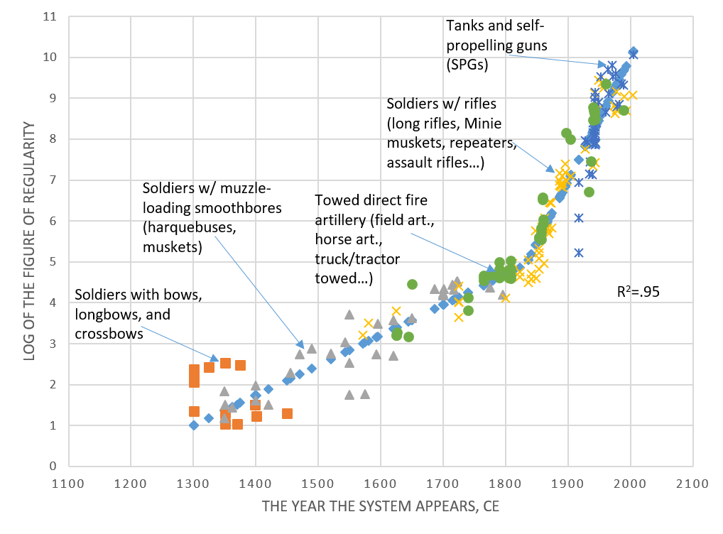
Kott, A. (2020). Toward universal laws of technology evolution: modeling multi-century advances in mobile direct-fire systems. The Journal of Defense Modeling and Simulation, 17(4), 373-388.

Slide 20
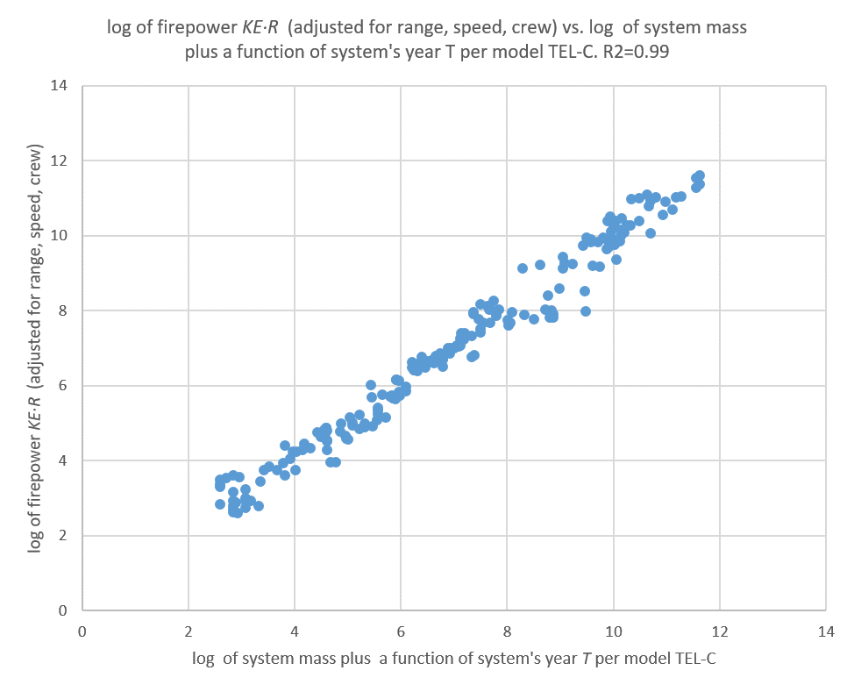
Kott, A. (2020). Toward universal laws of technology evolution: modeling multi-century advances in mobile direct-fire systems. The Journal of Defense Modeling and Simulation, 17(4), 373-388.

Slide 21
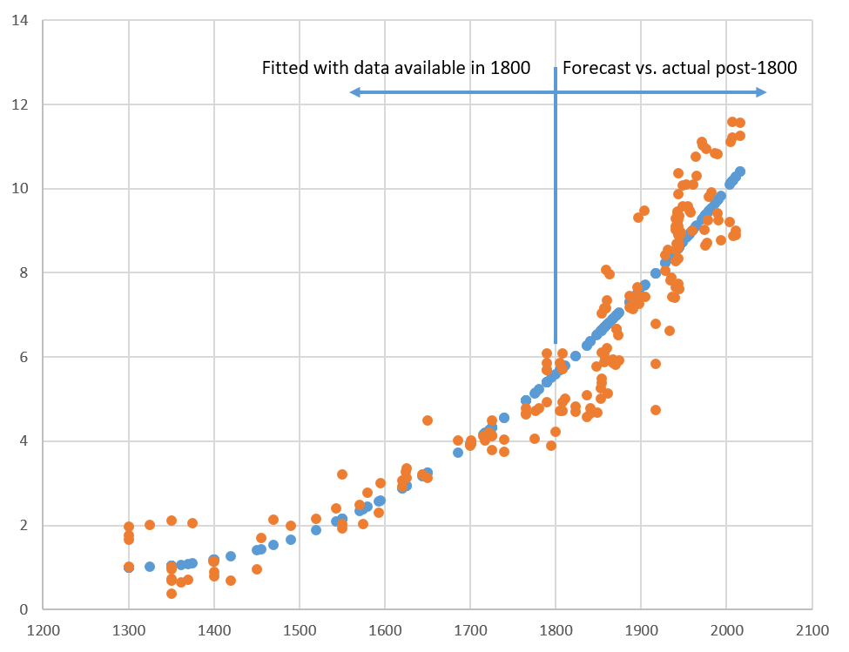
Kott, A. (2020). Toward universal laws of technology evolution: modeling multi-century advances in mobile direct-fire systems. The Journal of Defense Modeling and Simulation, 17(4), 373-388.

Slide 22
Recommendations and discussion

Slide 23
Recommendations for r&d analysts / managers
Longer-term history analysis is beneficial; reveals attributes; reduces biases
Consider a broader range of functionally similar artifacts
Start with exponential and/or super-exponential assumptions; they tend to work
Compare your forecast and your R&D portfolio; large disagreements are food for thought
History of technology exhibits a significant degree of regularity. Know it and use it!
Kott, A., Perconti, P., and Leslie, N. (2021). Anticipating the Next Technology, The Study of the 800-year Evolution in Small Arms. Research-Technology Management, v.64, n.4, pp.48-56

Slide 24
Technology history is an (RE)Evolutionary process
Note: here, evolution as an analogy of biological processes, not in distinction from “revolution” or “disruption”
Variation
Mutations of ideas
Recombination of ideas
Selection
Vicarious (analysis)
Real world

Slide 25
Can we accelerate the “evolution”?
The rate of mutations could be increased by environmental pressures:
Forecasting
Competition
Market changes
Culture and incentives
Foundational results

Slide 26
references
Kott, A., Perconti, P., and Leslie, N. (2021). Anticipating the Next Technology, The Study of the 800-year Evolution in Small Arms. Research-Technology Management, v.64, n.4, pp.48-56
Kott, A., & Perconti, P. (2018). Long-term forecasts of military technologies for a 20–30 year horizon: An empirical assessment of accuracy. Technological Forecasting and Social Change, 137, 272-279.
Kott, A. (2020). An extended data set for explorations in long-range forecasting of military technologies. US Army Combat Capabilities Development Command, Army Research Laboratory Adelphi United States.
Kott, A. (2020). Toward universal laws of technology evolution: modeling multi-century advances in mobile direct-fire systems. The Journal of Defense Modeling and Simulation, 17(4), 373-388.
West, B. J., West, D., & Kott, A. (2020). Size and History Combine in Allometry Relation of Technology Systems. The Journal of Defense Modeling and Simulation, 1548512920942327.
Kott, A. (2018). Ground warfare in 2050: How it might look. US Army Research Laboratory Aberdeen Proving Ground United States.
Schaller RR. Moore’s law: past, present and future. IEEE Spectr. 1997;34(6): 52–59.
Alexander AJ, Nelson JR. Measuring technological change: Aircraft turbine engines. Technol Forecast Soc Change. 1973;5(2): 189–203.
Lienhard JH. The rate of technological improvement before and after the 1830s. Technol Cult. 1979;20(3): 515–530. The Johns Hopkins University Press and the Society for the History of Technology. Available from: https://www.jstor.org/stable/3103814

Slide 27
BACKUP

Slide 28
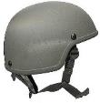
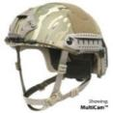
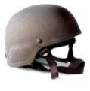
Helmet Innovation
Next Gen
Systems
Enhance Combat Helmet ECH
UHMWPE (Dyneema ® and Spectra ®) and Carbon Fiber
FAST Helmet
New
2D Materials
Primary changes in design and suspension; improved aramids
Fragmentary and 9mm protection
PASGT/ Aramid Fiber/ Kevlar
Fragmentary and 9mm protection
Fragmentary and 45 Cal protection
M1 Steel Pot /Woven Liner
Advanced Combat Helmet
Improved Kevlar ® and Twaron ®
3rd Gen Systems
Novel
Protection
Mechanisms
First helmet with specified frag and small arms protection
IMPACT
UHMWPE Dyneema & Spectra Fiber ®
Blunt Impact Protection
2nd Gen Systems
Aggressive innovation in design, manufacturing and materials
Helmet
Materials
Hadfield Steel
Fabric/woven Liner
Aramid Fiber (Kevlar ®)
Areal
Density
2.2 psf
2.2 psf
2.2 psf
1.8 psf
2.2 psf
Tenacity
23 gpd
27 gpd
34 gpd
40+ gpd
Disruptive Innovations
Material Revolution: Synthetic Ballistic Material
Breakthroughs
1943
1980
2005
2010
2013
2015
2030
TIME
Notes:
We are due for another knee in this curve. So what do we need to do…?
Exploit New 2D materials
Develop Novel Protection Mechanisms
Develop Blunt Impact Protection Schemes

