Slide 2
Define Helmbold Parameters
$$\left\{\begin{aligned}a=\cosh\left(ε\right)−μ\sinh\left(ε\right) \\ d=\cosh\left(ε\right)−\frac{1}{μ}\sinh\left(ε\right)\end{aligned}\right.$$
$$ε=λT$$
$$μ^{2}≈\frac{{CX}/{CY}}{{x_{0}}/{y_{0}}}≡\frac{FX}{FY}=FER$$
$$ε^{2}≅FX∗FY$$
$μ$ is your “Advantage parameter”
$ε$ is the “Bitterness parameter”
2

Slide 3
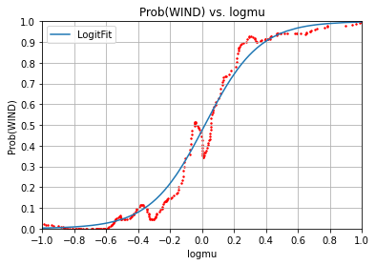

Slide 4
Use The Key To Victory (Part A)
Database scan
Raise issues
Report the advantage and bitterness parameter values
Teach commanders how to maximize their advantage parameter
Establish and fund permanent program to assemble large and highly accurate databases of historical land, sea, and air battles

Slide 5
Use The Key To Victory (Part B)
Use the advantage parameter as the primary objective function or figure of merit to be optimized when designing a force’s equipment, organization, and tactics.
Use the advantage parameter as the “score” of a trainee unit at Fort Irwin’s National Test Center
Start a major DARPA effort to provide our nation’s battle commanders with accurate, trustworthy, and timely intelligence regarding their logmu values (and to deny that to enemy commanders).

Slide 6
Use The Key To Victory (Part C)
Initiate theoretical and empirical efforts to better understand and take into account the effect of reinforcements and detachments during the course of a battle on the defender’s advantage parameter.
Study and refine our initial suggestion for an objective and quantitative measure of the quality of “generalship”.
Consider defining and using a new battle outcome category to cover cases where a tactical defeat is or was deliberately accepted because of its strategic benefits.

Slide 7
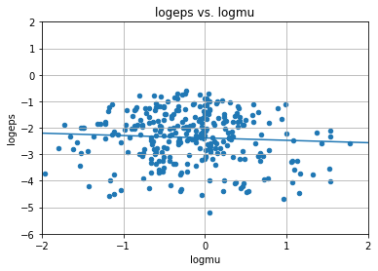

Slide 8
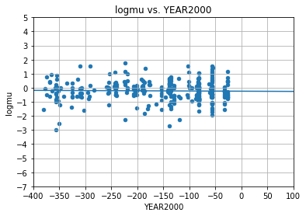

Slide 10
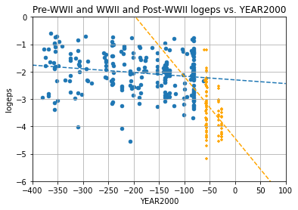

Slide 11
WWII Battle of Kursk

Slide 13
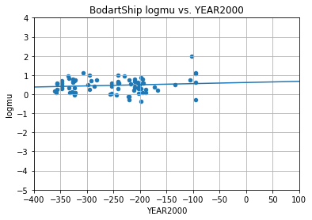
Bodart Naval Battle Data

Slide 14
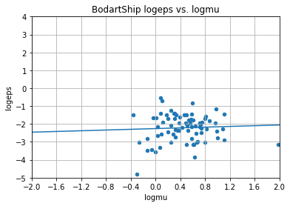
Bodart Naval Battle Data

Slide 15
Use The Key To Victory (Part A)
Database scan
Raise issues
Report the advantage and bitterness parameter values
Teach commanders how to maximize their advantage parameter
Establish and fund permanent program to assemble large and highly accurate databases of historical land, sea, and air battles

Slide 16
Use The Key To Victory (Part B)
Use the advantage parameter as the primary objective function or figure of merit to be optimized when designing a force’s equipment, organization, and tactics.
Use the advantage parameter as the “score” of a trainee unit at Fort Irwin’s National Test Center
Start a major DARPA effort to provide our nation’s battle commanders with accurate, trustworthy, and timely intelligence regarding their logmu values (and to deny that to enemy commanders).

Slide 17
Use The Key To Victory (Part C)
Initiate theoretical and empirical efforts to better understand and take into account the effect of reinforcements and detachments during the course of a battle on the defender’s advantage parameter.
Study and refine our initial suggestion for an objective and quantitative measure of the quality of “generalship”.
Consider defining and using a new battle outcome category to cover cases where a tactical defeat is or was deliberately accepted because of its strategic benefits.

Slide 18
After Words
Rating Commanders Objectively and Quantitatively
Personnel Strength or Man-Hours of Effort?

Slide 21
