Slide 1
The Combat Assessment Technique
William A. Sayers

Slide 2
1990 – Search for system to fill in holes of Soviet CoFM
  Means to develop Scores
  “K” factors for terrain, posture, etc.
Settled on Col. Dupuy’s Quantified Judgment Model
Received model and training in Summer 1990
  Just in time for Iraqi invasion of Kuwait
Created Combat Assessment Technique using Soviet CoFM and modification of Dupuy method from Options of Command and Understanding War

Slide 3
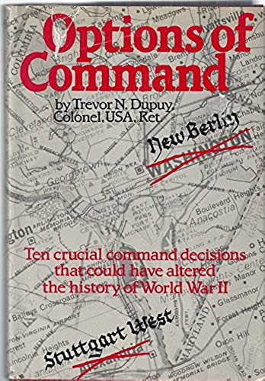

Slide 4
Each unit’s TO&E examined, individual weapons’ Operational Lethality Index scores totaled to yield a unit lethality Index ULI
ULIs totaled for each side in the engagement
ULIs for each side modified by Operational (K) Factors
Ratio taken of stronger side/weaker side
Outcome of engagement determined by magnitude of advantage

Slide 5
UK Para Battalion (Falklands War):
Weapon # OLI Tot OLI
L1A1 Rifle x 349 x .06 = 20.94
L2A3 SMG x 115 x .14 = 16.10
L7A2 GPMG x 72 x .64 = 46.08
M-79 GL x 39 x 3.95 = 154.05
L16A1 81mm x 8 x 46.00 = 368.00
Carl G. RR x 10 x 31.00 = 310.00
Milan ATGM x 6 x 82.00 = 492.00
M-72 LAW x 36 x 3.16 = 113.83
ULI = 1521

Slide 6
2 Para Battalion Attack at Goose Green:
Unit # ULI
2 Para x 1 = 1521
- mortars x - 6 = - 258
artillery supt x 3 = 396
HMS Ardent x 1 = 250
Harrier sorties x 3 = 1500
3409
Arg 12 Rgt (-) x 1 = 614
artillery supt x 3 = 315
20mm AAA x 6 = 378
35mm AAA x 2 = 468
1775

Slide 7
2 Para Battalion Attack at Goose Green:
Posture Terrain CEV
3409 x 1.0 x 1.0 x 1.5 = 5114
1775 x 1.5 x 1.2 x 1.0 = 3195
= 1.6: 1
1:1 – 2:1 = static
2:1 – 2.9:1 = minor movement
3:1 – 5.9:1 = successful attack
≥6:1 = overrun

Slide 8
RATE OF ADVANCE AS A FUNCTION OF THE CORRELATION OF FORCES

Slide 9
LOSS RATES AS A FUNCTION OF FORCE RATIOS

Slide 10
DIA stood up Combat Assessments Team During Air Phase
Produced situation map for White House 2xday
  Included assessed relative strength of IZ units
ARCENT Staff couldn’t come up with agreed procedure
CINCCENT gave up, wanted 50% attrition
  Far in excess of historical breakpoints
On eve of Ground War, CoF gave green light
  Probably little impact due to length of ground war

Slide 11
1994 – IZ Republican Guard rushes Kuwait border
US forces fall-in on prepositioned equipment at Camp Doha
“No Drive Zone” instituted for RG, but not RA
What if Baghdad led with the RA?
Could the Kuwaiti Land Forces hold off the Iraqis until US forces closed on Camp Doha?

Slide 13
 |  |  |  |  |  | Covering Force Battle
 |  |  |  | Posture |  | Terrain |  | CEV
 | 11 ID | 68 | x | 1 | x | 1 | x | 1 | = | 68
 |  |  |  |  |  |  |  |  |  |  | = | 1.2 | : 1
 | 3/6 Mech Bde | 31 | x | 1.2 | x | 1.05 | x | 1.5 | = | 59
 |  |  |  | Posture |  | Terrain |  | CEV
 | 6 Arm Div | 203 | x | 1 | x | 1 | x | 1 | = | 203
 |  |  |  |  |  |  |  |  |  |  | = | 3.5 | : 1
 | 2/6 Mech Bde | 31 | x | 1.2 | x | 1.05 | x | 1.5 | = | 59
 |  |  |  | Posture |  | Terrain |  | CEV
 | 51 MID | 139 | x | 1 | x | 1 | x | 1 | = | 139
 |  |  |  |  |  |  |  |  |  |  | = | 2.4 | : 1
 | 1/6 Mech Bde | 31 | x | 1.2 | x | 1.05 | x | 1.5 | = | 59

Slide 14
 |  |  |  |  |  | Main Line of Resistance
 |  |  |  | Posture |  | Terrain |  | CEV
 | 11 ID | 68 | x | 1 | x | 1 | x | 1 | = | 68
 |  |  |  |  |  |  |  |  |  |  | = | 1: | 3.1
 | 35 Arm Bde | 112 | x | 1.2 | x | 1.05 | x | 1.5 | = | 212
 |  |  |  | Posture |  | Terrain |  | CEV
 | 6 Arm Div | 203 | x | 1 | x | 1 | x | 1 | = | 203
 |  |  |  |  |  |  |  |  |  |  | = | 1.2 | : 1
 | 6 Mech Bde | 92 | x | 1.2 | x | 1.05 | x | 1.5 | = | 174
 |  |  |  | Posture |  | Terrain |  | CEV
 | 51 MID | 139 | x | 1 | x | 1 | x | 1 | = | 139
 |  |  |  |  |  |  |  |  |  |  | = | 1: | 2.6
 | 15 Arm Bde | 193 | x | 1.2 | x | 1.05 | x | 1.5 | = | 365

Slide 15
 |  |  |  | Posture |  | Terrain |  | CEV
 | IZ III Corps | 860 | x | 1 | x | 1 | x | 1 | = | 860
 |  |  |  |  |  |  |  |  |  |  | = | 0.9 | : 1
 | KLF | 464 | x | 1.3 | x | 1.05 | x | 1.5 | = | 950

Slide 16
While at USMC Command & Staff College learned
    Marine Corps Planning Process
MCPP included Wargaming Courses of Action,
    but provided no rules or practical guidance
First planning problem – did not go well
Used CAT in second run, always used after that

Slide 17
2D MARDI V attacks at a 1:1, which was insufficient to provide proper support.

Slide 18
Diversions were used to divert enemy attention away from the main attack which now concentrated the MEF’s combat power decisively.

Slide 19
Figure 1. Layout of the defense and the initial CoF analysis.
Figure 1. Layout of the defense and the initial CoF analysis.

Slide 20
Figure 2. Red begins the battle by making credible diversionary attacks.

Slide 21
Figure 3. Blue's first move is to stabilize its front in reaction to Red's initial successes.

Slide 22
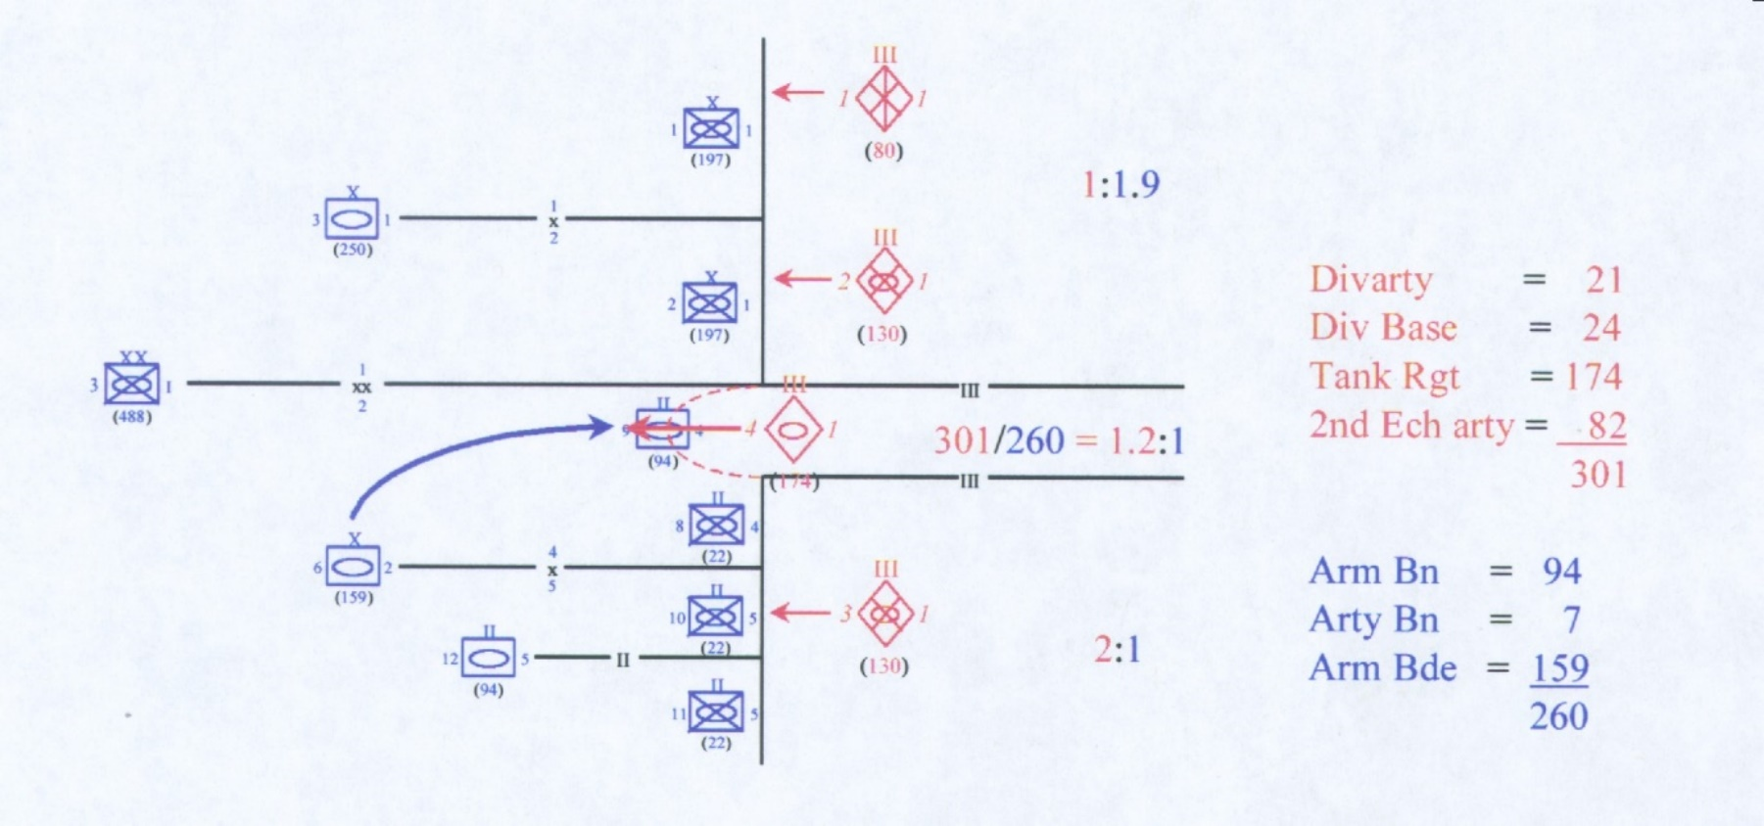
Figure 4. Blue commits his key armor brigade to the diversion.

Slide 23
Figure 5. The main attack begins.

Slide 24
Figure 6. The breakthrough continues.

Slide 25
Figure 7. The Blue commander on the horns of a dilemma: Either way, he loses.

Slide 26
Gave thesis & spreadsheet tool to MAGTF Staff Training
    Program cadre
Spreadsheet distributed to FMF in MSTP Pam 5-0.6

Slide 27
williamasayers@msn.com
On request:
This presentation
CAT Thesis
MSTP Pam 5-0.6 and spreadsheet
Staff Officer Rules
Falklands OOB

Slide 28
