Slide 1
Analysis of Unconventional Warfare Panel Presented by Dr. Christopher Davis (UNCG)

Slide 2
The Road to U.S. Intervention (1915)

Slide 3
Strategic Concerns - Haitian debts brought European gunboats to the Caribbean - Extent of German influence in Haitian affairs and disorder? - Mole St. Nicholas

Slide 4
July 28, 1915 – U.S. Occupation of Haiti Begins

Slide 5
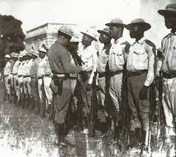
Restoring Order - Haiti administered by U.S. occupational forces - Phillipe Sudre Dartiguenave appointed President of Haiti - Establishment of the Gendarmerie of Haiti/Garde d’Haiti - Focus on centralizing Haitian institutions and maintaining stability - Initial backlash from the forces of Rosalvo Bobo (The First Caco War)

Slide 6
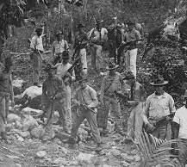
History As An Enemy
First Caco War (1915) is a counterinsurgency against the reactionary forces of Bobo
Cacos = Haitian insurgents, typically from the mountainous regions in the north, historically used by various political figures vying for power
Insurgency is quickly and effectively defeated
Overall view of the Haitian population to the U.S. occupation is perceived to have been more neutral than negative
Infrastructure strategy, and the failure to take Haitian history into account, undermines these initial gains and public goodwill

Slide 7
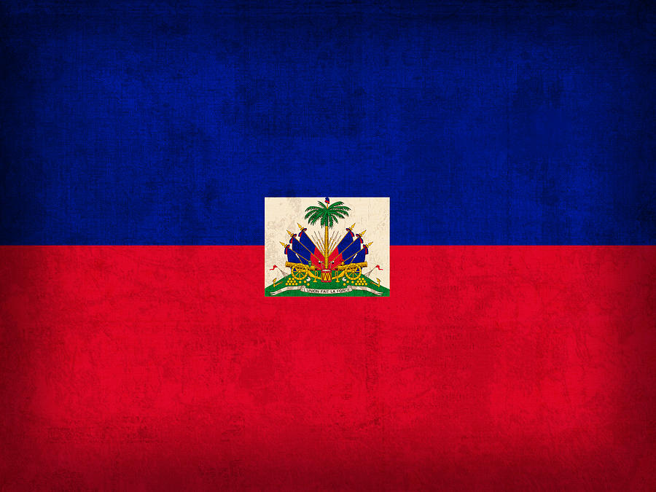
A Brief History of the Haitian Revolution (1791-1804)

Slide 8
- Established in 1659 as the French colony of Saint Domingue - “Pearl of the Antilles” – The sugar and coffee produced from this colony made it a jewel of the 18th Century French Empire - Demand for plantation labor resulted in growing number of African slaves brought to the colony through the 18th Century - Where in Africa these slaves were brought from may be significant in understanding the Haitian Revolution’s success

Slide 9
- Gained autonomy during French Revolution - Napoleon & Leclerc Expedition attempt to restore slavery in Saint Domingue (first through warfare, then through genocide) - January 1, 1804 – Republic of Haiti is founded after France is defeated followed by bitter reciprocity - Haiti becomes diplomatically isolated and forced by France to pay indemnity - 19th Century Haiti becomes a symbol of anti-slavery movements in the Americas -Haitian national identity solidified around resistance against foreign (“blan”) armies

Slide 10
History As An Enemy
To centralize political power in Port-au-Prince and provide local jobs, U.S. Marines prioritize infrastructure projects
To supply manpower and jobs, occupation administrators utilize a defunct Haitian law known as the “corvee”, in which labor was forced
While offering pay for labor, this was seen by Haitians as another form of slavery
Neutral attitudes of the occupation turn negative
Second Caco War begins (1918-1920)

Slide 11
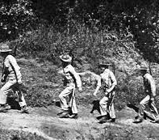
History as an Instructor

Slide 12
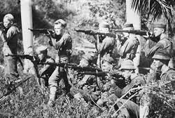
Innovations in Unconventional Warfare (First Caco War)

Slide 13
U.S. Marine Advantages
Equipped with (then) state-of-the-art rifles and machine guns
Cacos possessed antiquated rifles, pikes and/or machetes
Greater support from indigenous Haitians (1915)
Caco Advantages
Familiarity with the terrain
Greater support from indigenous Haitians (1918-1920)

Slide 14
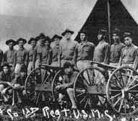
Evolution of Marine Strategy (1915)
Shift from conventional to unconventional warfare
Initially disarmed Cacos through negotiation and money-for-arms
Traded direct assaults for hunt-and-kill patrols
Utilized intelligence from local communities
Combination of superior training and technology, use of patrols, and intel resulted in very few Marine casualties and an extremely high Caco casualty rate

Slide 15
Evolution of Marine Strategy (1918 - 1920)
Small patrol tactics are developed further
Cacos further avoid direct engagement in exchange for quick strike-and-retreat attacks, and disruption of supply lines
Marines counter this by using patrols to bait the enemy
Marines then retooled and used Caco strategy against them
Patrols are to be “small, aggressive, and relentless” to disrupt Caco forces

Slide 16
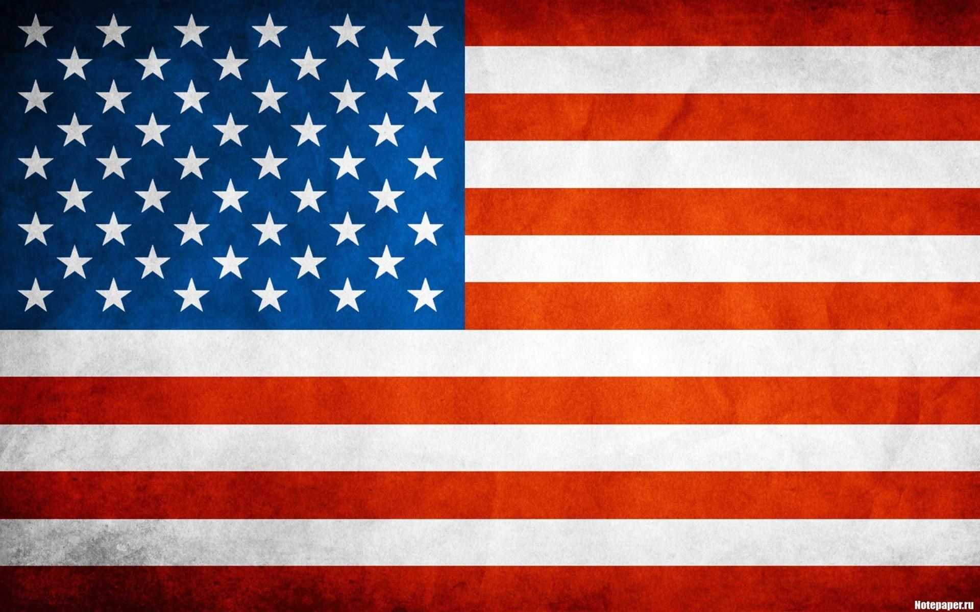
Why This is Relevant

Slide 17
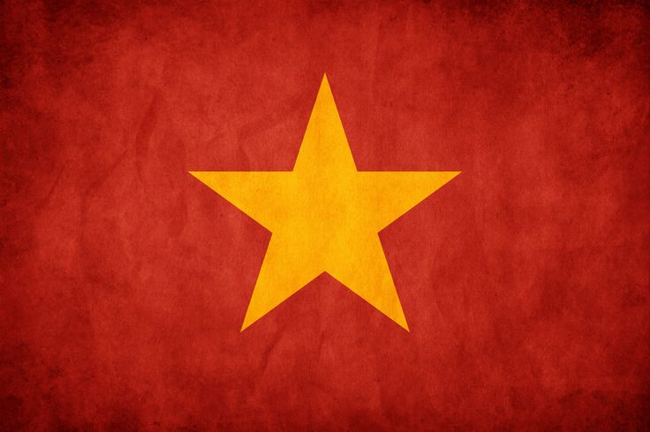
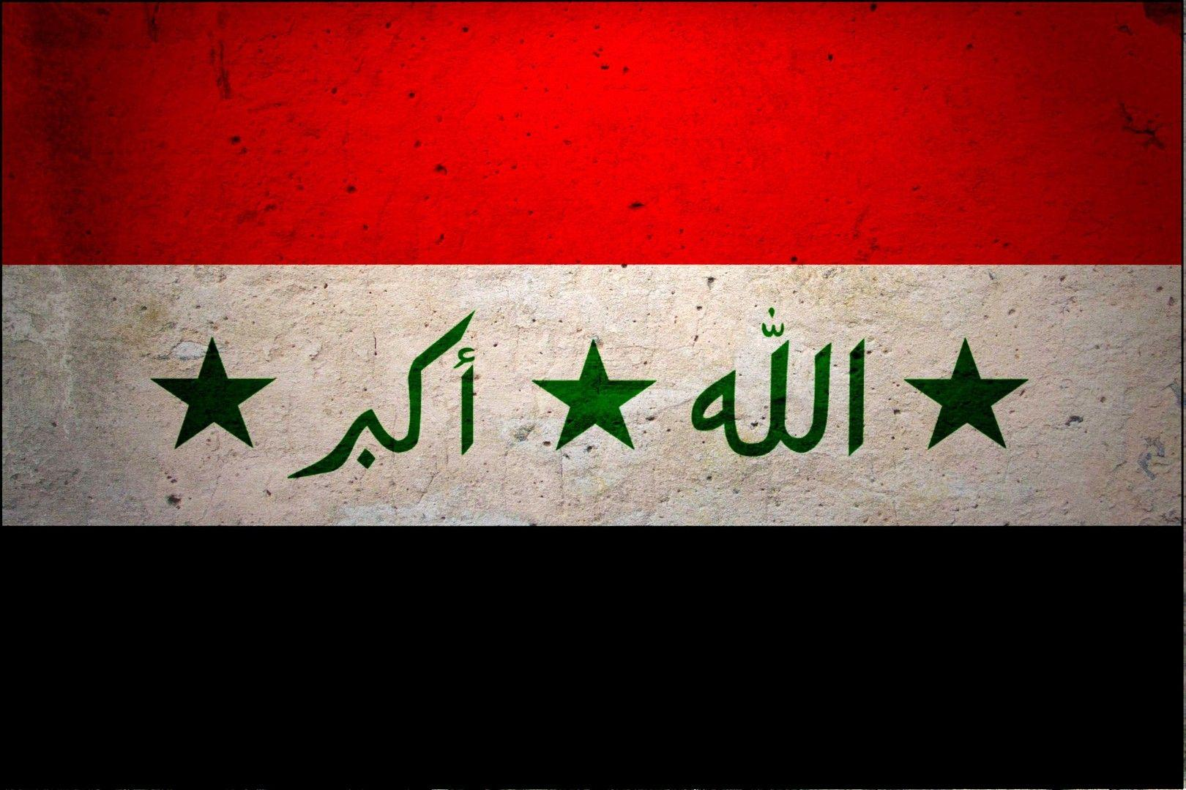
Almost every major U.S. conflict since the Korean War has been the same style of conflict:
Few engagements between conventional forces
Insurgency/Counterinsurgency
Conflict shaped by shifting indigenous and domestic (U.S.) opinion
Prolonged (10 years or more)

Slide 18
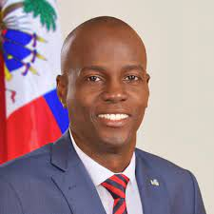
Current Crisis in Haiti
PetroCaribe Scandal ($4 billion raised between 2008 and 2016 for Haitian infrastructure and healthcare development)
Constitutional Crisis over Moise’s presidential term limit
Moise rules more and more by decree
July 7, 2021 – Jovenel Moise is assassinated
Ariel Henry (PM) remains acting president
Lack of functional government, fuel and food shortages, and exponential gang growth

Slide 19
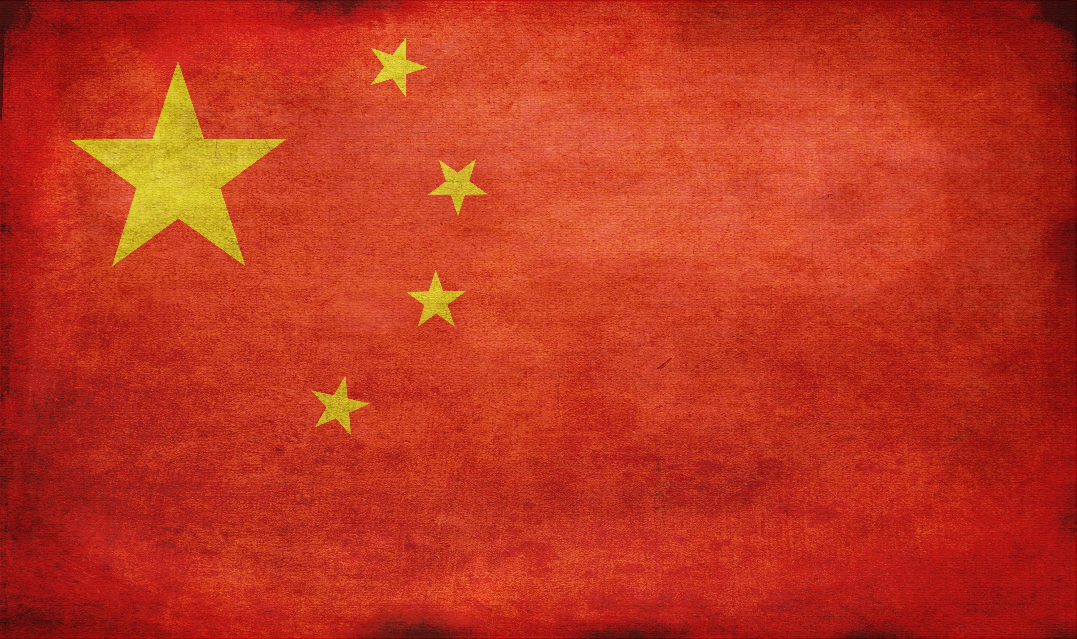
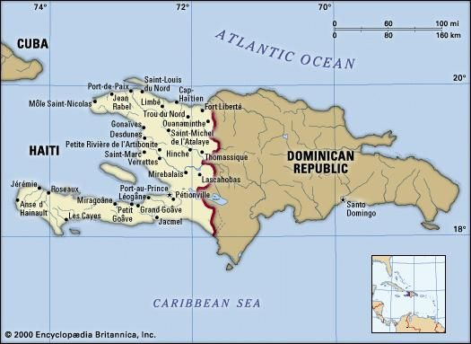
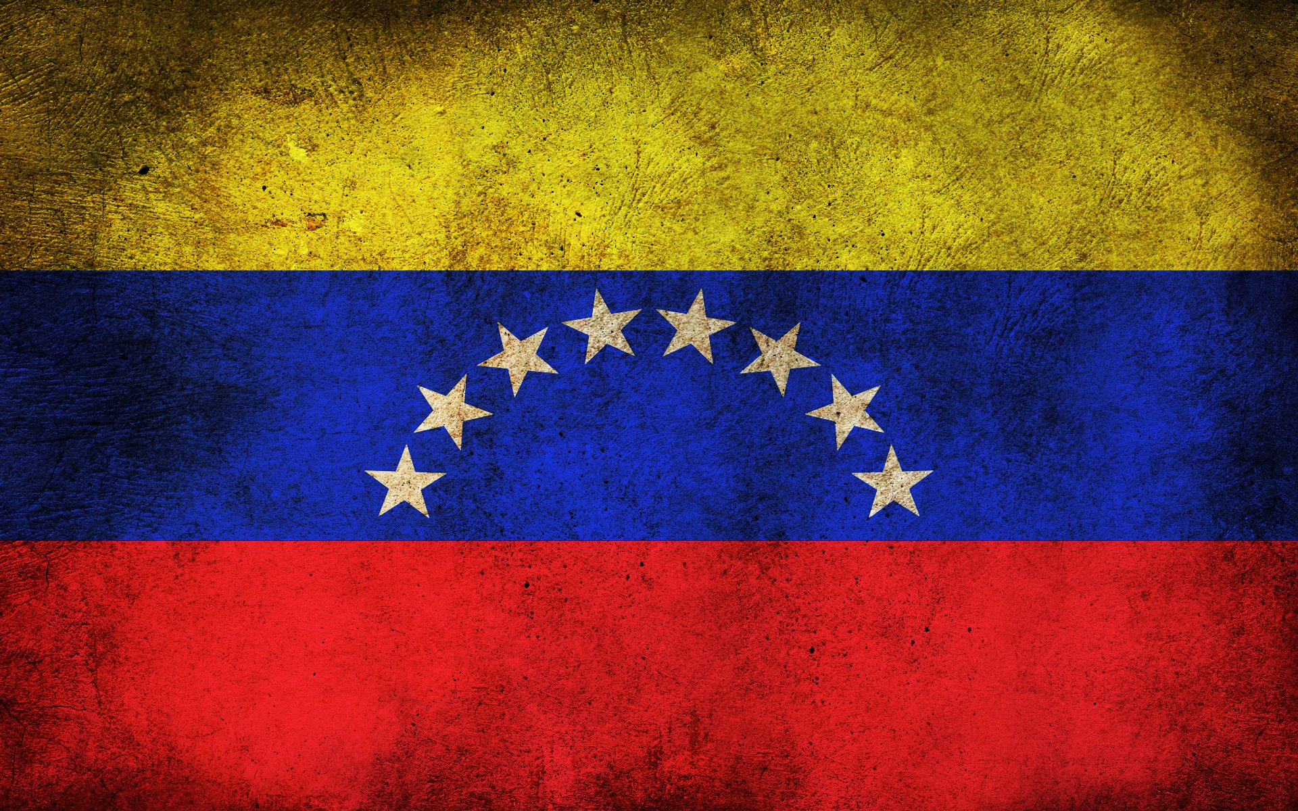
New Era of Great Power Competition

Slide 20
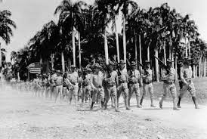
Analysis of Unconventional Warfare Panel Presented by Dr. Christopher Davis (UNCG)
QUESTIONS?

