Slide 1
Overview of the Future Study Program Wargaming
AGENDA
Directorate of Concepts’ Wargames and Experiments
Wargame Taxonomies and Development
DoC and the Operational Wargame System
Release of this information does not imply any commitment on the part of the U.S. Government to provide additional information. This information is provided with the understanding that the recipient government will make similar information available to the U.S. Government upon request.
The Overall Classification of this briefing is: Unclassified

Slide 2
Unclassified
Directorate of Concepts’ Wargames and Experiments
DoC experiments are system exploration games used to develop an understanding of a military problem and to both conduct and guide research for concept development and refinement. DoC experiments are analytical wargames and are therefore product-focused, not player-focused.
FCC-at-large conducts a large number of experiments at many echelons ranging from tactical systems-centric simulations to tabletop thought experiments
The Directorate of Concepts’ (DoC) Future Study Program (FSP) wargames explore, support/deny, and demonstrate the viability of central and supporting ideas of future concepts, when examined with projected future capabilities, against future threats, and in future environments.
Concepts experiments are not focused on achieving specific outcomes for either blue or red teams and are constructed as a systems exploration game to interrogate designated hypotheses.
FSP wargames are systems exploration games to develop a better understanding of the military problem – or range of military problems – future warfare poses for the US Army, the Joint force, and our allies and partners.
Unclassified

Slide 3
Experimentation & Wargaming “By the Books”
Unclassified
DoC experiments are systems exploration games used to develop an understanding of a military problem and to both conduct and guide research for concept development and refinement.
Experiments
“Cause and Effect”
Wargames
“Human Decision
Making”
Exercises
“Prepare and
Assess –
From a Known Point”
Future Study Program wargames explore, support/deny, and demonstrate the viability of central and supporting ideas of future concepts, when paired with projected future capabilities, threat, and environment. Experimental wargames are used when human decisions need to be integrated into the test.
Experiment Types:
Hypothesis Testing
Exploration
Demonstration
Research
Plan Refinement
Education
Training
Unclassified

Slide 4
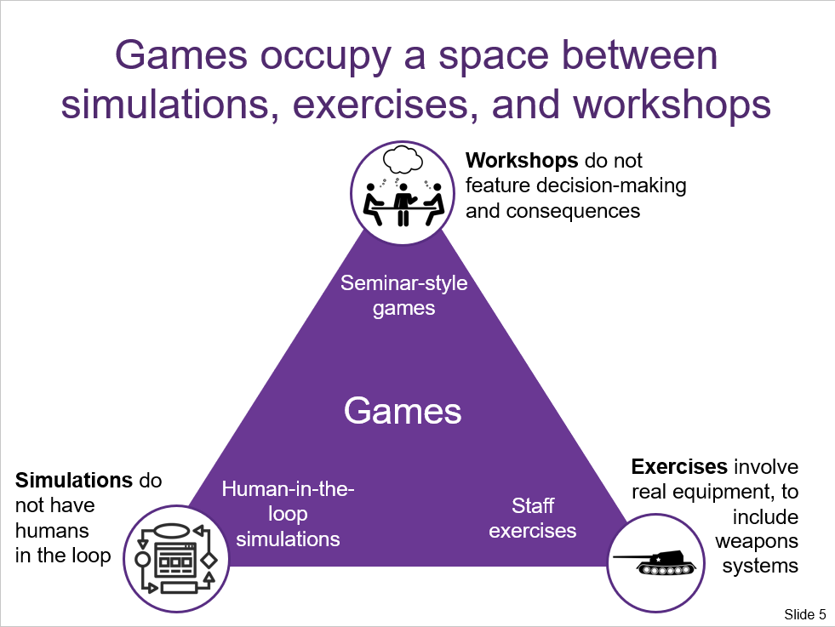
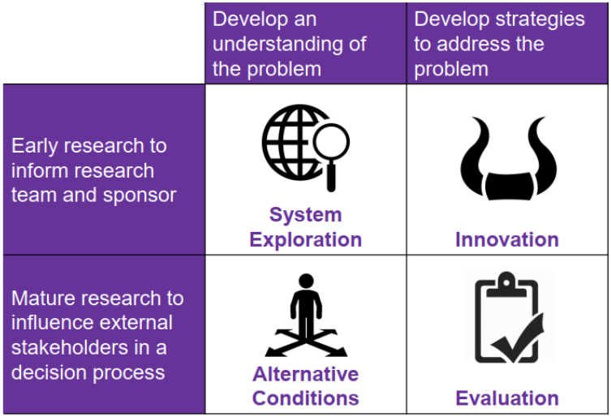
Wargames: Taxonomies
Unclassified
FSP Wargames are system exploration games in the early research (e.g. concept development) phase of force design and development. FSP Wargames also look to develop innovative methods to employ future forces.
Basic Types of Information Generated by Wargames
FSP
Events
Diagrams courtesy of Dr. Elizabeth Bartels, RAND Corporation
Unclassified

Slide 5
Unclassified
Transformation Through Modernization – A German Army Case Study
Transformation During the Interwar Period
Frame the Future OE
Rise of mechanized warfare – French fail to recognize implications for offensive operations, Germans and Soviets do
New technologies (tanks and airplanes) will increase mobility and lethality; improved communications (radios) enable synchronized operations in real-time
Identify key technologies: radios, tanks, airplanes, artillery
Frame the Problem(s): How do forces maneuver with enough force or depth to create an offensive outcome – how to avoid trench warfare? (Developing an operational concept that matches the warfighting culture of the nation)
Need for technological and doctrinal solutions to restore operational maneuver
Requirement to control forces differently to synchronize and coordinate actions – centralized French command structure versus decentralized German mission-type order
Frame Conceptual Approaches
Kesselschlacht – concentric assaults along operational lines to trap the enemy in a cauldron
Describe how tanks and airplanes transform combat from static, positional warfare to combined arms maneuver
Panzer Division becomes backbone of operational forces
Auftragstaktik - Increase flexibility in means and ways, orient on ends
Test the Concepts
Unclassified

Slide 6
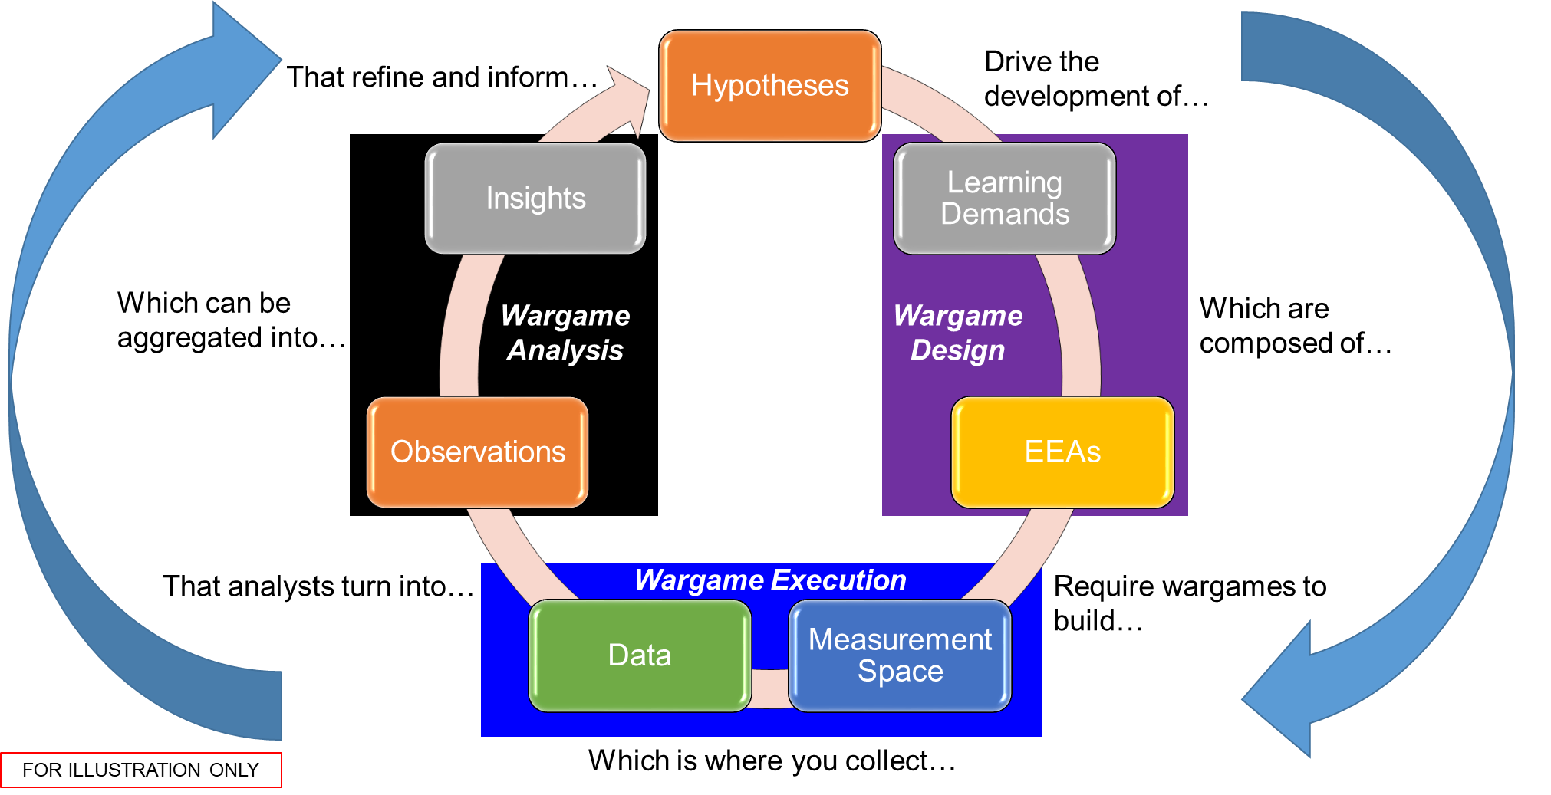
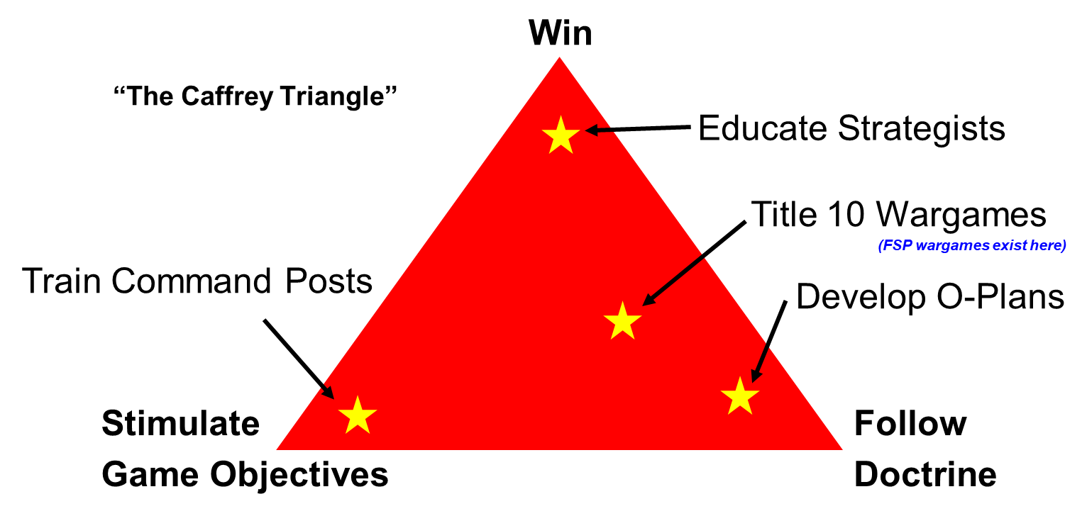
Concepts build hypotheses for the employment of the force in the future.
Analytical systems exploration wargames produce products to refine and inform hypotheses.
Unclassified

Slide 7
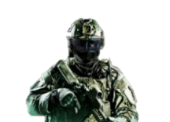
UNCLASSIFIED
Future Study Program: Refining What & How We Wargame
Each of the Future Study Program (FSP) events in FY21 and FY22 are unique pilots, cumulatively developing, assessing, and refining the AOC(E) 2040 and our ability to wargame
Since FY21, the FSP has brought together the threat, science and technology (S&T), concepts, and operational communities to develop, assess, and refine the Army Operational Concept for experimentation (AOC(E)) for 2040.
FY21/22 included seven FSP events. These provided sufficient evidence to support fundamental changes to how Army forces operate, equip, and organizein 2040.
FSP wargames utilized the USMC’s Operational Wargaming System(OWS) and an intel/analysis community validated scenario to assess how Army forces simultaneously conduct a land-based campaign and supported a counter-maritime campaign against a peer adversary.
These FSP events include analysis from four Focused Excursions that deep-dive priority S&T topics (e.g., power and energy) to help inform assessment of the AOC(E) core ideas.
Threat Community
S&T Community
Concept Community
Operational Community
“What Could be” in 2040
We are developing the Army Operating Concept for Experimentation (AOC(E)) 2040 and conducting its experimentation by integrating threat, science, tech, concept, and operational (to include law of armed conflict) communities from the beginning, to more quickly and effectively inform what “could be”
Unclassified

Slide 8
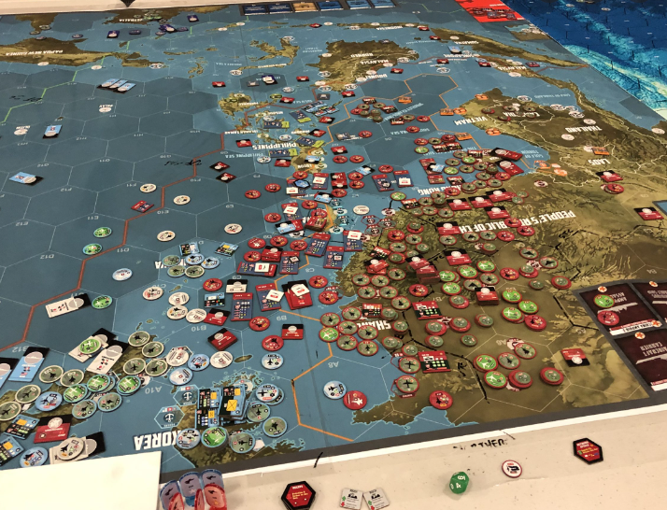
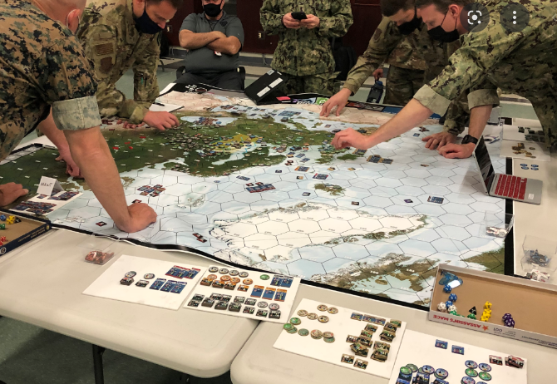
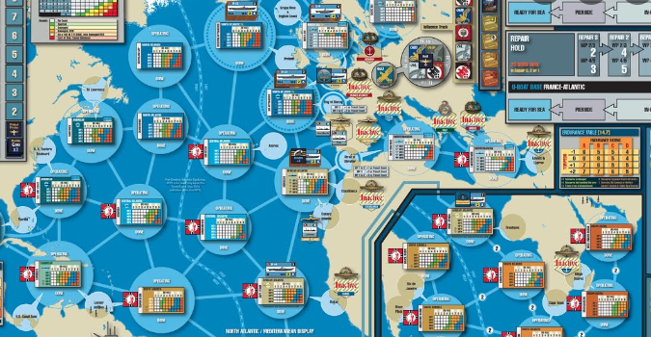
Unclassified
DoC and the Operational Wargame System
OWS provides a theater-level game capable of providing a level of rigor to operational and tactical actions at the Theater Army-through-battalion level.
OWS rule set provides rigor to adjudication and therefore measurable outcomes
OWS game play demonstrates the inherent “Jointness” that Army concepts must support
Physical and virtual versions of OWS allow for both immersive in-person and collaborative virtual iterations
OWS does have limitations on effectively simulating some battlefield functions and multi-domain operations in futures wargaming
Unclassified

