Slide 1
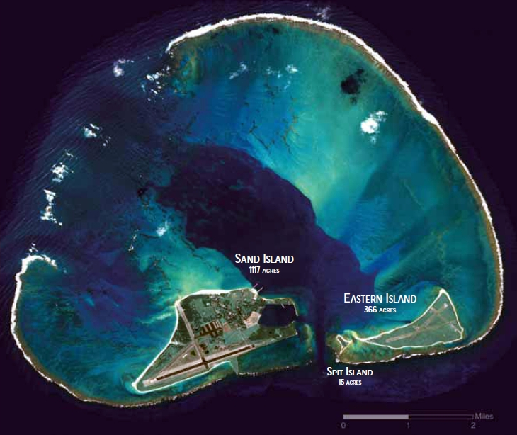
Midway
Mike Johnson

Slide 2
Outline
IJN organization
Kantai and Sentai (”ship group” or Fleet and “battle group”)
Battle; Amphibious; Mobile Striking; Land-based Air; Submarines; Geographic
USN organization
Pacific Fleet in 1941-42
Battle (Cover); Scouting (Amphibious); Scouting and Raiding; Maritime Patrol; Submarines
Midway
Roles of the “Kantai”
Conclusions

Slide 3
Sentai and Kantai
戦隊 | Sentai | battleship division cruiser division minelayer division auxiliary raider division coast defense division
戦 | sen | war, battle, fight
隊 | tai | military unit (corps, group)
Sentai = battle group or unit of action
Kantai is the unit of employment

Slide 4
Other Types of Sentai
航空戦隊 | Kōkū Sentai | Carrier Division or Air Flotilla: comprising two or more aircraft carriers, seaplane tenders or air groups.
航空 | Kōkū | aviation
航 | Kō | navigation
空 | sora | sky
水雷戦隊 | Suirai Sentai | Destroyer Squadron
水雷 | Suirai | Torpedo or mine
水 | Mizu | water
雷 | Kaminari | thunder
潜水戦隊 | Sensui Sentai | Submarine Squadron
潜水 | Sensui | diving
潜 | sen | submarine
水 | mizu | water
Air sentai
Destroyer sentai
Submarine sentai

Slide 5
Kantai
艦隊 | Kantai | “fleet”
艦 | kan | ship
隊 | tai | military unit (corps, group)
聯合艦隊 | Rengō Kantai | Combined Fleet
聯合 | Rengō | union, combination
聯 | Ren | together
合 | Gō | combination
basically, a group of ships.
Normally translated fleet, but more akin to a USN Force or Task Force
The integrated fleet, with a full range of capabilities.
Kantai is the unit of employment

Slide 6
Rengo and Hōmen Kantai
方面艦隊 | Homan Kantai | Area Fleet
方面 | Hōmen | direction, district, field
艦隊 | Kantai

Slide 7
Forces in Rengō Kantai / Combined Fleet
1st Kantai | Battle Force
2nd Kantai | Scouting Force
1st Air Kantai | Mobile Carrier Striking Force
11th Air Kantai | Land-based Aircraft
6th Kantai | Submarine Force
3rd Kantai | ==> 2nd Southern Expeditionary Kantai (and Southwest Area Kantai)
4th Kantai | Mandates Force
5th Kantai | Northern Force

Slide 8
Kantai of the Rengō Kantai 1941-42
1st Fleet (第一艦隊, Dai-Ichi Kantai) | 28 December 1903 => 25 February 1944, battle force
2nd Fleet (第二艦隊, Dai-Ni Kantai) | 28 December 1903 => 20 April 1945, cruiser force
4th Fleet (第四艦隊, Dai-Yon Kantai) | 15 November 1939 => 15 September 1945, mandates force
6th Fleet (第六艦隊, Dai-Roku Kantai) | 15 November 1940 => 15 September 1945. submarine force
11th Air Fleet (第十一航空艦隊, Dai-Jūichi Kōkū Kantai) | 15 January 1941 => 6 September 1945, shore-based air force
3rd Fleet (第三艦隊, Dai-San Kantai) | 10 April 1941 => 2nd Southern Expeditionary Fleet on 10 March 1942
1st Air Fleet (第一航空艦隊, Dai-Ichi Kōkū Kantai) | 10 April 1941 => 14 July 1942 (3rd Kantai), carrier task force
5th Fleet (第五艦隊, Dai-Go Kantai) | 25 July 1941 => 5 February 1945, northern force
Southern Expeditionary Fleet (南遣艦隊, Nanken Kantai) | 31 July 1941 => 2 Jan 1942 => 1st Southern Expeditionary Fleet on 3 Jan 1942

Slide 9
Kantai of the Rengo Kantai from 10 April 1942
1st Fleet (第一艦隊, Dai-Ichi Kantai) | battle force
2nd Fleet (第二艦隊, Dai-Ni Kantai) | amphibious force
1st Air Fleet (第一航空艦隊, Dai-Ichi Kōkū Kantai) | carrier task force
6th Fleet (第六艦隊, Dai-Roku Kantai) | submarine force
11th Air Fleet (第十一航空艦隊, Dai-Jūichi Kōkū Kantai) | shore-based air force
5th Fleet (第五艦隊, Dai-Go Kantai) | northern force
4th Fleet (第四艦隊, Dai-Yon Kantai) | mandates force
Southwest Area Fleet (南西方面艦隊, Nansei Hōmen Kantai) | 10 April 1941 => 15 September 1945
1st Southern Expeditionary Fleet (第一南遣艦隊, Dai-Ichi Nanken Kantai) (Malaya, Singapore)
2nd Southern Expeditionary Fleet (第二南遣艦隊, Dai-Ni Nanken Kantai) (Dutch East Indies)
3rd Southern Expeditionary Fleet (第三南遣艦隊, Dai-San Nanken Kantai) (Philippines)

Slide 10
Daiichi Kōkū Kantai 1st Air Kantai
Commander, Aircraft, Battle Force
Created on 10 April 1941
1st Air Sentai
Akagi
Kaga
2nd Air Sentai
Soryu
Hiryu
4th Air Sentai
Ryujo
Remaining in 1st Kantai
3rd Air Sentai
Hosho
Carrier Division ONE
Lexington
Saratoga
Carrier Division TWO
Yorktown
Enterprise
In Atlantic Fleet
Carrier Division THREE
Ranger
Wasp

Slide 11
Outline
IJN organization
Kantai and Sentai (”ship group” or Fleet and “battle group”)
Battle; Amphibious; Mobile Striking; Land-based Air; Submarines; Geographic
USN organization
Pacific Fleet in 1941-42
Battle (Cover); Scouting (Amphibious); Scouting and Raiding; Maritime Patrol; Submarines
Midway
Roles of the “Kantai”
Conclusions

Slide 12
Fleet, Force, Squadron
General Order No. 218 of 5 June 1916:
A Fleet is an organized body of ships under the command of a Commander-in-Chief.
A Force is the major subdivision of a Fleet.
A Squadron is the major subdivision of a Force.
General Order No. 30 of 5 January 1921:
A force is a command composed of a number of vessels or larger units, organized for a specific task. In the peace organization of the fleets, vessels of the same type with the additional flagships and tenders assigned thereto, in each fleet, constitute a force; the specific task of such force being the training of similar type units for war. During war operations, forces will be organized to perform tasks assigned by their immediate superior.

Slide 13
General Order No. 94 of 6 December 1922
The Atlantic and Pacific Fleets replaced by United States Fleet:
"the principal naval force of the United States,”
(a) Battle Fleet
(b) Scouting Fleet
(c) Control Force
(d) Fleet Base Force.
Forces Not Assigned to the United States Fleet:
(a) Asiatic Fleet
(b) Naval Forces, Europe
(c) Special Service Squadrons
(d) Submarine Divisions, Atlantic
(e) Submarine Divisions, Pacific
(f) Naval District Forces

Slide 14
General Order No. 94 of 6 December 1922 211 of 10 December 1930
The United States Fleet:
"the principal naval force of the United States,”
(a) the Battle Fleet Force
(b) the Scouting Fleet Force
(c) the Control Force Submarine Force
(d) the Fleet Base Force.
Forces Not Assigned to the United States Fleet:
(a) Asiatic Fleet
(b) Naval Forces, Europe
(c) Special Service Squadrons
(d) Submarine Divisions, Atlantic
(e) Submarine Divisions, Pacific
(f) Naval District Forces
Naval Transportation Service

Slide 15
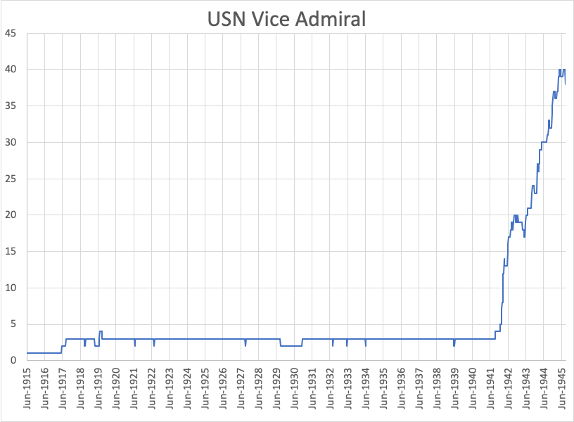
16 at time of Midway
3 for WW1 and interwar years (Act of 22 May 1917)

Slide 16
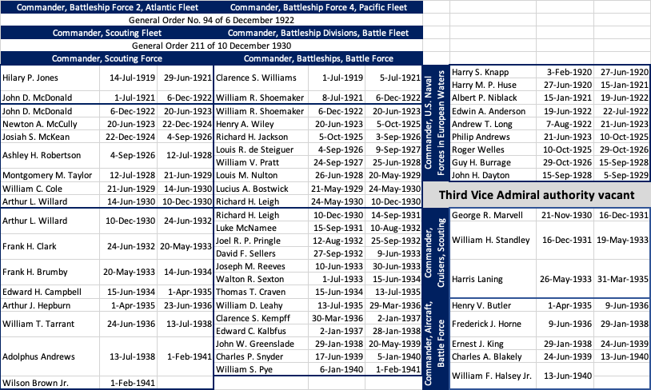
3 4-stars and 3 3-stars authorized to command fleets and major subdivisions (Act of 22 May 1917)

Slide 17
On 1 Feb 1941, US Atlantic Fleet was reestablished as a 4-star command.
The 4-star billet came from downgrading the Commander, Battle Force from 4 to 3 stars.
That would have raised the number of 3-star billets to 4. So, a 3-star billet had to drop to 2-stars.
Choices were Commander, Battleships, Battle Force then commanding 4 divisions of 12 battleships or Commander, Aircraft, Battle Force, then commanding 2 divisions of 4 carriers.
More than 10 months before Pearl Harbor, Commander, Aircraft was retained as a 3-star, while Commander, Battleships was downgraded to 2-stars
Battle Force, Pacific Fleet
Battleship Division 1 |  | Carrier Division 1
USS Pennsylvania |  | USS Lexington
USS Arizona |  | USS Saratoga
USS Nevada |  | Carrier Division 2 (Commander, Aircraft, Battle Force)
Battleship Division 2
USS Tennessee |  | USS Yorktown
USS California |  | USS Enterprise
USS Oklahoma
Battleship Division 3
USS New Mexico
USS Mississippi
USS Idaho
Battleship Division 4 (Commander, Battleships, Battle Force)
USS Colorado
USS Maryland
USS West Virginia
Atlantic Fleet
Battleship Division 5 |  | Carrier Division 3
USS New York |  | USS Ranger
USS Texas |  | USS Wasp
USS Arkansas
525,000 tons
135,000 tons

Slide 18
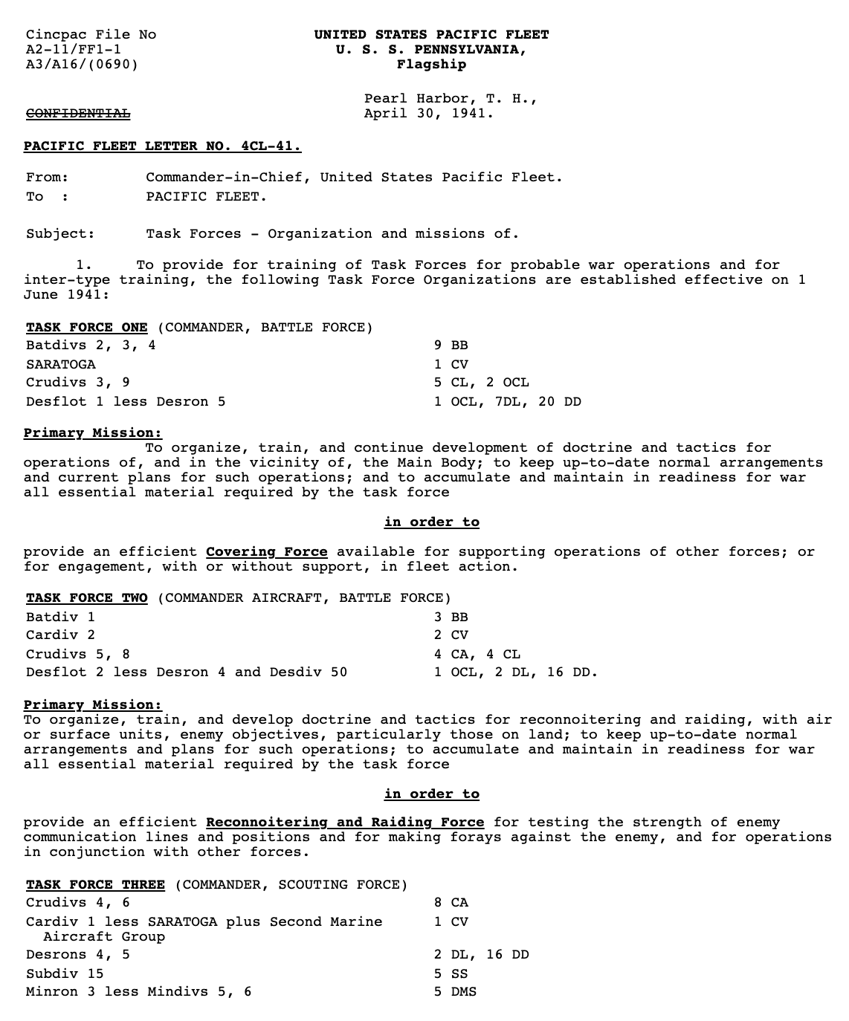
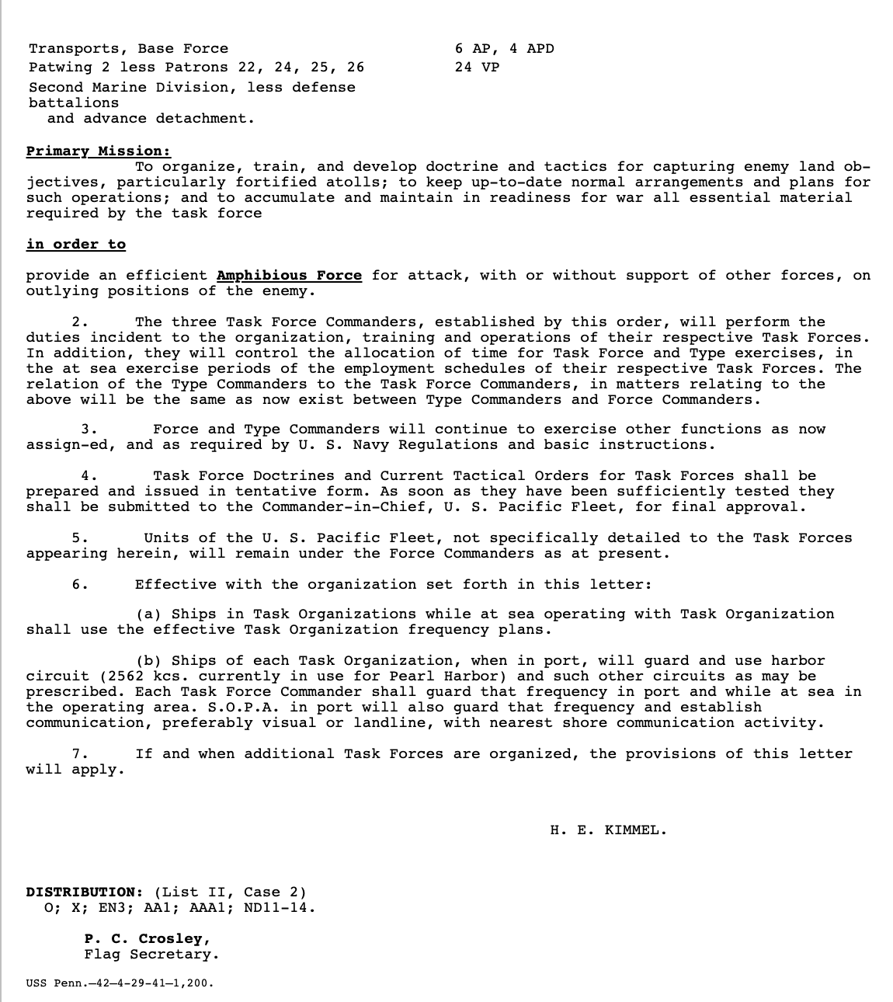

Slide 19
Task Force ONE: VADM Pye

Slide 20
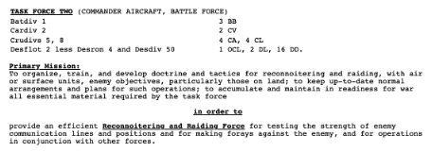
Task Force TWO: VADM Halsey

Slide 21
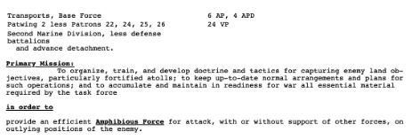
Task Force THREE: VADM Brown

Slide 22
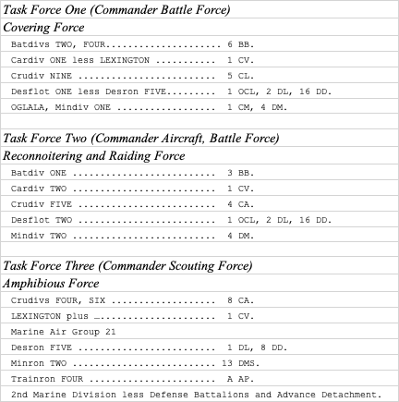
31-Oct-41

Slide 23
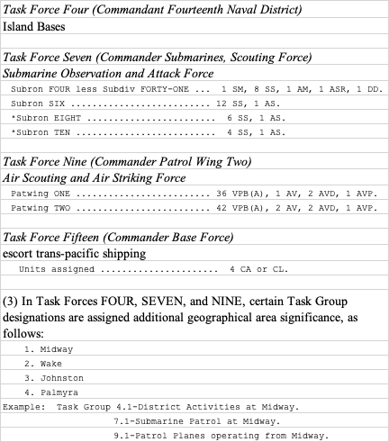
31-Oct-41

Slide 24
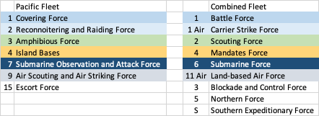
Comparison isn’t perfect—reflects similar maritime requirements

Slide 25
Conclusions from USN preparations
Why put battleships, carriers, and cruisers in TF 1, 2, and 3?
These TFs had very different roles, but the ships were divided among them.
Japan was centralizing carriers just as the US was distributing them.
But, at the time, 12 new carriers were under construction or funded, as were 8 fast battleships and plenty of cruisers. The point of the TFs was to prepare and each was able to experiment with a range of ships to facilitate distribution when more assets arrived.
Battleships had already been displaced by carriers well before Pearl Harbor.
USN and IJN had similar roles for subordinate forces.

Slide 26
Outline
IJN organization
Kantai and Sentai (”ship group” or Fleet and “battle group”)
Battle; Amphibious; Mobile Striking; Land-based Air; Submarines; Geographic
USN organization
Pacific Fleet in 1941-42
Battle (Cover); Scouting (Amphibious); Scouting and Raiding; Maritime Patrol; Submarines
Midway
Roles of the “Kantai”
Conclusions

Slide 27
Japanese forces
39 Kantai and Sentai commanders at time of Midway
All commanded by flag officers
36 were in the Combined Fleet (Rengo Kantai)
27 are on many Midway OOBs
Appears complex, but
4 in Mobile Striking Group (1st Air Kantai)
7 in Amphibious Force (2nd Kantai)
(these 11 include 3 destroyer Sentai)

Slide 28
Main Participants
Nagumo
1st Air Kantai (Carrier Strike Force)
Fletcher
Carrier Task Forces 16 & 17
Kondo
2nd Kantai (Amphibious Force)
Midway Defenses
TG 4.1, 9.1
+individual submarines
+US maritime patrol

Slide 29
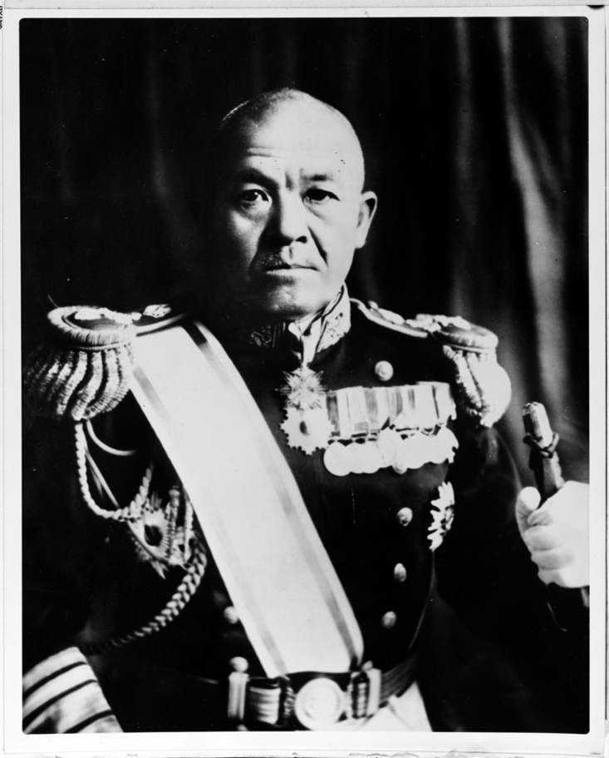
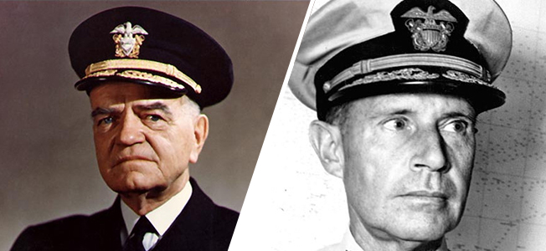
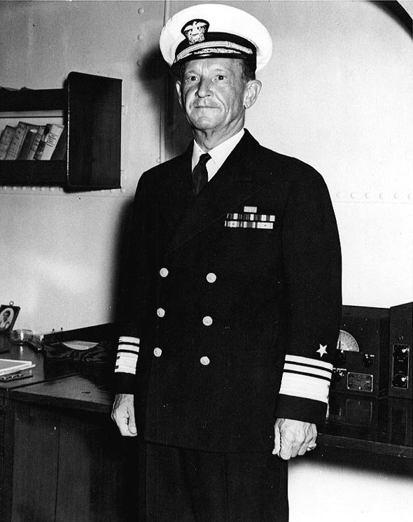
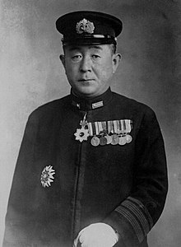
Carrier striking Forces
Conflicting vs single focus mission requirements
Integrated vs distributed multi-carrier operations
He who strikes first wins
Hornet air operations
Non-aviator admirals
X
Halsey Spruance
Nagumo
Decisive Operations
Fletcher
Yamaguchi

Slide 30
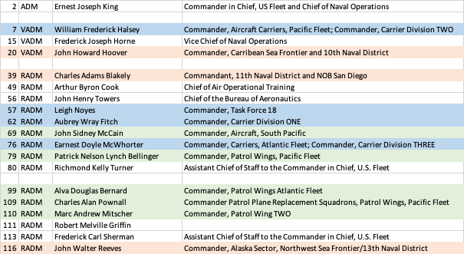
USN Aviator Admirals on 30 June 1942

Slide 31
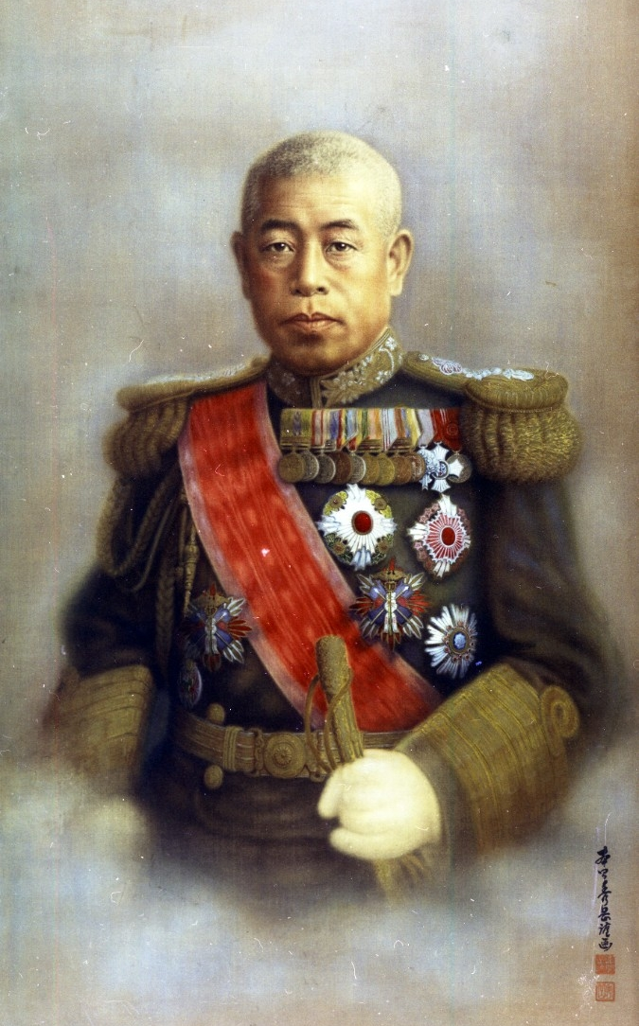
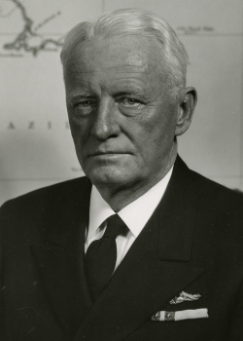
Fleet Commanders-in-Chief
At sea (radio silence) vs in a building at Pearl Harbor
Note, CINCPACFLT moved into building because of PH
Cryptology
Deception
Submarines/Land-based Air
Reconnaissance
Overconfidence vs. growing confidence
Nimitz had two objectives--defend Hawaii and defend SLOC to Australia.
Admiral Isoroku Yamamoto
Naval History and Heritage Command
Admiral Chester W. Nimitz
Naval History and Heritage Command
Nimitz won the information fight enabling the physical battle

Slide 32
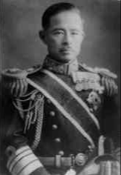
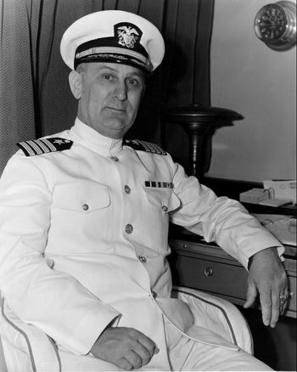
Submarines
18 IJN and 20 USN submarines participated
Submarine Cordon
DD vs sub fight led to Enterprise SBDs finding 1st Air Kantai
7th Sentai
Yorktown
Komatsu
6th Kantai
English
TF 7

Slide 33
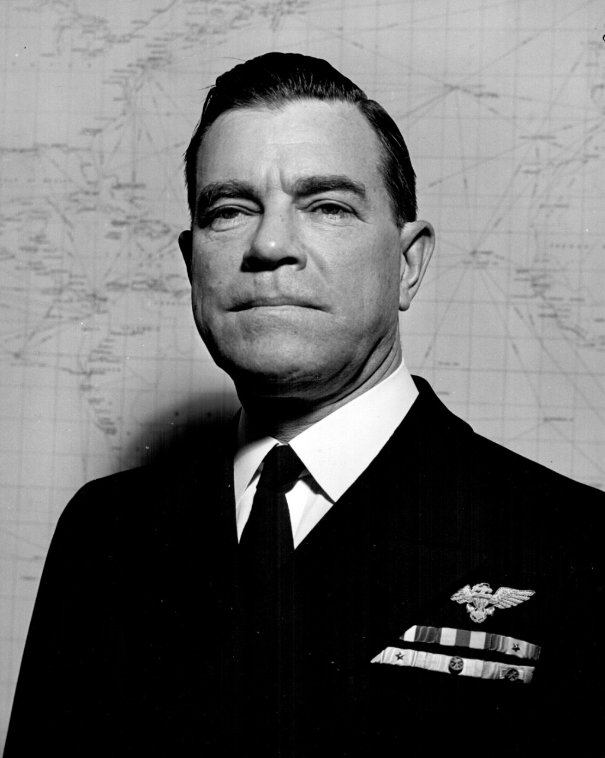
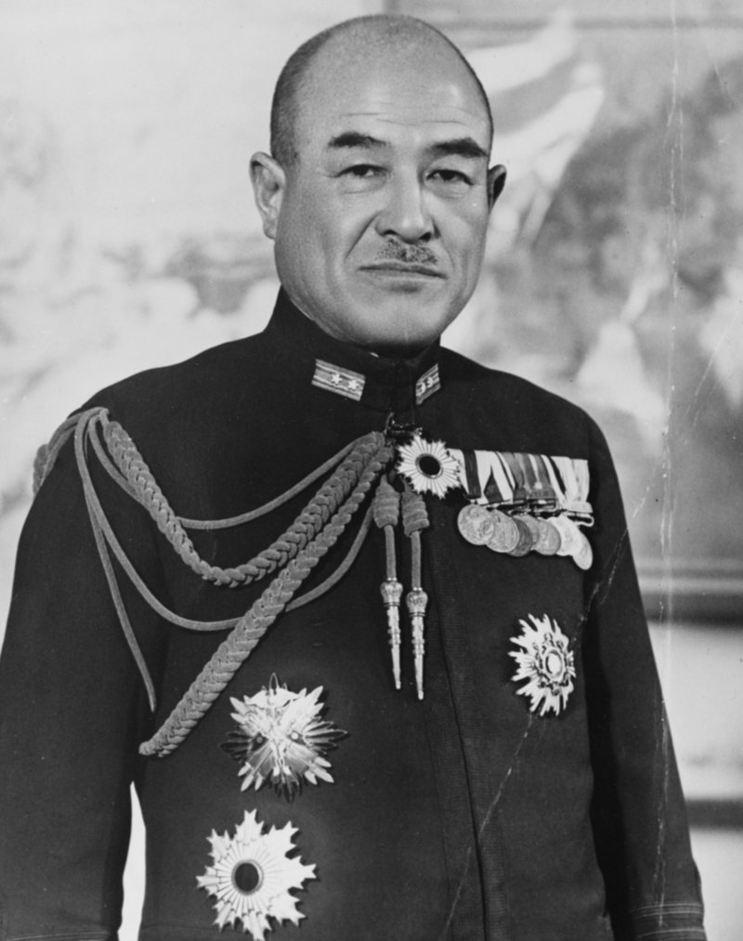
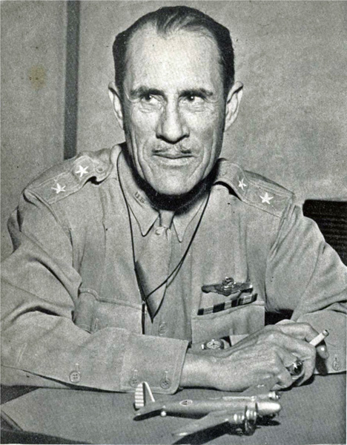
Shore-based air
Japanese Air Kantai and one Air Sentai usually listed in OOBs
However, only two flying boats (and potentially the fighters in the carrier hangars) had any means of impacting the battle.
US shore-based air only counted if at Midway, but many assets in Hawaii could have an impact
French Frigate Shores
Bellinger Patrol Wing TWO, Task Force 9
Tsukahara
11th Air Kantai
Tinker, 7th Air Force

Slide 34
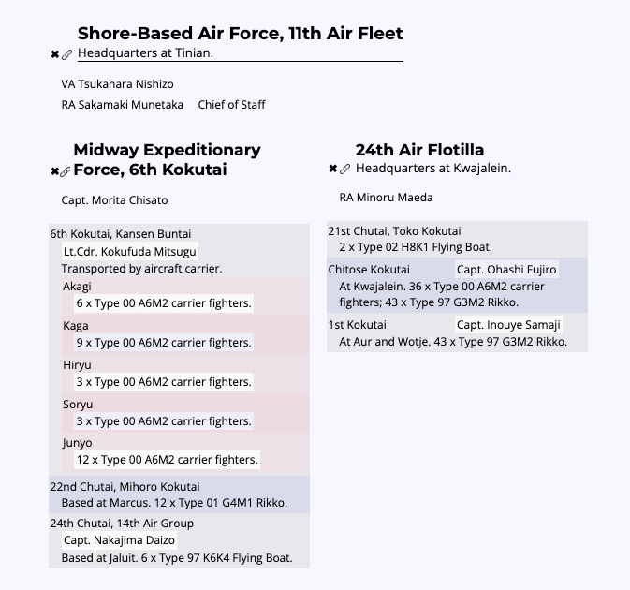
Cannot reach fight
Cannot reach fight

Slide 35
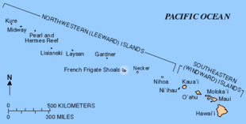
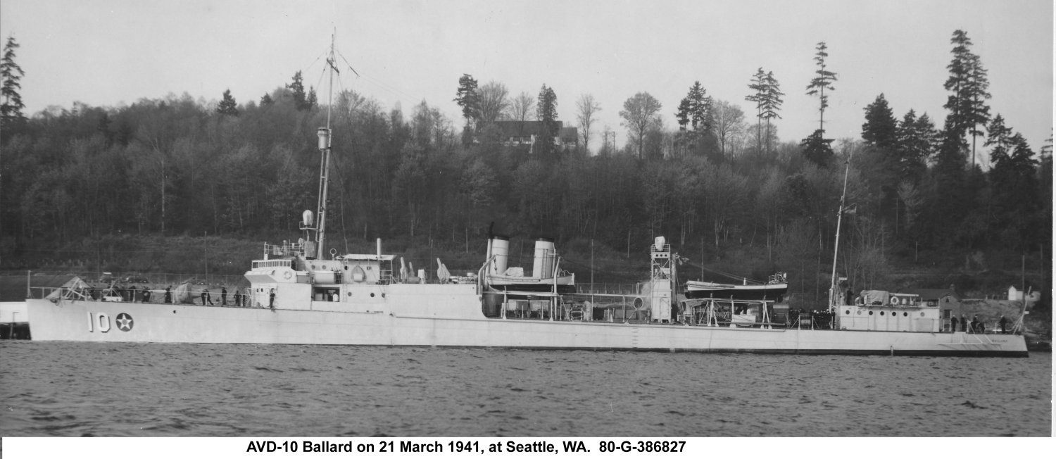

Slide 36
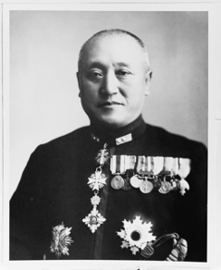
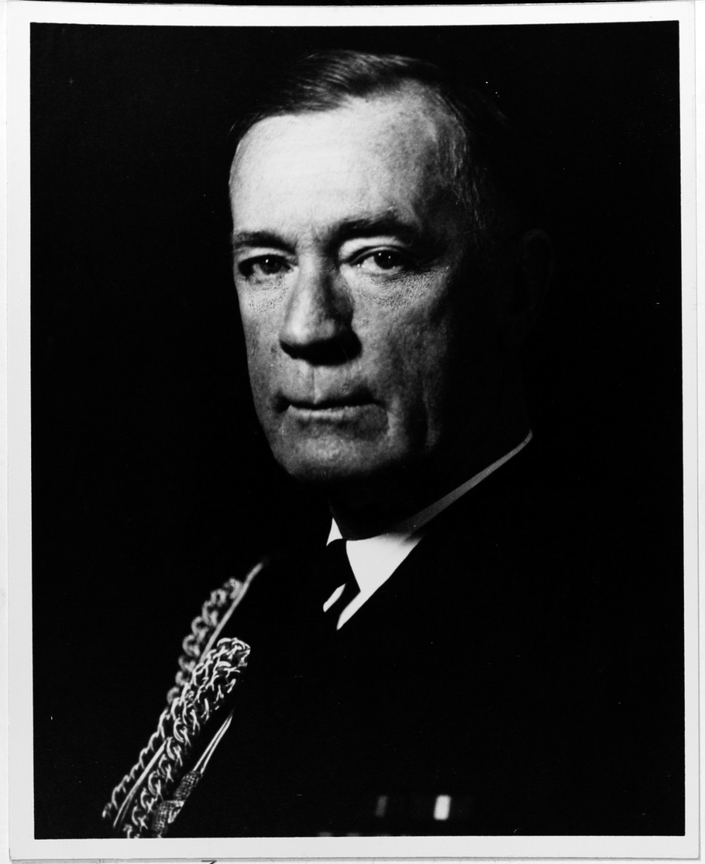
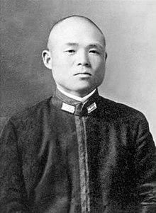
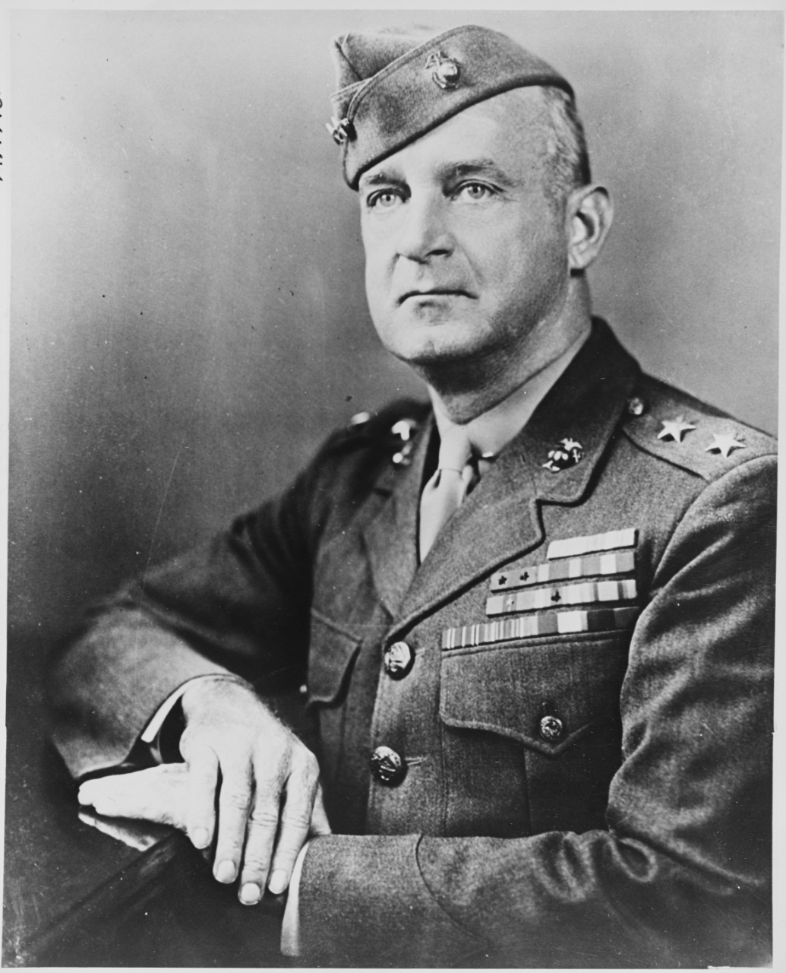
Amphibious Forces - different focus and geography
Complicated
Kondo (2nd Kantai) commanded the amphibious force at Midway
7 Sentai (3rd, 4th, 5th, 7th, 2nd destroyer, 4th destroyer, 11th air)
Amphibious ships (12 AP, 3 APD)
Special Naval Landing Forces and Ichiki 28th Regiment
Primary opponents were the task groups at Midway from TG 4.1, 7.1, and 9.1 and the carrier forces (CTF 16, 17)
Brown (Commander, Amphibious Force, Pacific Fleet) was not sent to Midway
Employed in moving forces to the South Pacific
Keeping SLOC to Australia Open (Pacific Fleet’s #2 priority)
Primary opponent was 4th Kantai
Kondo
Brown
Captain Ōta Minoru
Vandegrift

Slide 37
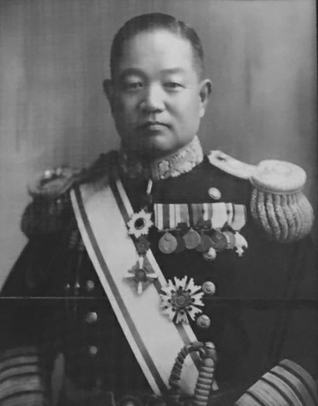
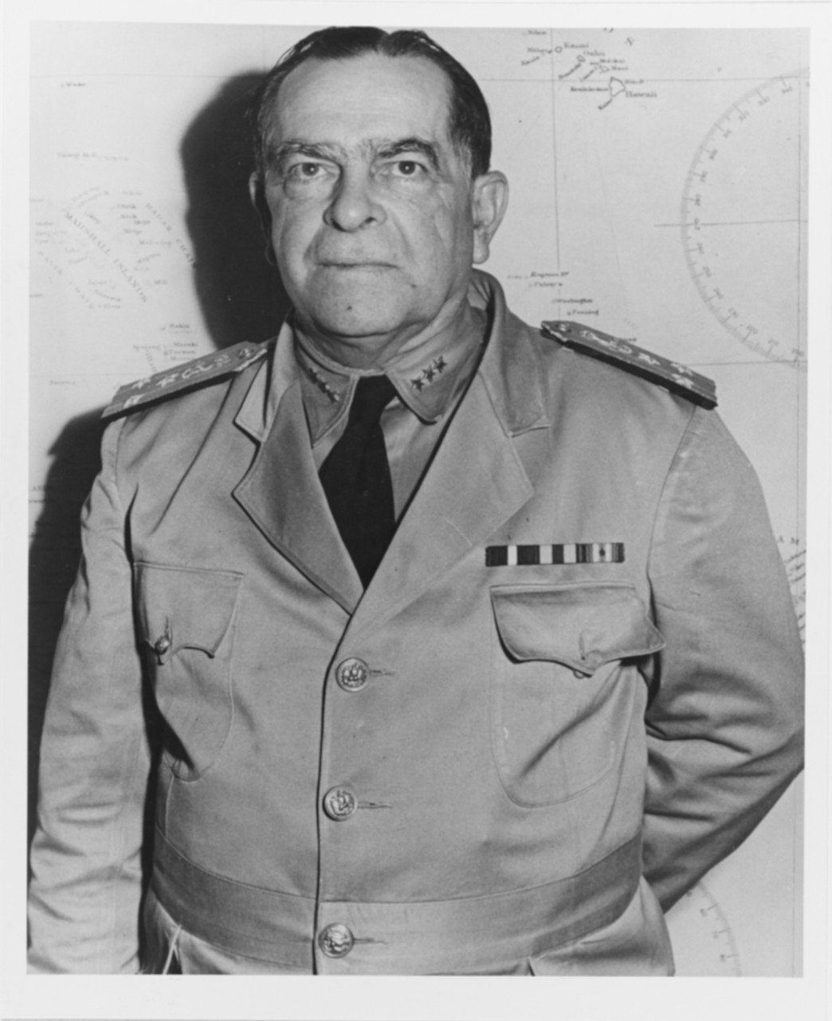
Cover Forces
Least relevant of the major forces on each side
Generally counted on the Japanese side
4 fast battleships (2 each in 1st Air Kantai and 2nd Kantai) were relevant
Generally, to the rear in case enemy gets behind the fleet
1st Kantai not used prior to Midway in the War, awaiting the opportunity for a climatic naval battle.
Deployed in Midway campaign in the hopes of that battle
Myth that Pearl Harbor forced USN to rely on aircraft carriers vice battleships—very quickly US had seven available long before Midway, but generally not used anyway.
Takasu
1st Kantai
Pye
Battle Force

Slide 38
16 at time of Midway
3 for WW1 and interwar years (Act of 22 May 1917)

Slide 39
3 4-stars and 3 3-stars authorized to command fleets and major subdivisions (Act of 22 May 1917)

Slide 40
On 1 Feb 1941, US Atlantic Fleet was reestablished as a 4-star command.
The 4-star billet came from downgrading the Commander, Battle Force from 4 to 3 stars.
That would have raised the number of 3-star billets to 4. So, a 3-star billet had to drop to 2-stars.
Choices were Commander, Battleships, Battle Force then commanding 4 divisions of 12 battleships or Commander, Aircraft, Battle Force, then commanding 2 divisions of 4 carriers.
More than 10 months before Pearl Harbor, Commander, Aircraft was retained as a 3-star, while Commander, Battleships was downgraded to 2-stars
Battle Force, Pacific Fleet
Battleship Division 1 |  | Carrier Division 1
USS Pennsylvania |  | USS Lexington
USS Arizona |  | USS Saratoga
USS Nevada |  | Carrier Division 2 (Commander, Aircraft, Battle Force)
Battleship Division 2
USS Tennessee |  | USS Yorktown
USS California |  | USS Enterprise
USS Oklahoma
Battleship Division 3
USS New Mexico
USS Mississippi
USS Idaho
Battleship Division 4 (Commander, Battleships, Battle Force)
USS Colorado
USS Maryland
USS West Virginia
Atlantic Fleet
Battleship Division 5 |  | Carrier Division 3
USS New York |  | USS Ranger
USS Texas |  | USS Wasp
USS Arkansas
525,000 tons
135,000 tons

Slide 41
What about Japan’s geographic Kantai?
Southwest Area Kantai
1st Southern Expeditionary Kantai (Singapore)
2nd Southern Expeditionary Kantai (Surabaya)
3rd Southern Expeditionary Kantai (Manila)
4th Kantai in the Mandates (Truk, Palau, Marshalls, Gilberts, Marianas, Wake, New Britain) focused on approaching Australia
5th Kantai (Northern Force)—usually included in the Midway OOB and significantly reinforced for Aleutian operations

Slide 42
In traditional Midway OOBs
 | Total | Midway OOB | Elsewhere
Battleships | 11 | 11
Heavy Cruiser | 18 | 13 | 5
Light Cruiser | 20 | 10 | 10

Slide 43
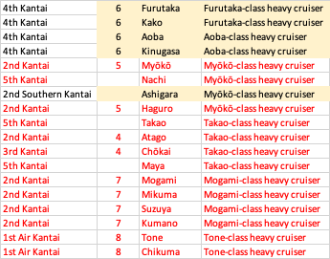
Japanese heavy cruisers
red font = on traditional Midway OOB
yellow shade = dry docked during Midway

Slide 44
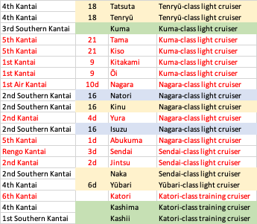
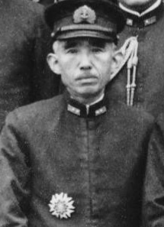
Japanese light cruisers
red font = on traditional Midway OOB
yellow shade = dry docked during Midway
green shade = listed as guard ship at a harbor
blue shade = active (Natori and Isuzu in 16th Sendai in the 2nd Southern Kantai
Takahashi

Slide 45
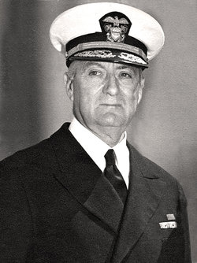
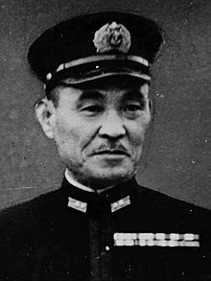
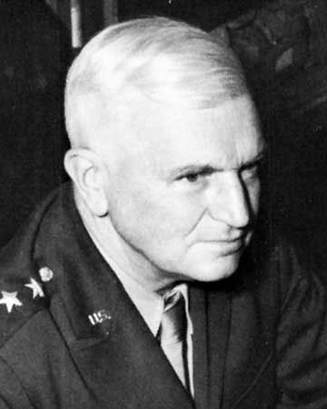
North Pacific
5th Kantai reinforced
21st Sentai
22nd Sentai
reinforcements:
4th Air Sentai
1st Destroyer Sentai
1st Submarine Sentai
Cruisers Nachi, Maya, Takao
3 APs; SNLF, Army, Laborers
Cruisers: Indianapolis, Louisville, Nashville, Honolulu, St. Louis
13 destroyers
PG-51 Charleston
6 submarines
PATWING 4 (40 PBY)
Army Air Forces
3 BS; 7 PS
Theobald
TF 8
Hosogaya
5th Kantai
Buckner

Slide 46
Why 5th Kantai into the Aleutians?
Diversion?
Take Islands?

Slide 47
 | Midway | Dutch Harbor | Kure | Pearl Harbor | French Frigate Shoals
Kure | 2,568 | 2,775 | 0 | 3,700 | 3,230
Guam | 2,290 | 3,333 | 1,413 | 3,299 | 2,847
Tokyo | 2,216 | 2,465 | 359 | 3,345 | 2,877
Yokosuka | 2,215 | 2,480 | 356 | 3,345 | 2,877
Tinian | 2,200 | 3,225 | 1,353 | 3,223 | 2,767
Saipan | 2,189 | 3,212 | 1,347 | 3,214 | 2,757
Ominato | 2,166 | 2,192 | 585 | 3,271 | 2,818
Marcus | 1,556 | 2,501 | 1,266 | 2,652 | 2,178
Jaluit | 1,524 | 3,098 | 2,655 | 2,100 | 1,760
Kwajalein | 1,441 | 2,980 | 2,467 | 2,122 | 1,749
Aur | 1,369 | 2,948 | 2,631 | 1,961 | 1,610
Wotje | 1,332 | 2,895 | 2,537 | 1,981 | 1,613
Wake | 1,026 | 2,415 | 2,021 | 1,992 | 1,540
Midway | 0 | 1,613 | 2,568 | 1,134
Dutch Harbor | 1,613 | 0 | 2,775 | 1,992
French Frigate Shoals | 662 | 1,809 | 3,230 | 477
Pearl Harbor | 1,134 | 1,992 | 3,700 | 0
San Francisco | 2,784 | 2,039 | 4,794 | 2,082
San Diego | 3,084 | 2,435 | 5,183 | 2,268
Seattle | 2,784 | 1,691 | 4,459 | 2,328
Kodiak | 2,060 | 529 | 3,231 | 2,200

Slide 48
To Aleutians (Pearl Harbor to Dutch Harbor)

Slide 49
Was it a diversion?
attack on Dutch Harbor: 3-Jun-1942 07:00
time to build steam: 4 hrs
speed to Dutch Harbor: 18 kts
attack on Midway: 4-Jun-1942 07:00
Started with assumptions

Slide 50
Was it a diversion?
attack on Dutch Harbor: 3-Jun-1942 07:00
time to build steam: 4 hrs
speed to Dutch Harbor: 18 kts
attack on Midway: 4-Jun-1942 07:00
distance from Midway: 360 nmi
Where is the task force now?

Slide 51
Was it a diversion?
attack on Dutch Harbor: 3-Jun-1942 07:00
time to build steam: 4 hrs
speed to Dutch Harbor: 18 kts
attack on Midway: 4-Jun-1942 07:00
distance from Midway: 360 nmi
new speed: 20 kts

Slide 52
Was it a diversion?
attack on Dutch Harbor: 3-Jun-1942 07:00
time to build steam: 4 hrs
speed to Dutch Harbor: 18 kts
attack on Midway: 4-Jun-1942 07:00
distance from Midway: 360 nmi
new speed: 20 kts
time: 11.9 hrs

Slide 53
Was it a diversion?
attack on Dutch Harbor: 3-Jun-1942 07:00
time to build steam: 4 hrs
speed to Dutch Harbor: 18 kts
attack on Midway: 4-Jun-1942 07:00
distance from Midway: 360 nmi
new speed: 20 kts
time: 11.9 hrs
time to Midway from attack on Dutch Harbor: 48.8 hrs

Slide 54
Was it a diversion?
attack on Dutch Harbor: 3-Jun-1942 07:00
time to build steam: 4 hrs
speed to Dutch Harbor: 18 kts
attack on Midway: 4-Jun-1942 07:00
distance from Midway: 360 nmi
new speed: 20 kts
time: 11.9 hrs
time to Midway from attack on Dutch Harbor: 48.8 hrs
arrival at Midway: 6-Jun 07:45 (11.9 hours earlier)
Right in the middle of the planned landings

Slide 55
Parameterizing the assumptions
Build steam | knots | dist | new lat | new lon | dist to Midway | 16 kts | 18 kts | 20 kts | 22 kts | 24 kts
0 hrs | 16 kts | 384 nmi | 27.65 | -159.10 | 968 nmi | 60.5 hrs | 53.8 hrs | 48.4 hrs | 44.0 hrs | 40.3 hrs
0 hrs | 18 kts | 432 nmi | 28.44 | -159.26 | 956 nmi | 59.8 hrs | 53.1 hrs | 47.8 hrs | 43.5 hrs | 39.8 hrs
0 hrs | 20 kts | 480 nmi | 29.22 | -159.41 | 946 nmi | 59.1 hrs | 52.6 hrs | 47.3 hrs | 43.0 hrs | 39.4 hrs
0 hrs | 22 kts | 528 nmi | 30.01 | -159.57 | 939 nmi | 58.7 hrs | 52.1 hrs | 46.9 hrs | 42.7 hrs | 39.1 hrs
0 hrs | 24 kts | 576 nmi | 30.80 | -159.73 | 933 nmi | 58.3 hrs | 51.9 hrs | 46.7 hrs | 42.4 hrs | 38.9 hrs
2 hrs | 16 kts | 352 nmi | 27.13 | -159.00 | 978 nmi | 61.1 hrs | 54.3 hrs | 48.9 hrs | 44.4 hrs | 40.7 hrs
2 hrs | 18 kts | 396 nmi | 27.85 | -159.14 | 965 nmi | 60.3 hrs | 53.6 hrs | 48.3 hrs | 43.9 hrs | 40.2 hrs
2 hrs | 20 kts | 440 nmi | 28.57 | -159.28 | 954 nmi | 59.6 hrs | 53.0 hrs | 47.7 hrs | 43.4 hrs | 39.8 hrs
2 hrs | 22 kts | 484 nmi | 29.29 | -159.42 | 946 nmi | 59.1 hrs | 52.5 hrs | 47.3 hrs | 43.0 hrs | 39.4 hrs
2 hrs | 24 kts | 528 nmi | 30.01 | -159.57 | 939 nmi | 58.7 hrs | 52.1 hrs | 46.9 hrs | 42.7 hrs | 39.1 hrs
4 hrs | 16 kts | 320 nmi | 26.60 | -158.90 | 988 nmi | 61.7 hrs | 54.9 hrs | 49.4 hrs | 44.9 hrs | 41.2 hrs
4 hrs | 18 kts | 360 nmi | 27.26 | -159.03 | 975 nmi | 60.9 hrs | 54.2 hrs | 48.8 hrs | 44.3 hrs | 40.6 hrs
4 hrs | 20 kts | 400 nmi | 27.91 | -159.15 | 964 nmi | 60.2 hrs | 53.6 hrs | 48.2 hrs | 43.8 hrs | 40.2 hrs
4 hrs | 22 kts | 440 nmi | 28.57 | -159.28 | 954 nmi | 59.6 hrs | 53.0 hrs | 47.7 hrs | 43.4 hrs | 39.8 hrs
4 hrs | 24 kts | 480 nmi | 29.22 | -159.41 | 946 nmi | 59.1 hrs | 52.6 hrs | 47.3 hrs | 43.0 hrs | 39.4 hrs
6 hrs | 16 kts | 288 nmi | 26.08 | -158.80 | 999 nmi | 62.4 hrs | 55.5 hrs | 49.9 hrs | 45.4 hrs | 41.6 hrs
6 hrs | 18 kts | 324 nmi | 26.67 | -158.91 | 986 nmi | 61.7 hrs | 54.8 hrs | 49.3 hrs | 44.8 hrs | 41.1 hrs
6 hrs | 20 kts | 360 nmi | 27.26 | -159.03 | 975 nmi | 60.9 hrs | 54.2 hrs | 48.8 hrs | 44.3 hrs | 40.6 hrs
6 hrs | 22 kts | 396 nmi | 27.85 | -159.14 | 965 nmi | 60.3 hrs | 53.6 hrs | 48.3 hrs | 43.9 hrs | 40.2 hrs
6 hrs | 24 kts | 432 nmi | 28.44 | -159.26 | 956 nmi | 59.8 hrs | 53.1 hrs | 47.8 hrs | 43.5 hrs | 39.8 hrs
8 hrs | 16 kts | 256 nmi | 25.55 | -158.70 | 1,011 nmi | 63.2 hrs | 56.2 hrs | 50.5 hrs | 45.9 hrs | 42.1 hrs
8 hrs | 18 kts | 288 nmi | 26.08 | -158.80 | 999 nmi | 62.4 hrs | 55.5 hrs | 49.9 hrs | 45.4 hrs | 41.6 hrs
8 hrs | 20 kts | 320 nmi | 26.60 | -158.90 | 988 nmi | 61.7 hrs | 54.9 hrs | 49.4 hrs | 44.9 hrs | 41.2 hrs
8 hrs | 22 kts | 352 nmi | 27.13 | -159.00 | 978 nmi | 61.1 hrs | 54.3 hrs | 48.9 hrs | 44.4 hrs | 40.7 hrs
8 hrs | 24 kts | 384 nmi | 27.65 | -159.10 | 968 nmi | 60.5 hrs | 53.8 hrs | 48.4 hrs | 44.0 hrs | 40.3 hrs

Slide 56
Build steam | knots | dist | new lat | new lon | dist to Midway | 16 kts | 18 kts | 20 kts | 22 kts | 24 kts
0 hrs | 16 kts | 384 nmi | 27.65 | -159.10 | 968 nmi | 6-Jun 19:31 | 6-Jun 12:47 | 6-Jun 07:24 | 6-Jun 03:00 | 5-Jun 23:20
0 hrs | 18 kts | 432 nmi | 28.44 | -159.26 | 956 nmi | 6-Jun 18:45 | 6-Jun 12:07 | 6-Jun 06:48 | 6-Jun 02:27 | 5-Jun 22:50
0 hrs | 20 kts | 480 nmi | 29.22 | -159.41 | 946 nmi | 6-Jun 18:08 | 6-Jun 11:34 | 6-Jun 06:18 | 6-Jun 02:00 | 5-Jun 22:25
0 hrs | 22 kts | 528 nmi | 30.01 | -159.57 | 939 nmi | 6-Jun 17:39 | 6-Jun 11:08 | 6-Jun 05:55 | 6-Jun 01:39 | 5-Jun 22:06
0 hrs | 24 kts | 576 nmi | 30.80 | -159.73 | 933 nmi | 6-Jun 17:19 | 6-Jun 10:51 | 6-Jun 05:39 | 6-Jun 01:25 | 5-Jun 21:53
2 hrs | 16 kts | 352 nmi | 27.13 | -159.00 | 978 nmi | 6-Jun 20:05 | 6-Jun 13:18 | 6-Jun 07:52 | 6-Jun 03:26 | 5-Jun 23:43
2 hrs | 18 kts | 396 nmi | 27.85 | -159.14 | 965 nmi | 6-Jun 19:18 | 6-Jun 12:36 | 6-Jun 07:15 | 6-Jun 02:51 | 5-Jun 23:12
2 hrs | 20 kts | 440 nmi | 28.57 | -159.28 | 954 nmi | 6-Jun 18:38 | 6-Jun 12:01 | 6-Jun 06:43 | 6-Jun 02:22 | 5-Jun 22:45
2 hrs | 22 kts | 484 nmi | 29.29 | -159.42 | 946 nmi | 6-Jun 18:05 | 6-Jun 11:31 | 6-Jun 06:16 | 6-Jun 01:58 | 5-Jun 22:23
2 hrs | 24 kts | 528 nmi | 30.01 | -159.57 | 939 nmi | 6-Jun 17:39 | 6-Jun 11:08 | 6-Jun 05:55 | 6-Jun 01:39 | 5-Jun 22:06
4 hrs | 16 kts | 320 nmi | 26.60 | -158.90 | 988 nmi | 6-Jun 20:44 | 6-Jun 13:52 | 6-Jun 08:23 | 6-Jun 03:53 | 6-Jun 00:09
4 hrs | 18 kts | 360 nmi | 27.26 | -159.03 | 975 nmi | 6-Jun 19:56 | 6-Jun 13:10 | 6-Jun 07:45 | 6-Jun 03:19 | 5-Jun 23:37
4 hrs | 20 kts | 400 nmi | 27.91 | -159.15 | 964 nmi | 6-Jun 19:14 | 6-Jun 12:33 | 6-Jun 07:11 | 6-Jun 02:49 | 5-Jun 23:09
4 hrs | 22 kts | 440 nmi | 28.57 | -159.28 | 954 nmi | 6-Jun 18:38 | 6-Jun 12:01 | 6-Jun 06:43 | 6-Jun 02:22 | 5-Jun 22:45
4 hrs | 24 kts | 480 nmi | 29.22 | -159.41 | 946 nmi | 6-Jun 18:08 | 6-Jun 11:34 | 6-Jun 06:18 | 6-Jun 02:00 | 5-Jun 22:25
6 hrs | 16 kts | 288 nmi | 26.08 | -158.80 | 999 nmi | 6-Jun 21:25 | 6-Jun 14:29 | 6-Jun 08:56 | 6-Jun 04:24 | 6-Jun 00:37
6 hrs | 18 kts | 324 nmi | 26.67 | -158.91 | 986 nmi | 6-Jun 20:39 | 6-Jun 13:48 | 6-Jun 08:19 | 6-Jun 03:50 | 6-Jun 00:06
6 hrs | 20 kts | 360 nmi | 27.26 | -159.03 | 975 nmi | 6-Jun 19:56 | 6-Jun 13:10 | 6-Jun 07:45 | 6-Jun 03:19 | 5-Jun 23:37
6 hrs | 22 kts | 396 nmi | 27.85 | -159.14 | 965 nmi | 6-Jun 19:18 | 6-Jun 12:36 | 6-Jun 07:15 | 6-Jun 02:51 | 5-Jun 23:12
6 hrs | 24 kts | 432 nmi | 28.44 | -159.26 | 956 nmi | 6-Jun 18:45 | 6-Jun 12:07 | 6-Jun 06:48 | 6-Jun 02:27 | 5-Jun 22:50
8 hrs | 16 kts | 256 nmi | 25.55 | -158.70 | 1,011 nmi | 6-Jun 22:10 | 6-Jun 15:09 | 6-Jun 09:32 | 6-Jun 04:56 | 6-Jun 01:07
8 hrs | 18 kts | 288 nmi | 26.08 | -158.80 | 999 nmi | 6-Jun 21:25 | 6-Jun 14:29 | 6-Jun 08:56 | 6-Jun 04:24 | 6-Jun 00:37
8 hrs | 20 kts | 320 nmi | 26.60 | -158.90 | 988 nmi | 6-Jun 20:44 | 6-Jun 13:52 | 6-Jun 08:23 | 6-Jun 03:53 | 6-Jun 00:09
8 hrs | 22 kts | 352 nmi | 27.13 | -159.00 | 978 nmi | 6-Jun 20:05 | 6-Jun 13:18 | 6-Jun 07:52 | 6-Jun 03:26 | 5-Jun 23:43
8 hrs | 24 kts | 384 nmi | 27.65 | -159.10 | 968 nmi | 6-Jun 19:31 | 6-Jun 12:47 | 6-Jun 07:24 | 6-Jun 03:00 | 5-Jun 23:20
933 to 1,011 nmi from Midway
5 June 21:53 to 6 Jun 22:10

Slide 57
Build steam | knots | 16 kts | 18 kts | 20 kts | 22 kts | 24 kts
0 hrs | 16 kts | 10.3 hrs | 9.2 hrs | 8.3 hrs | 7.5 hrs | 6.9 hrs
0 hrs | 18 kts | 11.1 hrs | 9.9 hrs | 8.9 hrs | 8.1 hrs | 7.4 hrs
0 hrs | 20 kts | 11.7 hrs | 10.4 hrs | 9.4 hrs | 8.5 hrs | 7.8 hrs
0 hrs | 22 kts | 12.2 hrs | 10.8 hrs | 9.8 hrs | 8.9 hrs | 8.1 hrs
0 hrs | 24 kts | 12.5 hrs | 11.1 hrs | 10.0 hrs | 9.1 hrs | 8.4 hrs
2 hrs | 16 kts | 11.8 hrs | 10.7 hrs | 9.8 hrs | 9.1 hrs | 8.5 hrs
2 hrs | 18 kts | 12.5 hrs | 11.4 hrs | 10.4 hrs | 9.7 hrs | 9.0 hrs
2 hrs | 20 kts | 13.2 hrs | 12.0 hrs | 11.0 hrs | 10.2 hrs | 9.5 hrs
2 hrs | 22 kts | 13.8 hrs | 12.5 hrs | 11.4 hrs | 10.6 hrs | 9.8 hrs
2 hrs | 24 kts | 14.2 hrs | 12.8 hrs | 11.8 hrs | 10.9 hrs | 10.1 hrs
4 hrs | 16 kts | 13.1 hrs | 12.1 hrs | 11.3 hrs | 10.6 hrs | 10.1 hrs
4 hrs | 18 kts | 13.9 hrs | 12.8 hrs | 11.9 hrs | 11.2 hrs | 10.6 hrs
4 hrs | 20 kts | 14.6 hrs | 13.4 hrs | 12.5 hrs | 11.7 hrs | 11.1 hrs
4 hrs | 22 kts | 15.2 hrs | 14.0 hrs | 13.0 hrs | 12.2 hrs | 11.5 hrs
4 hrs | 24 kts | 15.7 hrs | 14.4 hrs | 13.4 hrs | 12.5 hrs | 11.8 hrs
6 hrs | 16 kts | 14.4 hrs | 13.5 hrs | 12.7 hrs | 12.1 hrs | 11.6 hrs
6 hrs | 18 kts | 15.2 hrs | 14.2 hrs | 13.4 hrs | 12.7 hrs | 12.1 hrs
6 hrs | 20 kts | 15.9 hrs | 14.8 hrs | 13.9 hrs | 13.2 hrs | 12.6 hrs
6 hrs | 22 kts | 16.5 hrs | 15.4 hrs | 14.4 hrs | 13.7 hrs | 13.0 hrs
6 hrs | 24 kts | 17.1 hrs | 15.9 hrs | 14.9 hrs | 14.1 hrs | 13.4 hrs
8 hrs | 16 kts | 15.7 hrs | 14.8 hrs | 14.2 hrs | 13.6 hrs | 13.1 hrs
8 hrs | 18 kts | 16.4 hrs | 15.5 hrs | 14.7 hrs | 14.1 hrs | 13.6 hrs
8 hrs | 20 kts | 17.1 hrs | 16.1 hrs | 15.3 hrs | 14.6 hrs | 14.1 hrs
8 hrs | 22 kts | 17.8 hrs | 16.7 hrs | 15.8 hrs | 15.1 hrs | 14.5 hrs
8 hrs | 24 kts | 18.3 hrs | 17.2 hrs | 16.3 hrs | 15.5 hrs | 14.9 hrs
US task force arrives at Midway 6.9 to 18.3 hours sooner

Slide 58
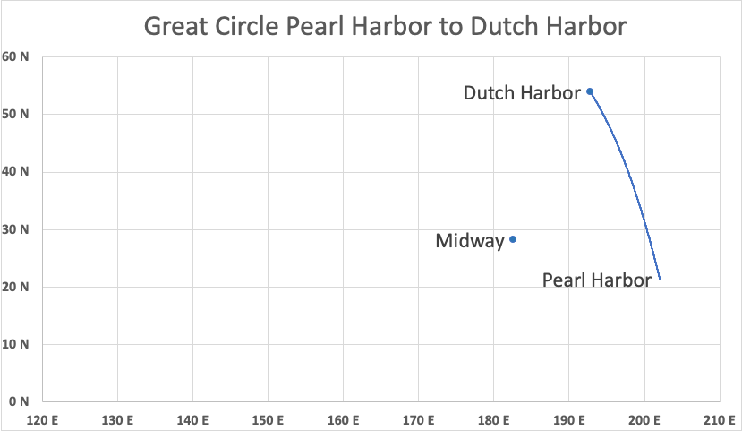
170 W 160 W 150 W

Slide 59
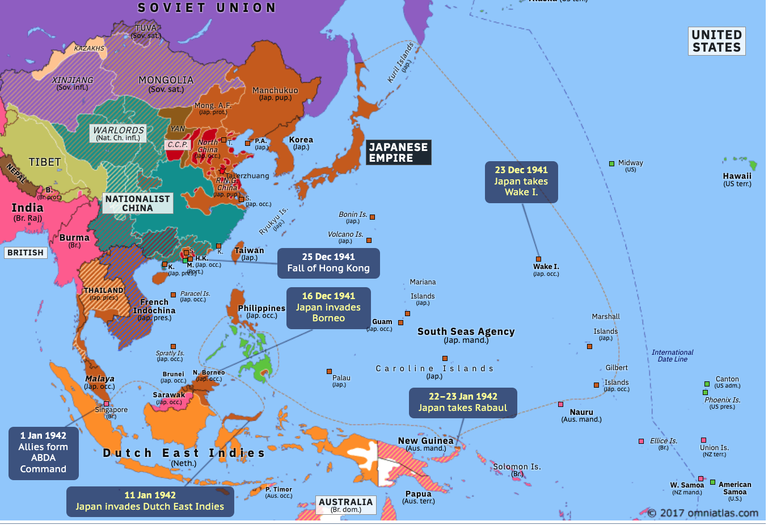
https://omniatlas.com/maps/asia-pacific/19420123/

Slide 60
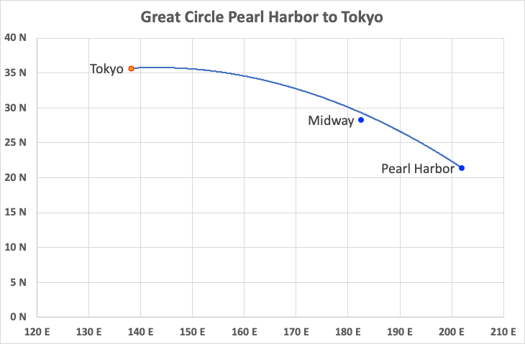
60 nmi closest approach to Midway
7 days from Pearl Harbor to Tokyo at 20 kt
170 W 160 W 150 W

Slide 61
Naval History and Heritage Command. Nashville II (CL-43)
https://www.history.navy.mil/research/histories/ship-histories/danfs/n/nashville-ii.html
4 days for TF 16 to get from “north of Midway” to the point of the B-25 launch

Slide 62
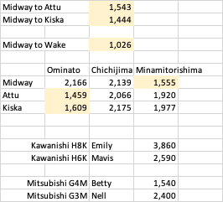

Slide 63
Outline
IJN organization
Kantai and Sentai (”ship group” or Fleet and “battle group”)
Battle; Amphibious; Mobile Striking; Land-based Air; Submarines; Geographic
USN organization
Pacific Fleet in 1941-42
Battle (Cover); Scouting (Amphibious); Scouting and Raiding; Maritime Patrol; Submarines
Midway
Roles of the “Kantai”
Conclusions

Slide 64
Conclusions
Winning the information fight contributed significantly to victory.
The relationship between Midway and the Aleutians was not because the Aleutians was a diversion for Midway, but because the approach to Japan from either was covered by the 5th Kantai—which had not had its frontiers moved forward before the campaign.
A Japanese garrison on Midway would make an approach from Pearl Harbor to Japan much more difficult.
If Japan was primarily interested in destroying carriers
Why not call it off when it was learned that the only two carriers, they believed the USN had in the Pacific, were in the South Pacific?
Why not set the trap in May with 6 fleet carriers at Coral Sea? Or at some other time?

