Slide 1
How important are superior numbers?
David Kirkpatrick
Emeritus Professor, University College London
Historical Analysis Annual Conference, September 2022

Slide 2
Quality versus Quantity
decision analysis services
A nation must strike the right balance between the quality and quantity of its armed forces.
Numerous poorly armed forces generally suffer bloody defeat.
Small forces are vulnerable to unserviceability, surprise and diseconomies of scale.
The chosen balance is set by –
Tradition and institutional inertia.
Pressure from political, military and industrial factions.
Rigorous cost-effectiveness studies, blending operational analysis and military judgement.
The ideal balance maximizes national security within an allocated budget.
Notes:
Tom

Slide 3
Victory in battle
decision analysis services
Victory can be decided in terms of the battle’s immediate results, or of its strategic/political consequences.
E.g. Antietam, Gravelotte.
The battle’s results can be assessed in terms of -
Relative losses during (and after?) battle.
Terrain won or lost.
Both measures affect the opponents’ ability to continue the war.
This analysis of the effect of superior numbers focuses on the loss ratios of land battles.
Notes:
Tom

Slide 4
Assessment of land battles
decision analysis services
In the classical and medieval periods there are no reliable data, and a battle was a series of duels between individual warriors.
Superior numbers were probably unimportant?
In modern times armies are heterogeneous.
Comparisons of combat power are complex.
In the 18th and 19th centuries armies had only three combat arms,
Deployed in similar proportions, so combat power = numbers.
Credible estimates of numbers and losses.
But short wars yield inadequate databases, and strength ratios are generally close to unity.
Notes:
Tom

Slide 5
Assessing the effect of superior numbers
decision analysis services
Omnibus review of multiple battles, 17th-19th cent.
US amphibious assaults on Pacific islands.
Affected by fortifications and bombardment.
WW2 battles in Italy and Ardennes.
Using combat power derived from the ‘lethality indices’ of various force elements.
American Civil War open-field battles.
27 by Weiss in 1966, 16 by Kirkpatrick in 1985.
All of these analyses found no clear relationship between loss ratios and strength ratios.
Notes:
Tom

Slide 6
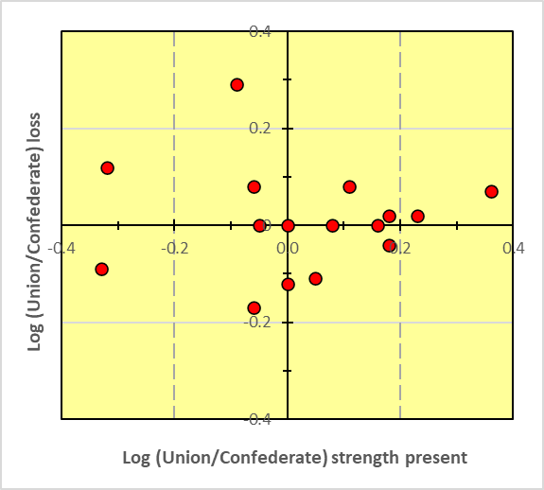
Fig 1 – U/C Loss vs U/C strength present
decision analysis services
Figure 1 shows variation of Union/Confederate (U/C) loss ratios with ratios of Union/Confederate strengths present.
Notes:
Tom

Slide 7
Lanchester’s Square Law (LSL)
decision analysis services
Lanchester’s combat model for modern warfare.
d(Blue numbers)/dt = Red Numbers R x Red effectiveness r.
Hence
Blue/Red loss = r/b x R/B.
Log (Blue/ Red loss) = log (r/b effect.) – log (B/R numbers).
The model expects Blue to be victorious if –
bB² > rR², other things being equal.
The model assumes that all Blue and Red units are in action.
Notes:
Tom

Slide 8
LSL was popular
decision analysis services
It reinforced generals’ long-standing belief in the effectiveness of superior numbers.
Admirals were less impressed.
It allowed politicians to glorify the sheer scale of their armed forces, and to ignore new-fangled weaponry.
It strengthened democrats’ faith in numerous (and ideally well-regulated) militia forces.
The LSL was widely accepted without supporting evidence, like many other theories in the social sciences.
Notes:
Tom

Slide 9
ACW is suitable for validation of LSL
decision analysis services
Armies were almost homogeneous.
Infantry inflicted most of the enemy’s losses.
There were many open-field battles.
Excluding skirmishes where loss ratios could depend on chance events and topography.
There are abundant and relatively credible data.
But battle outcomes were affected by several factors, so loss ratios were inevitably scattered.
Notes:
Tom

Slide 10
Problems with ACW data
decision analysis services
Some post-battle reports of losses were incomplete or biased.
Some strength estimates did not account for straggling.
Losses are presented as killed, wounded, prisoners and missing.
Some losses in prisoners and missing might be incurred after the battle and were determined by morale and terrain rather than firepower.
Some published battle data covered a series of engagements separated in time and space, with different strength and loss ratios.
Notes:
Tom

Slide 11
Methodology of this analysis
decision analysis services
It estimates strength ratios in terms of troops engaged.
It excludes reserves and unarmed troops.
When armies receive reinforcements, it estimates time-averaged ratios of strength engaged, where practicable.
It excludes battles where loss ratios were distorted by particular circumstances.
E.g. fortifications, training, surprise.
It updates strength and loss estimates using the latest research.
It uses strength and loss ratios for discrete and bounded engagements, rather than using a single pair of ratios for an amalgam of two or more associated engagements.
Notes:
Tom

Slide 12
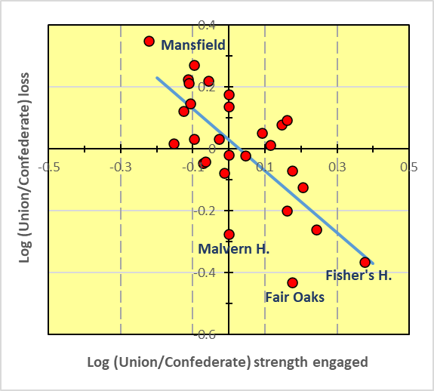
Fig 2 – U/C Loss vs U/C strength engaged
decision analysis services
Figure 2 shows variation of Union/Confederate (U/C) loss ratios with ratios of Union/Confederate strengths engaged.
Notes:
Tom

Slide 13
Earlier and later wars
decision analysis services
Seven Years War 1756-63
Campaigns of the Grande Armee 1805-07
Peninsular War 1808-13
Napoleon’s last campaign in Germany 1813
Seven Weeks War 1866
Franco-Prussian War 1870-71
These wars are less suitable for analysis than the ACW.
Some armies had heterogeneous contingents.
The number of battles was limited.
Do battle data from these wars align with the ACW?
Notes:
Tom

Slide 14
Problems in analyses of earlier wars
decision analysis services
Both cavalry and artillery were important in battle.
So armies had three significant force elements, and hence ‘strength’ should ideally be a synthesis of those elements.
Loss ratios could be drastically modified by cavalry charges on the battlefield, and by cavalry pursuit of a defeated army.
Soldiers in dynastic wars tended to surrender in large numbers.
Data on strengths and losses are less reliable.
Notes:
Tom

Slide 15
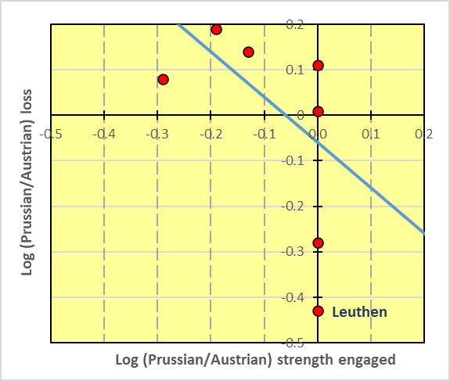
Fig 3 - P/A loss vs P/A strength engaged
decision analysis services
Figure 3 shows variation of Prussian/Austrian (P/A) loss ratios with ratios of Prussian/Austrian strengths engaged.
Notes:
Tom

Slide 16
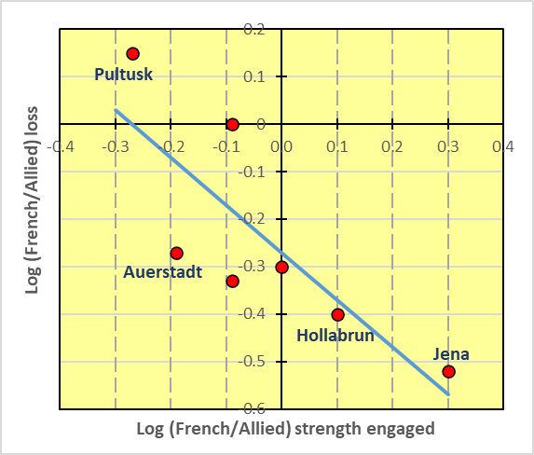
Fig 4 - F/A loss vs F/A strength engaged
decision analysis services
Figure 4 shows variation of French/Allied (F/A) loss ratios with ratios of French/Allied strengths engaged.
Notes:
Tom

Slide 17
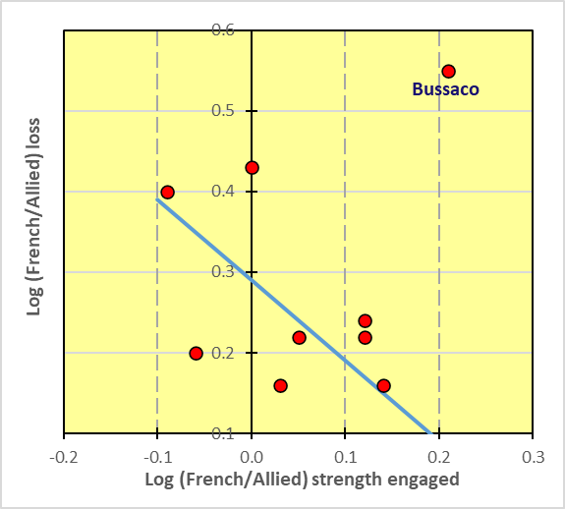
Fig 5 - F/A loss vs F/A strength engaged
decision analysis services
Figure 5 shows variation of French/Allied (F/A) loss ratios with ratios of French/Allied strengths engaged.
Notes:
Tom

Slide 18
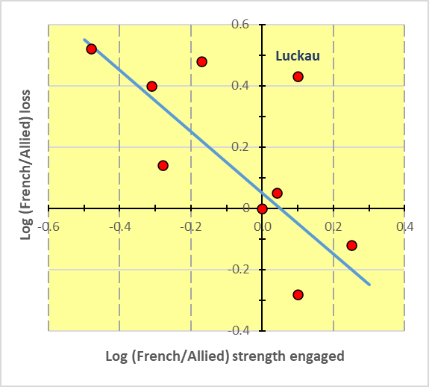
Fig 6 - F/A loss vs F/A strength engaged
decision analysis services
Figure 6 shows variation of French/Allied (F/A) loss ratios with ratios of French/Allied strengths engaged.
Notes:
Tom

Slide 19
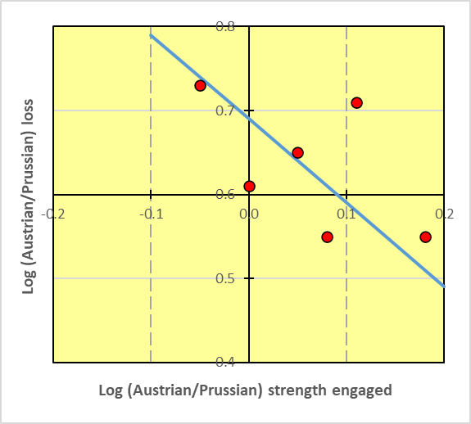
Fig 7 – A/P loss vs A/P strength engaged
decision analysis services
Figure 7 shows variation of Austrian/Prussian (A/P) loss ratios with ratios of Austrian/Prussian strengths engaged.
Notes:
Tom

Slide 20
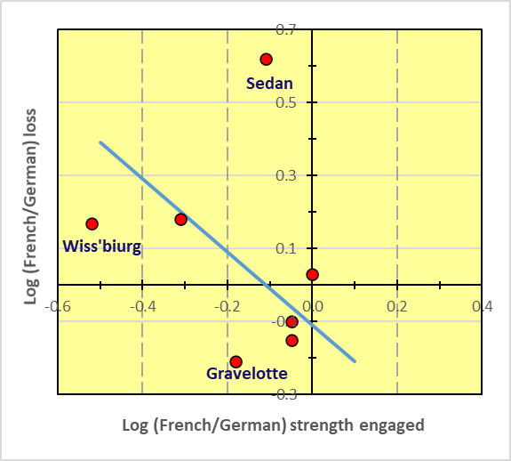
Fig 8 – F/G loss vs F/G strength engaged
decision analysis services
Figure 8 shows variation of French/German (F/G) loss ratios with ratios of French/German strengths engaged.
Notes:
Tom

Slide 21
Results of this analysis
decision analysis services
Loss ratios in open-field battles of the ACW were inversely proportional to the ratios of strength engaged.
In accordance with LSL when correctly applied.
Supports President Lincoln’s advice to ‘Put in all your men’.
Loss ratios in the battles of other contemporary wars were consistent with the Square Law.
Loss ratios in the ACW and in contemporary wars were significantly affected by other factors, as well as by superior numbers.
Fortification, weaponry, training, tactical doctrine and surprise.
Notes:
Tom

Slide 22
Undue faith in superior numbers?
decision analysis services
German fear of the ‘Russian steamroller’ pre-1914.
France’s rejection in the 1930s of elite armoured divisions in favour of a mass army.
The US Army’s constraint on the footprint of the M4 Sherman AFV.
RAF attracted by the ‘Big Wing’ concept in 1940.
Notes:
Tom

Slide 23
Conclusions
decision analysis services
Lanchester’s Square Law has remained attractive.
It is valid for 19th century land battles, when correctly applied in terms of strengths engaged.
Several other factors can be as important as superior numbers.
In other historical periods and in other scenarios, Lanchester’s Square Law can be misleading, and it should not be applied indiscriminately.
Notes:
Tom

Slide 24
Thanks for listening…
How Important are Superior Numbers? A Reappraisal of Lanchester's Square Law
David L. I. Kirkpatrick
A century ago Frederick Lanchester formulated a mathematical model of combat which suggested that the combat power of a military force was proportional to the product of the individual effectiveness of the units in the force and the square of the number of units deployed. This model reinforced a long-established faith in the importance of superior numbers.
However, successive historical studies failed to identify any clear relationship between the numbers and losses in opposing forces. This Element analyses American Civil War battles, and shows that the ratio of losses incurred was inversely proportional to the ratio of numbers effectively engaged.
Publication date: March 2021
To view and buy this Element title visit: cambridge.org/9781108977876

Slide 25
For further information contact:
David Kirkpatrick
Collegauename@das-ltd.co.uk
+44 (0) XXXX XXXXXX
decision analysis services

