Slide 1
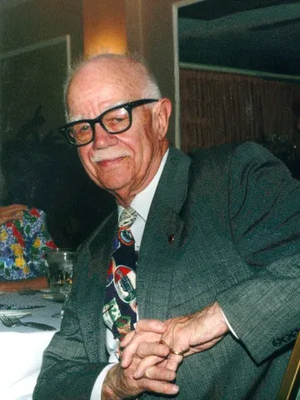
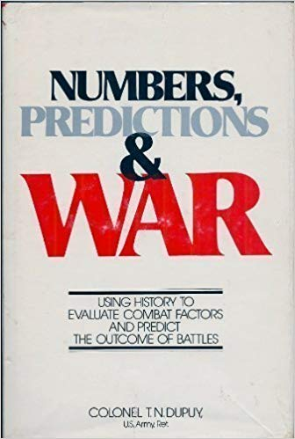
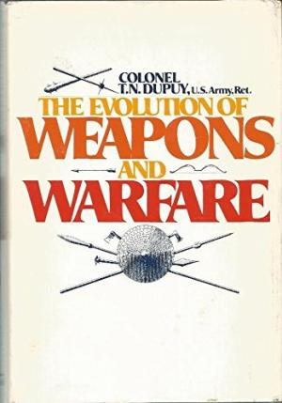
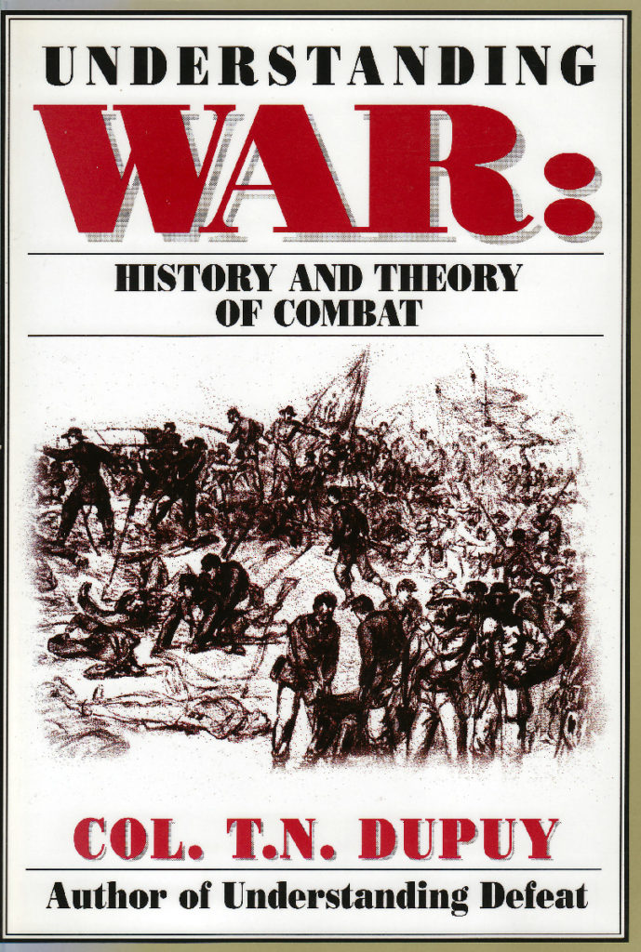
Understanding Dupuy:
Trevor N. Dupuy’s Theory of Combat
Presented by Shawn R. Woodford, PhD
Historical Analysis Annual Conference
27 September 2022

Slide 2
Definition of a Theory of Combat
“[T] embodiment of a set of fundamental principles governing or explaining military combat, whose purpose is to provide the formulation of doctrine, and to assist military commanders and planners to engage successfully in combat at any level. Such a theory includes the following elements:
Identifying the major elements of combat and the combat processes through which they operate and patterns in the interactions and relationships among them;
Describing combat structures and patterns of interactions and relationships of variable factors that constantly shape or determine the outcome of combat;
Expressing in quantitative terms the patterns so identified and described.”
“Please note this is not a philosophy of war.”
[Dupuy, Understanding War, p. 79]

Slide 3
Definition of Military Combat
“[A] violent, planned form of physical interaction (fighting) between two hostile opponents, where at least one party is an organized force, recognized by governmental or de facto authority, and one or both opposing parties hold one or more of the follow-on objectives: to seize control of territory or people; to prevent the opponent from seizing or controlling territory or people; to protect one’s own territory or people; to dominate, destroy, or incapacitate the opponent.
The impact of weapons creates an environment of lethality, danger, and fear in which achievement of the objectives by one party may require the opponent to choose among: continued resistance and resultant destruction; retreat and loss of territory, facilities, and people; surrender. Military combat begins in any interaction, or at any level of combat from duel to full-scale war, when weapons are first employed with hostile intent by one or both opponents. Military combat ends for any interaction or level of combat when both sides have stopped fighting.”
[Dupuy, Understanding War, 63-64]
Notes:
There are two key points in this definition that Dupuy wished to emphasize. “Though there may be much in common between military combat and a brawl in a barroom, there are important differences. The opponents in military combat are to some degree organized, and both represent a government or quasi-governmental authority. There is one other essential difference: the all-pervasive influence of fear in a lethal environment. People have been killed in barroom brawls, but this is exceptional. In military combat there is the constant danger of death from lethal weapons employed by opponents with deadly intent. Fear is without question the most important characteristic of combat.” [Dupuy, Understanding War, 63-64]

Slide 4
Concept of Combat Power
Combat power is the product of force strength (lethality) and the environmental, operational, and moral (human) variables circumstantial to every engagement.
Superior combat power always wins.
[Dupuy, Understanding War, 6, Chapter 8]

Slide 5
Clausewitz’s “Law of Numbers”
“In tactics, as in strategy, superiority of numbers is the most common element in victory…
If we thus strip the engagement of all the variables arising from its purpose and circumstance, and disregard the fighting value of the troops involved (which is a given quantity), we are left with the bare concept of the engagement, a shapeless battle in which the only distinguishing factors is the number of troops on either side.
These numbers, therefore, will determine victory. It is, of course, evident from the mass of abstractions I have made to reach this point that superiority of numbers in a given engagement is only one of the factors that determines victory. Superior numbers, far from contributing everything, or even a substantial part, to victory, may actually be contributing very little, depending on the circumstances.
But superiority varies in degree. It can be two to one, or three or four to one, and so on; it can obviously reach the point where it is overwhelming.
In this sense superiority of numbers admittedly is the most important factor in the outcome of an engagement, as long as it is great enough to counterbalance all other contributing circumstance. It thus follows that as many troops as possible should be brought into the engagement at the decisive point.”
[Carl von Clausewitz, On War, Book Three, Chapter 8]

Slide 6
Concept of Force Strength
Force Strength is the number of weapons and personnel in a force. [Dupuy, Attrition, 1]
“All weapons have at least one common characteristic: lethality. This is the ability to injure and, if possible, to kill people.” [Dupuy, Attrition, 25]
Calculated using the Theoretical Lethality Index (TLI)/Operational Lethality Index (OLI) formulation
TLIs/OLIs are a firepower scoring methodology
Created in 1964 to compare lethality of weapons to each other and through time
Any objective firepower scoring method, properly calibrated with Dupuy’s models, will probably work just as well
Additional units of force strength are additive, not multiplicative

Slide 7
Circumstantial Variables of Combat
ENVIRONMENTAL
Terrain*
Weather*
Season*
BEHAVIORAL (MORAL)
Leadership
Training/Experience
Application of Combat Multipliers*
Set-Piece Battle Preparations*
Logistical Effectiveness
Disruption
Surprise*
Suppression*
Unit "Breakpoints"*
Quality of Forces & Manpower
Relative Combat Effectiveness*
Trends over Time*
Morale
Cohesion
Fatigue*
Relationship of Physical & Moral Factors*
Interaction of Firepower, Mobility, Dispersion*
Combat Intensity*
Friction*
Defensive Posture*
Momentum
Time & Space
Chance
OPERATIONAL
Posture and Fortiﬁcations*
Mobility*
Vulnerability*
Air Superiority*
Weapons Sophistication*
Logistical Capability
Intelligence
Initiative
Command and Control
Communication
* Quantification hypotheses exist

Slide 8
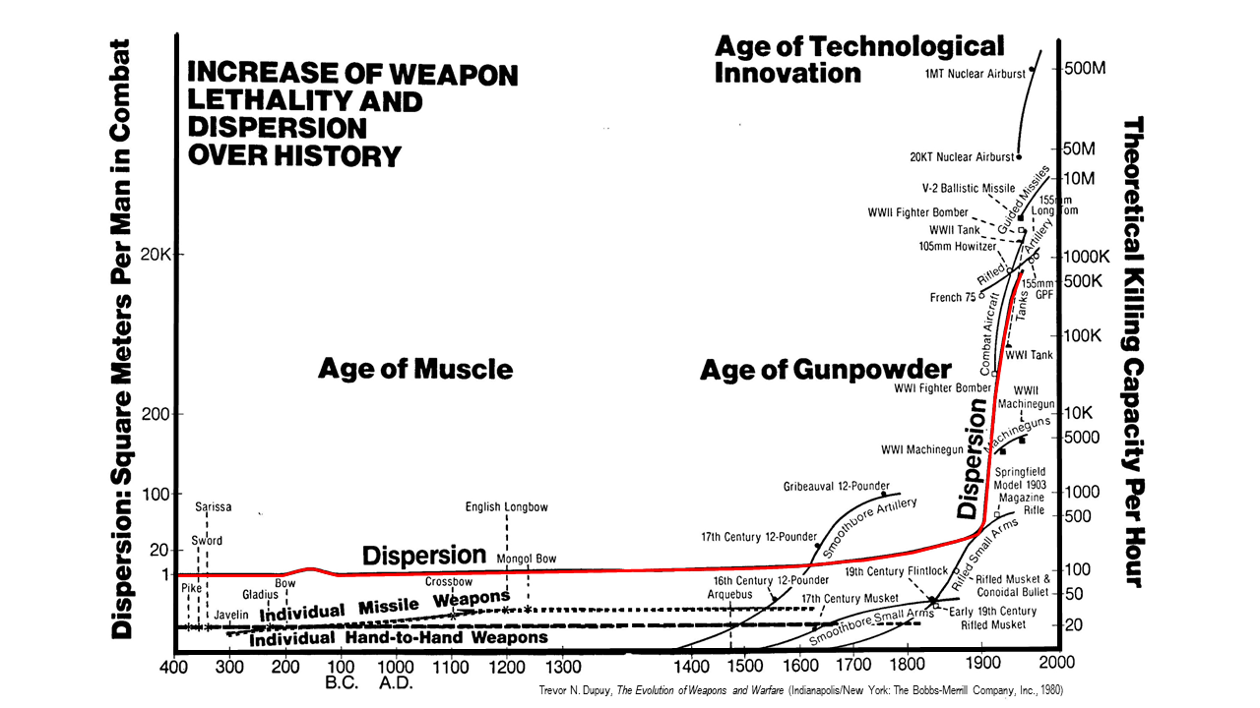
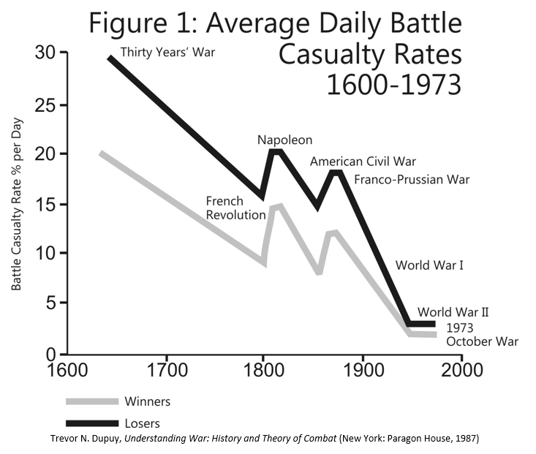
Firepower, Dispersion, and Casualty Rates
[P]assion, emotion, and fear [are] the fundamental characteristics of combat… No one who has participated in combat can disagree with this Clausewitzean emphasis on passion, emotion, and fear. Without doubt, the single most distinctive and pervasive characteristic of combat is fear: fear in a lethal environment. [Dupuy, “The Fundamental Information Base for Modeling Human Behavior in Combat” (1989)]

Slide 9
Relative Combat Effectiveness
Clear and consistent patterns in historical combat data led Dupuy to conclude that superior effectiveness on the battlefield was attributable to moral and behavioral (human) factors. The factors most important to combat effectiveness are:
Dupuy believed the influence of intangible human factors on combat outcomes could be measured in the aggregate, but was skeptical they could be parsed out discreetly. This included a blend of human and operational factors:
He did think that human factors were the most substantial of the combat variables. Therefore any model or theory of combat that failed to account for them would invariably be inaccurate.
Leadership
Training
Morale; which may or may not include
Cohesion
Logistical effectiveness
Time and Space
Momentum
Technical Command, Control, Communications
Intelligence
Initiative
Chance

Slide 10
Derivatives
Combat effectiveness
New Square Law
Quantification of surprise
Quantification of friction
Quantification of force multipliers
Dupuy’s “Verities”
Timeless Verities of Combat
Combat Advance Rate Verities
Combat Attrition Verities
Dupuy considered the 1954 edition of the U.S. Army’s Field Manual FM 100-5, Field Service Regulations, Operations to have the best summary of the principles of war

